Slide 1
CSNET Home First release of PRO features
June 2023
PRODUCT DEVELOPMENT EUROPE

Slide 2
Content
Detailed features
Profiles and privileges
Preview of the next release October 2023

Slide 3
CSNET Home PRO Detailed features
1

Slide 4
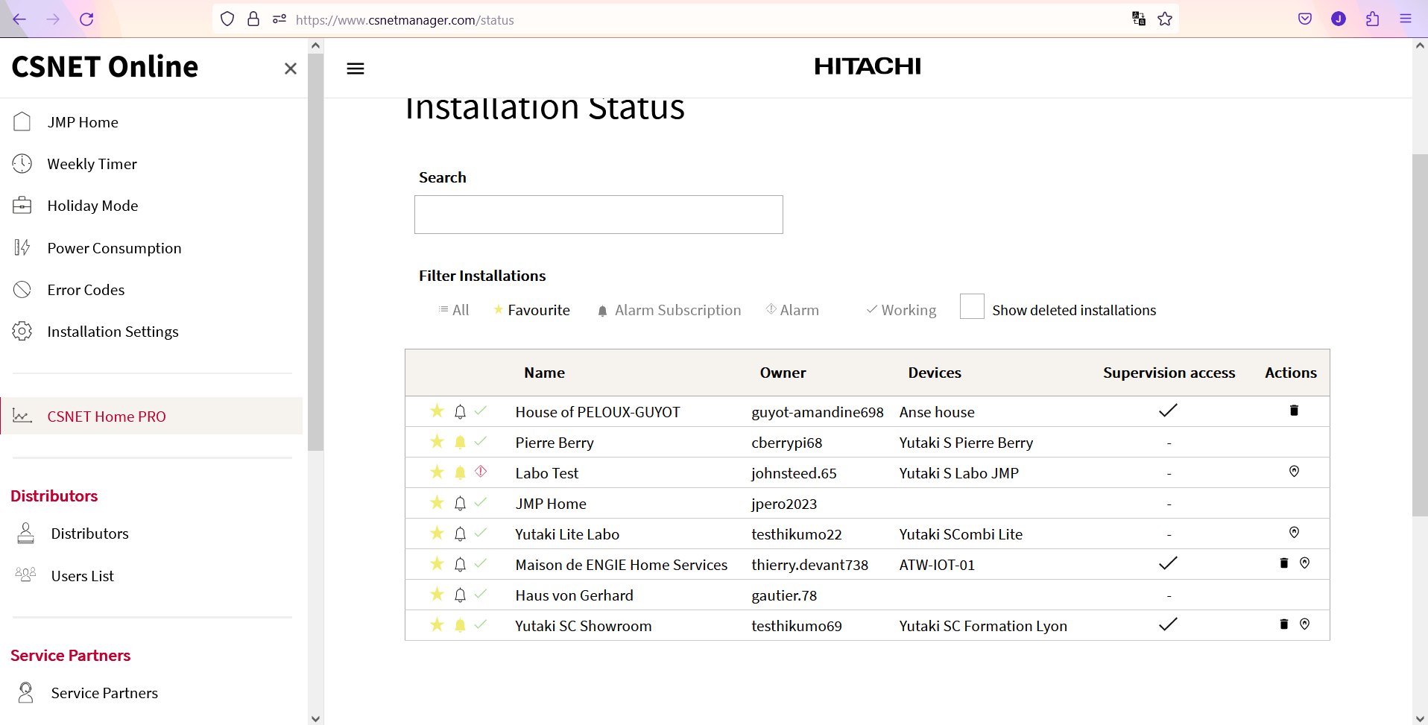
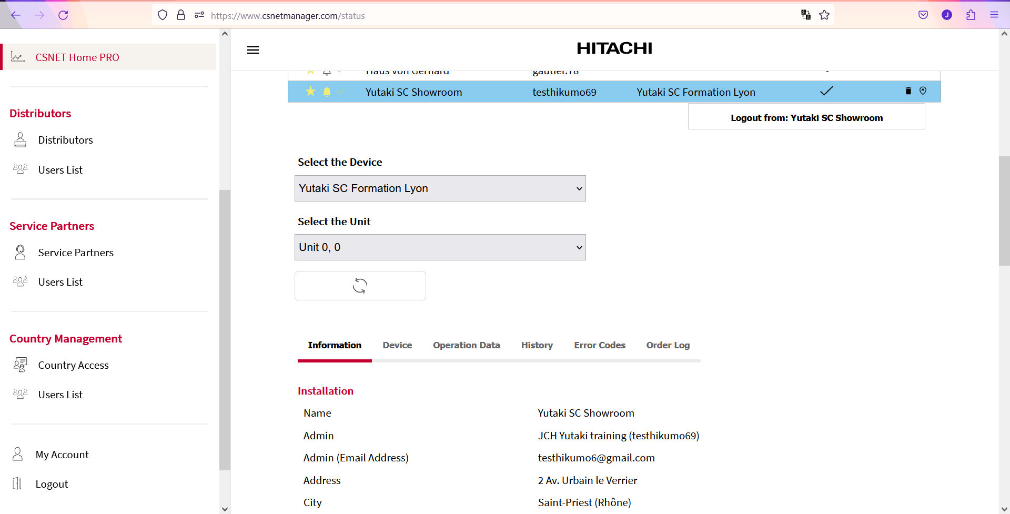
CSNET Home: PRO features
General concept:
Using the WEB App of CSNET Home (not available on mobile Apps): https://www.csnetmanager.com/status
PRO users can get access to installations and monitor them.
As a first step, only monitoring features are proposed. System parameter settings will come in the 2nd released scheduled in October 23.
Parameters available for monitoring: same scope as Hi-Kumo Pro.
One new feature: PRO users can get connected to the installation, to get the same view and control options as the end user.

Slide 5
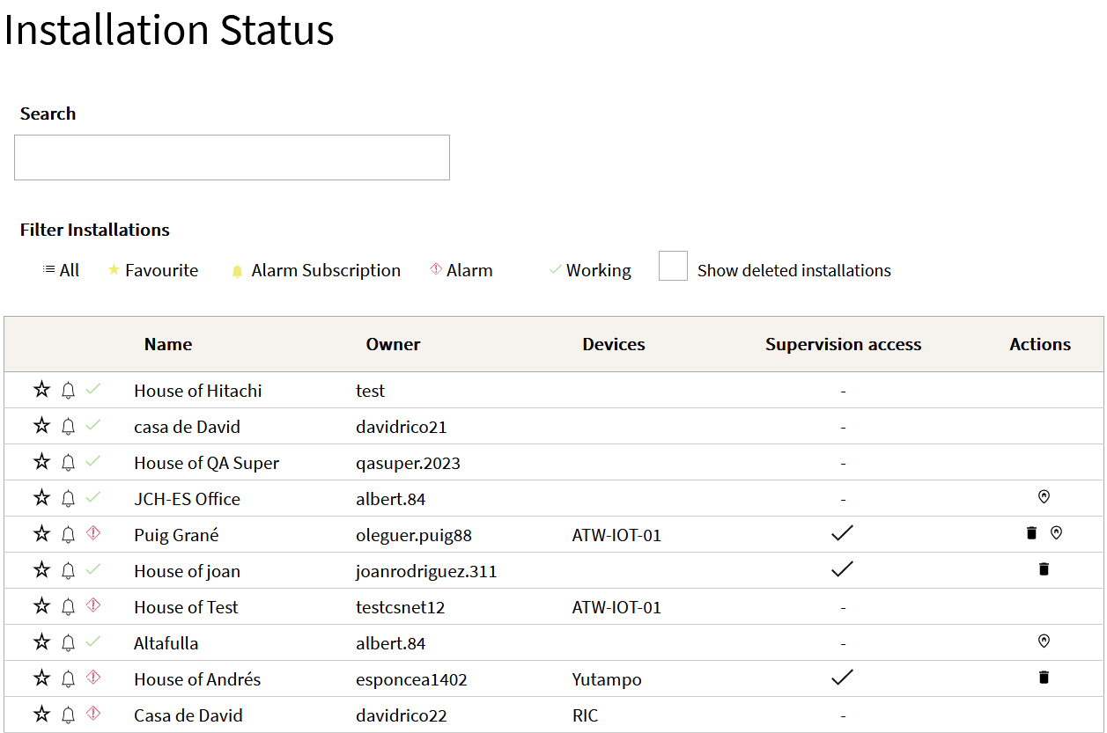
CSNET Home: PRO features
Main functions and available data:
When a PRO user gets logged in, he can get similar functions and features as with Hi-Kumo Pro:
General dashboard with a search bar, list of installations with filters (all, favourite, alarm subscribed, alarm status), actions commands (delete installation, view location on Google map)
General information about the selected installation
Information about the ATW-IOT-01 device
Operation data, sorted by circuit / zone
Data history (graphic view, data can be exported)
Alarm log, with the related troubleshooting document and main items to check (for the main alarms).
Order log, mentioning the origin of the order

Slide 6
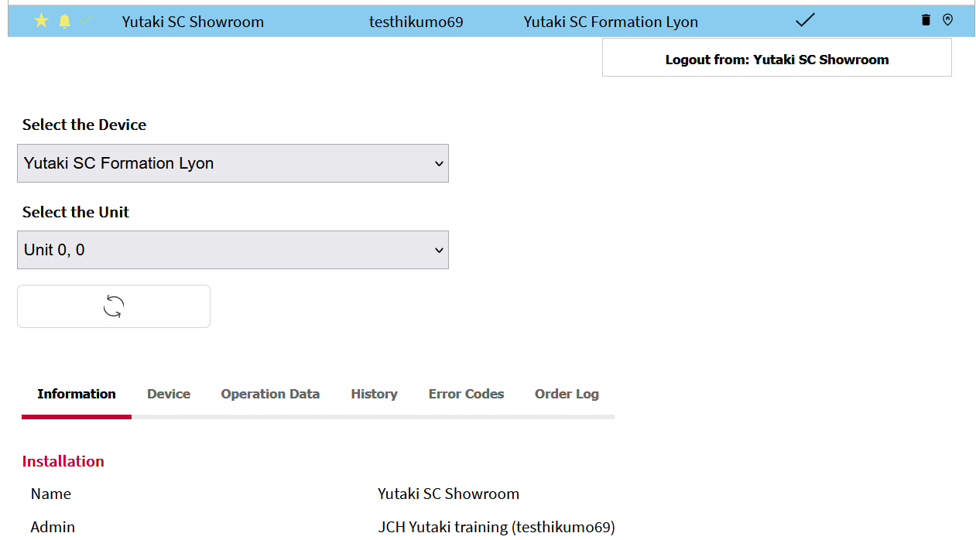
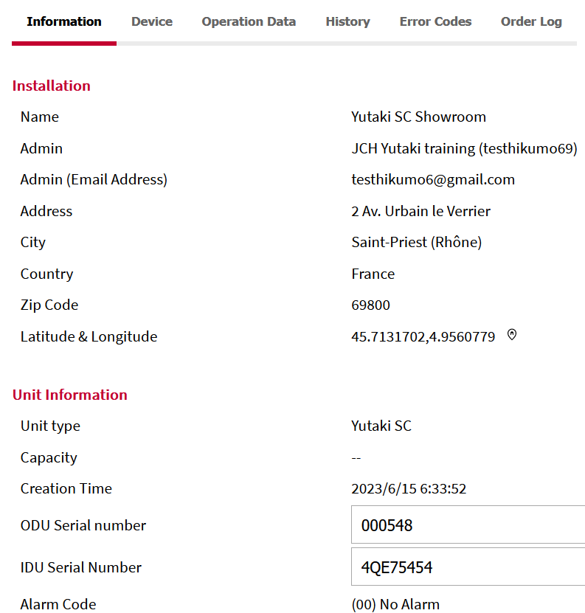
CSNET Home: PRO features
Main functions and available data:
When a PRO user gets logged in, he can get similar functions and features as with Hi-Kumo Pro:
General dashboard with a search bar, list of installations with filters (all, favourite, alarm subscribed, alarm status), actions commands, view on map via a shortcut and Google Map
General information about the selected installation
Information about the ATW-IOT-01 device
Operation data, sorted by circuit / zone
Data history (graphic view, data can be exported)
Alarm log, with the related troubleshooting document and main items to check (for the main alarms).
Order log, mentioning the origin of the order

Slide 7
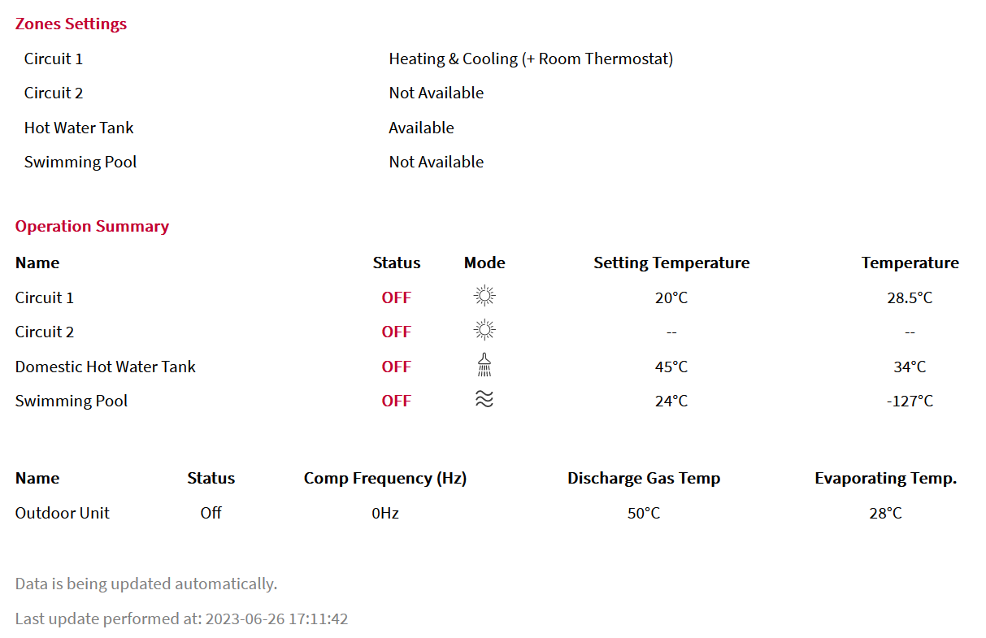
CSNET Home: PRO features
Main functions and available data:
When a PRO user gets logged in, he can get similar functions and features as with Hi-Kumo Pro:
General dashboard with a search bar, list of installations with filters (all, favourite, alarm subscribed, alarm status), actions commands, view on map via a shortcut and Google Map
General information about the selected installation
Information about the ATW-IOT-01 device
Operation data, sorted by circuit / zone
Data history (graphic view, data can be exported)
Alarm log, with the related troubleshooting document and main items to check (for the main alarms).
Order log, mentioning the origin of the order

Slide 8
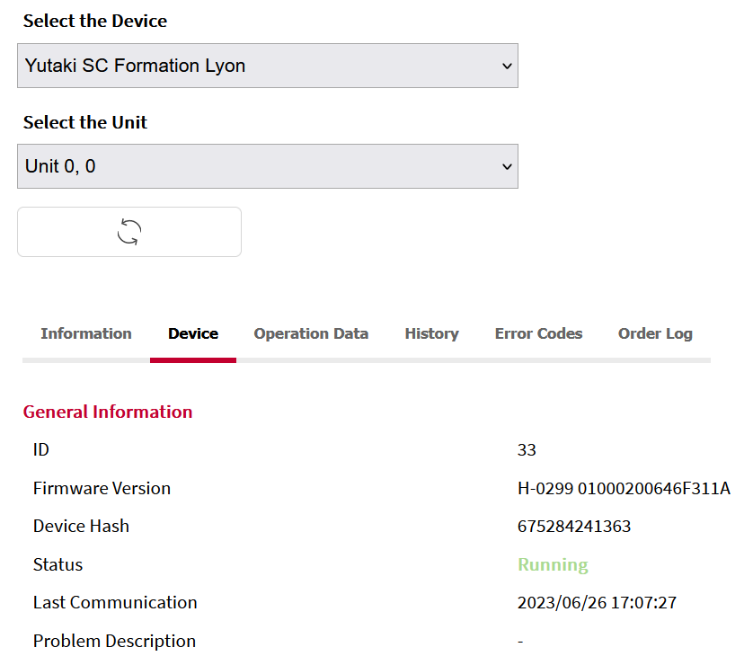
CSNET Home: PRO features
Main functions and available data:
When a PRO user gets logged in, he can get similar functions and features as with Hi-Kumo Pro:
General dashboard with a search bar, list of installations with filters (all, favourite, alarm subscribed, alarm status), actions commands, view on map via a shortcut and Google Map
General information about the selected installation
Information about ATW-IOT-01 device
Operation data, sorted by circuit / zone
Data history (graphic view, data can be exported)
Alarm log, with the related troubleshooting document and main items to check (for the main alarms).
Order log, mentioning the origin of the order

Slide 9
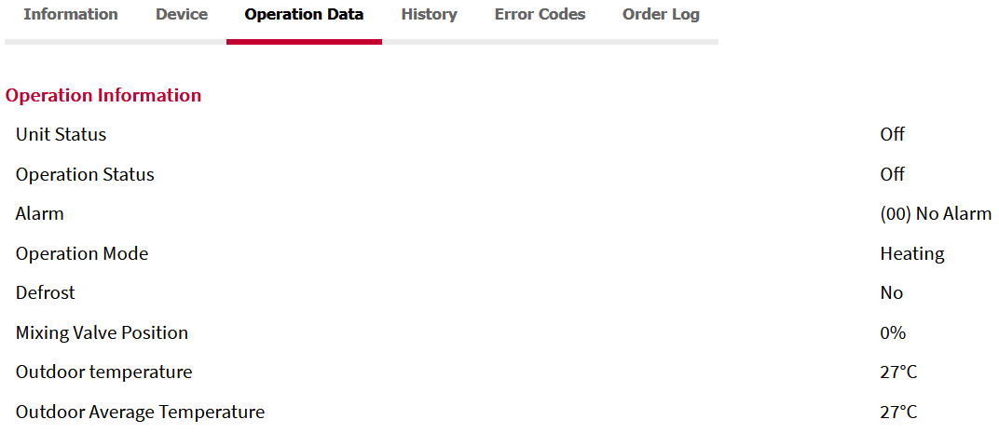
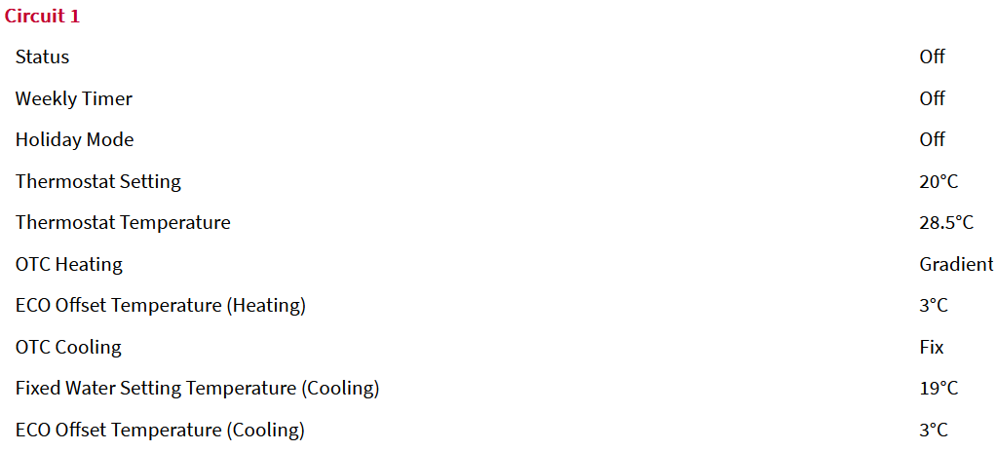
CSNET Home: PRO features
Main functions and available data:
When a PRO user gets logged in, he can get similar functions and features as with Hi-Kumo Pro:
General dashboard with a search bar, list of installations with filters (all, favourite, alarm subscribed, alarm status), actions commands, view on map via a shortcut and Google Map
General information about the selected installation
Information about ATW-IOT-01 device
Operation data, sorted by circuit / zone
Data history (graphic view, data can be exported)
Alarm log, with the related troubleshooting document and main items to check (for the main alarms).
Order log, mentioning the origin of the order

Slide 10
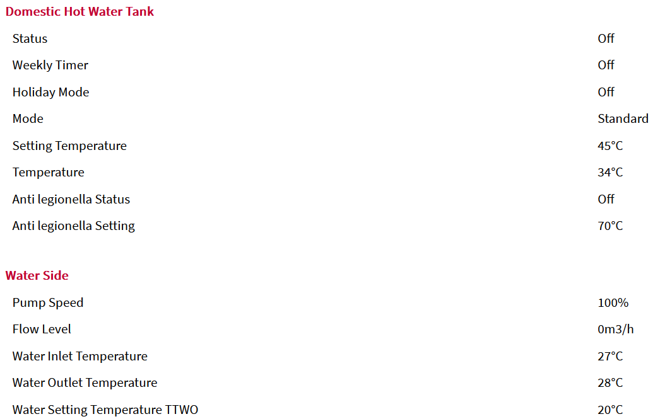
CSNET Home: PRO features
Main functions and available data:
When a PRO user gets logged in, he can get similar functions and features as with Hi-Kumo Pro:
General dashboard with a search bar, list of installations with filters (all, favourite, alarm subscribed, alarm status), actions commands, view on map via a shortcut and Google Map
General information about the selected installation
Information about ATW-IOT-01 device
Operation data, sorted by circuit / zone
Data history (graphic view, data can be exported)
Alarm log, with the related troubleshooting document and main items to check (for the main alarms).
Order log, mentioning the origin of the order

Slide 11
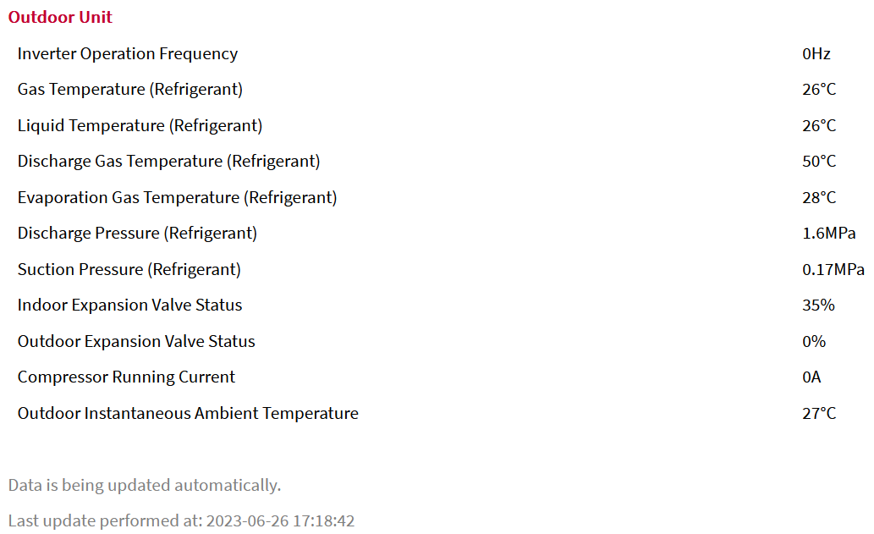
CSNET Home: PRO features
Main functions and available data:
When a PRO user gets logged in, he can get similar functions and features as with Hi-Kumo Pro:
General dashboard with a search bar, list of installations with filters (all, favourite, alarm subscribed, alarm status), actions commands, view on map via a shortcut and Google Map
General information about the selected installation
Information about ATW-IOT-01 device
Operation data, sorted by circuit / zone
Data history (graphic view, data can be exported)
Alarm log, with the related troubleshooting document and main items to check (for the main alarms).
Order log, mentioning the origin of the order

Slide 12
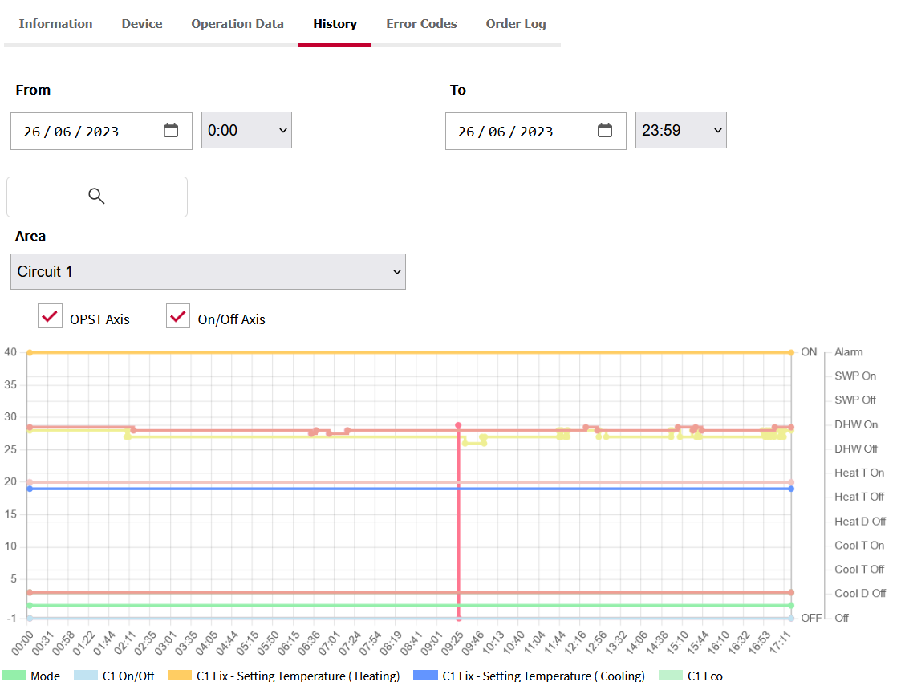
CSNET Home: PRO features
Main functions and available data:
When a PRO user gets logged in, he can get similar functions and features as with Hi-Kumo Pro:
General dashboard with a search bar, list of installations with filters (all, favourite, alarm subscribed, alarm status), actions commands, view on map via a shortcut and Google Map
General information about the selected installation
Information about ATW-IOT-01 device
Operation data, sorted by circuit / zone
Data history per zone (graphic view, data can be exported)
Alarm log, with the related troubleshooting document and main items to check (for the main alarms).
Order log, mentioning the origin of the order

Slide 13
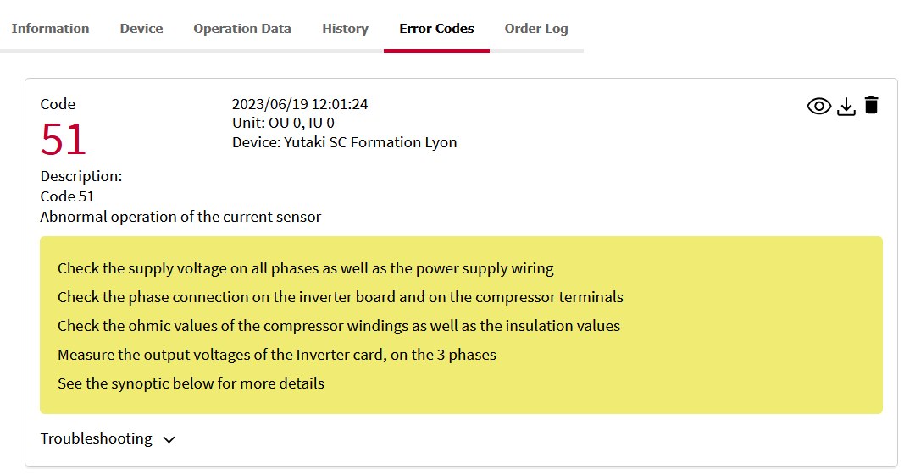
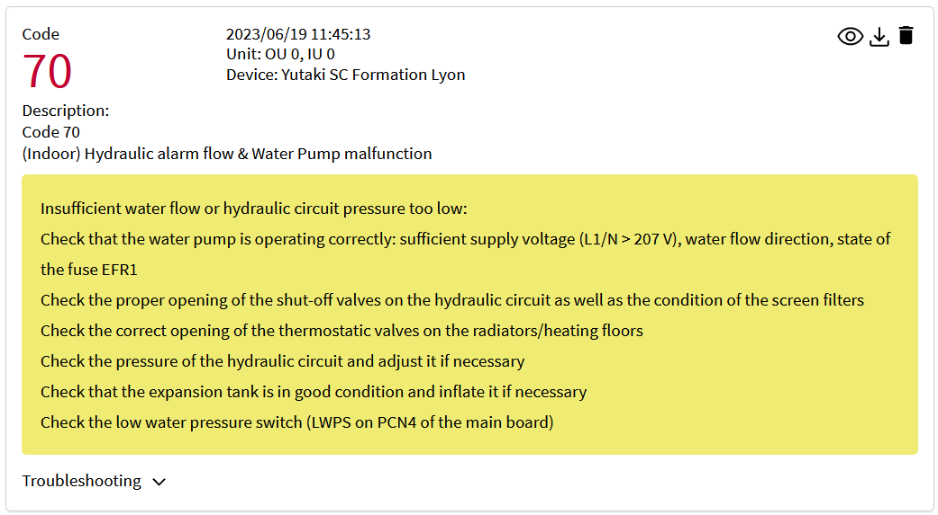
CSNET Home: PRO features
Main functions and available data:
When a PRO user gets logged in, he can get similar functions and features as with Hi-Kumo Pro:
General dashboard with a search bar, list of installations with filters (all, favourite, alarm subscribed, alarm status), actions commands, view on map via a shortcut and Google Map
General information about the selected installation
Information about ATW-IOT-01 device
Operation data, sorted by circuit / zone
Data history per zone (graphic view, data can be exported)
Alarm log, with the related troubleshooting document and main items to check (for the main alarms).
Order log, mentioning the origin of the order

Slide 14
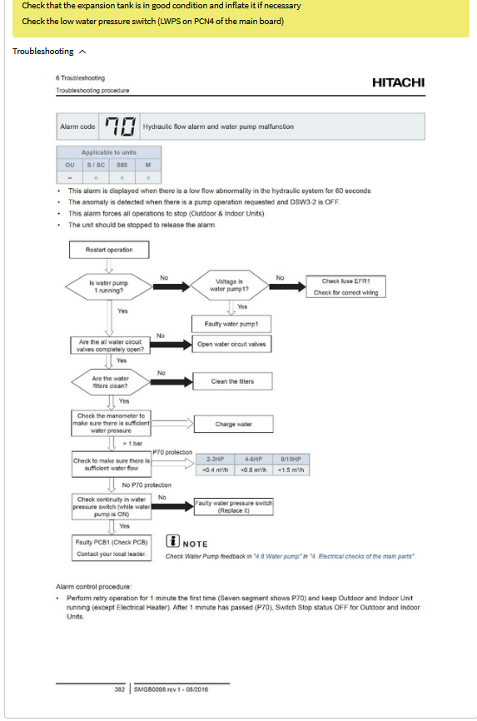
CSNET Home: PRO features
Main functions and available data:
When a PRO user gets logged in, he can get similar functions and features as with Hi-Kumo Pro:
General dashboard with a search bar, list of installations with filters (all, favourite, alarm subscribed, alarm status), actions commands, view on map via a shortcut and Google Map
General information about the selected installation
Information about ATW-IOT-01 device
Operation data, sorted by circuit / zone
Data history per zone (graphic view, data can be exported)
Alarm log, with the related troubleshooting document and main items to check (for the main alarms).
Order log, mentioning the origin of the order

Slide 15
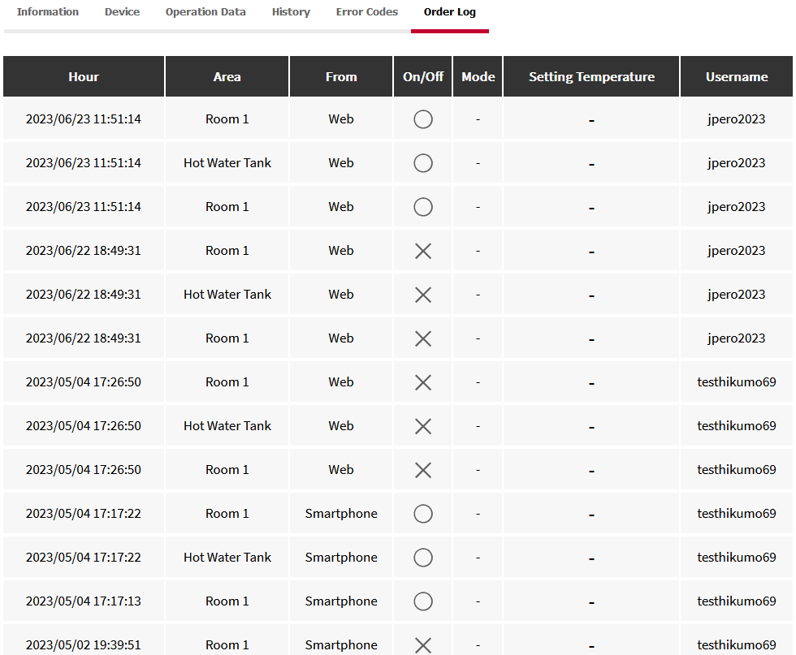
CSNET Home: PRO features
Main functions and available data:
When a PRO user gets logged in, he can get similar functions and features as with Hi-Kumo Pro:
General dashboard with a search bar, list of installations with filters (all, favourite, alarm subscribed, alarm status), actions commands, view on map via a shortcut and Google Map
General information about the selected installation
Information about ATW-IOT-01 device
Operation data, sorted by circuit / zone
Data history per zone (graphic view, data can be exported)
Alarm log, with the related troubleshooting document and main items to check (for the main alarms).
Order log, mentioning the origin of the order

Slide 16
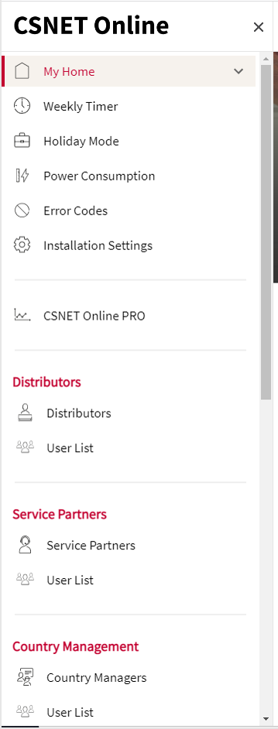
CSNET Home: PRO features
Main menu of WEB App
Standard CSNET Home features – “End user” features
Can be used by PRO users to control one remote installation (selected in the installation list)
Additional menu for PRO user - “PRO” features

Slide 17
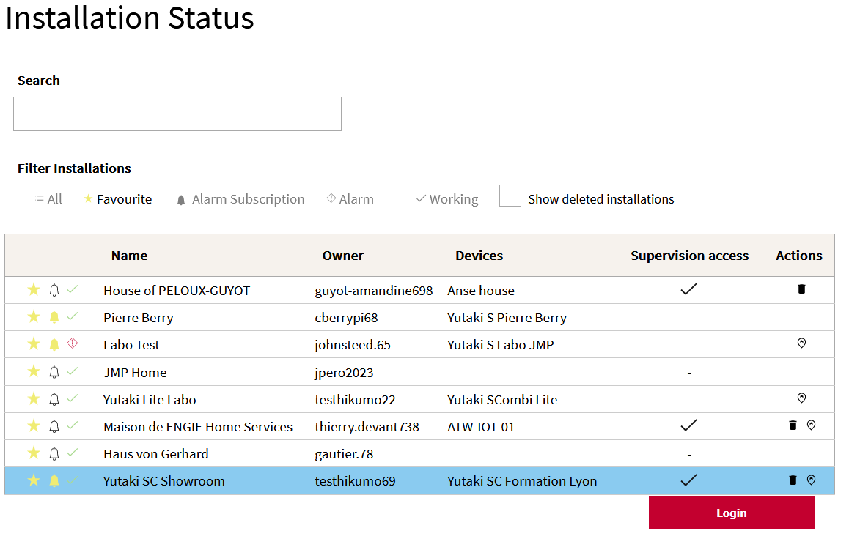
CSNET Home PRO – selecting and controlling one installation
From the main menu, select one installation for which Supervision access was granted by the end user (control access allowed, not read only mode)
The login button appears at the lower right corner
Note: it is not necessary to login on a site to monitor the related parameters – this is only necessary in order to control the unit from the CSNET Home end user view.
Click on Login to access to the control view of the system, as if you were the end user.

Slide 18
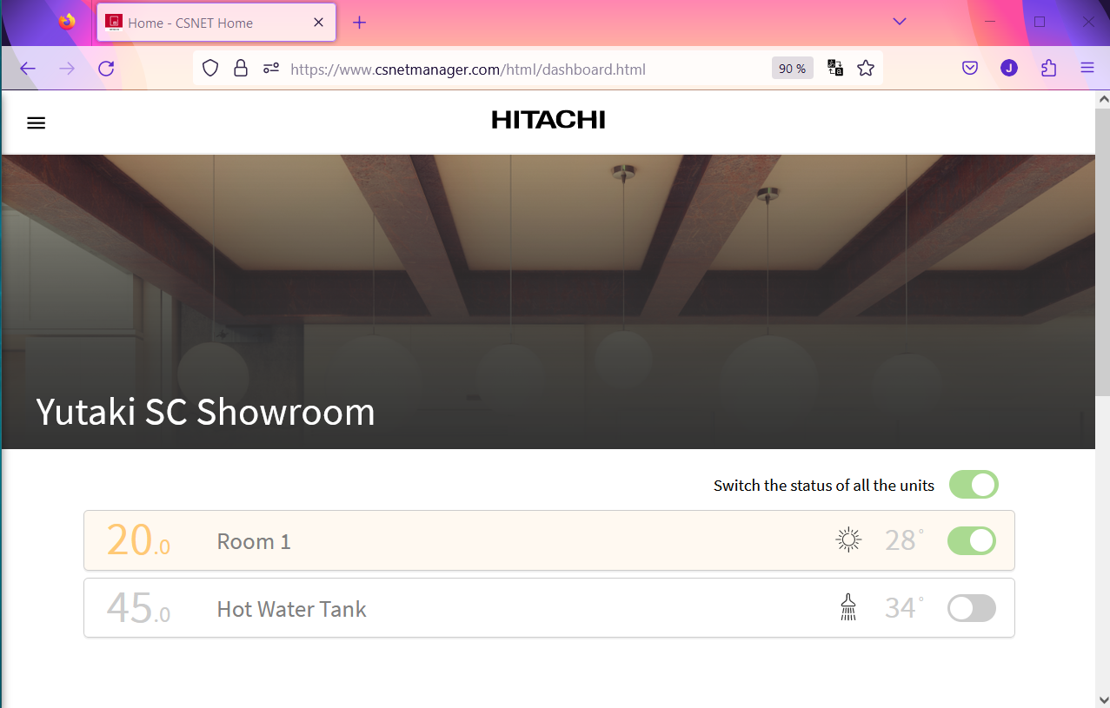
CSNET Home PRO – selecting and controlling one installation
Once logged in, the PRO user can control the system as if he was the end user.
This control mode requires the agreement of the end user (control mode shall granted for the related PRO user, instead of monitoring mode set by default).

Slide 19
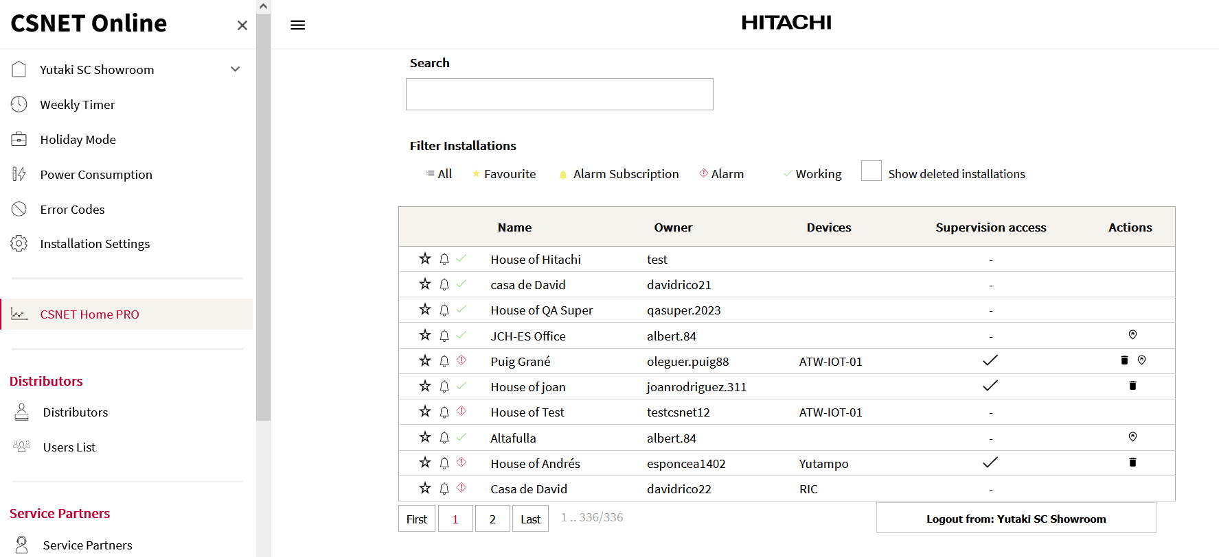
CSNET Home PRO – selecting and controlling one installation
At any time, using the main menu button, the PRO user can come back to the list of installations and select another unit.
Logout from the selected site before logging in to another installation and get control.

Slide 20
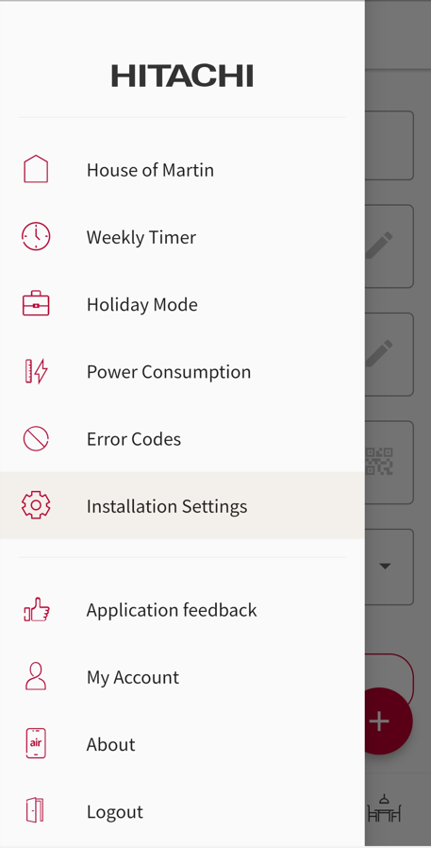
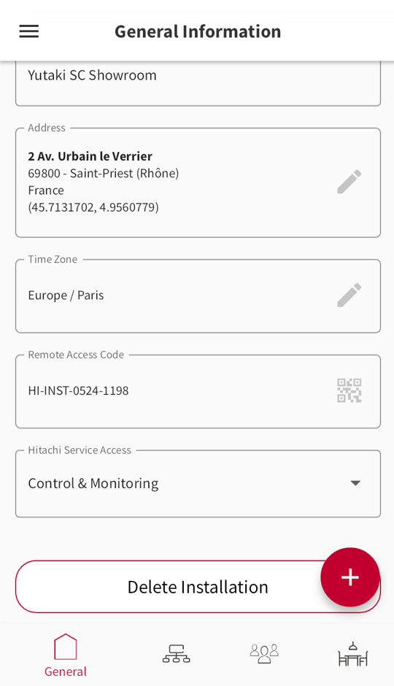
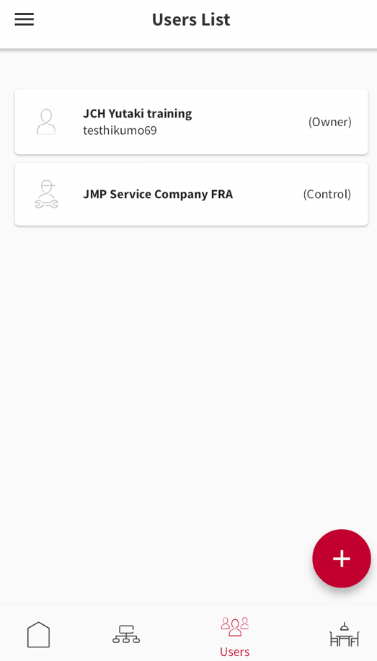
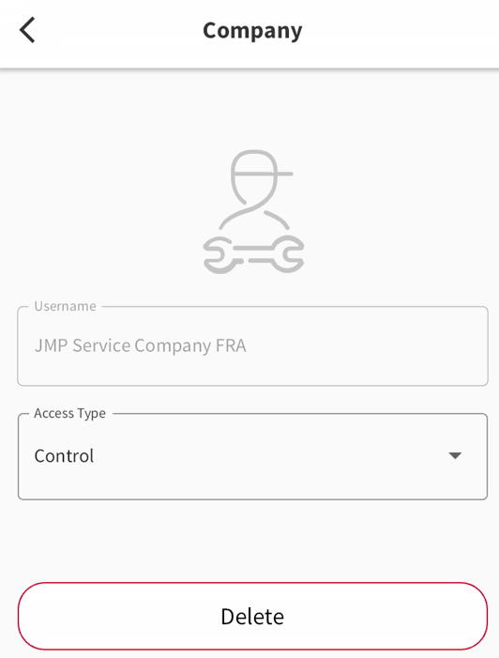
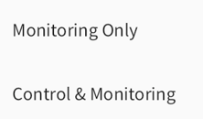
Installation details – granting control access to PRO users
From the mobile App, the end user can activate the “Control & Monitoring” option to allow PRO users to control his system remotely.
From the mobile App, the End user can manage some settings related to his installation.
Among these setting, the remote access to Hitachi Service users can be defined as “Control & Monitoring” or as “Monitoring only”.
The default setting is “Monitoring only”.
When “Control & Monitoring” is activated, “Supervision access” is displayed as activated on CSNET Home Pro (list of installation).
From the mobile App, Users list menu, the end user can manage the access rights to his system.
For the service partner users or for distributor users, the access type can be defined to “Control” or “Read Only”.
The default setting is “Control”.
When “Control” is activated, the control functions are available for the related service users (control the system as the end user, delete the installation)

Slide 21
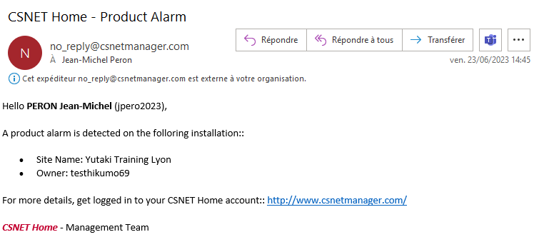
CSNET Home PRO – Favourite sites and alarm notifications
From the list of installation, click on the star icon to set one installation as one of your favourite sites.
Once done, you can easily sort the list of installation by clicking on the favourite button: only your favourite sites are displayed. Same concept to sort the list by alarm status or to see all the units.
Click on the bell icon to activate email notifications in case of product alarm on the related installation.
When the bell icon is highlighted in yellow, alarm notification is activated for your user account. Emails are sent on the email address linked to your user account.

Slide 22
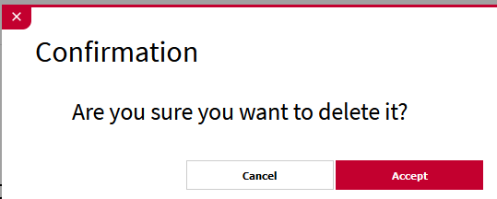
CSNET Home PRO – Actions from the installation list
From the list of installation, actions are possible, depending on your user profile and on the installation settings.
Location icon:
If the location of the installation is well defined (installation settings), it is possible to view the location on Google Maps by clicking on this icon.
Trash icon:
If the owner of the installation has activated the “Control” mode for the “Remote Control and Monitoring” setting, this icon can be used to delete the installation.
Deleting the installation:
Currently the information message is not so clear. It will be improved in the next update (Oct 23), with a double confirmation for safety.

Slide 23
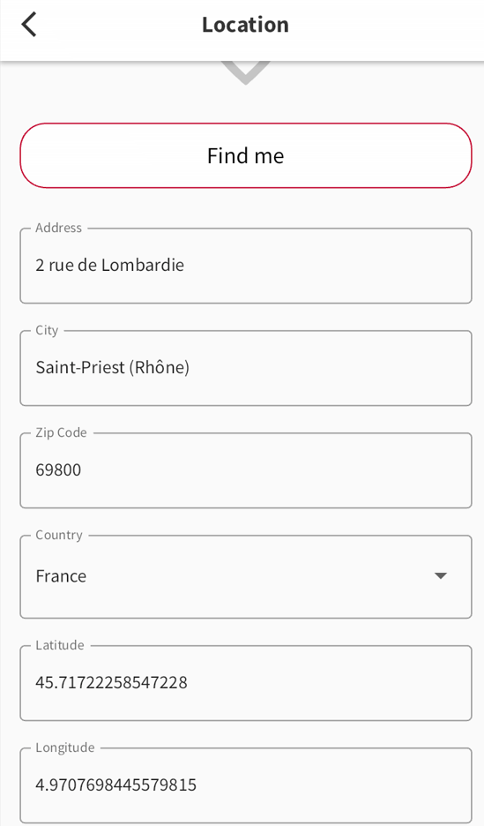
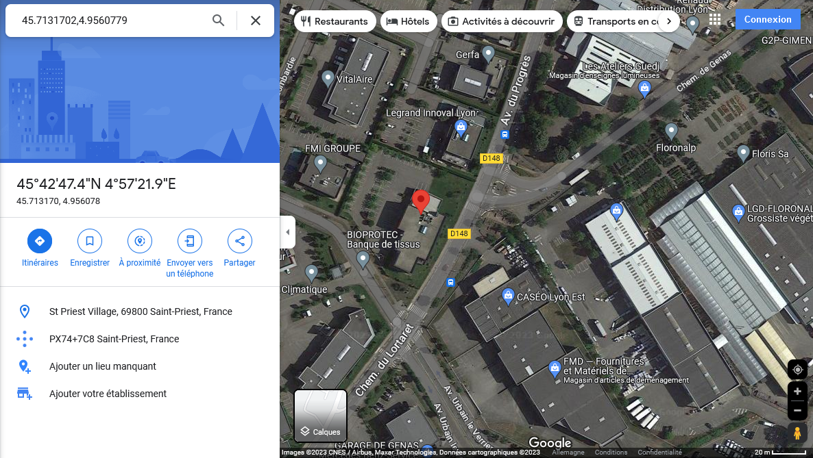
CSNET Home PRO – Actions from the installation list
From the list of installation, actions are possible, depending on your user profile and on the installation settings.
Location icon:
If the location of the installation is well defined (installation settings), it is possible to view the location on Google Maps by clicking on this icon.
Trash icon:
If the owner of the installation has activated the “Control” mode for the “Remote Control and Monitoring” setting, this icon can be used to delete the installation.
View on Maps:
For security reasons (JCI DFS), it has not been possible to implement the same Map view as Hi-Kumo Pro.
The location can be checked on Google Maps if well defined on the Installation settings.

Slide 24
CSNET Home PRO Profiles and privileges
2

Slide 25
CSNET Home PRO: profiles and privileges
CSNET HOME user profiles
HITACHI Super Administrators: JCH-ES factory design team
JCH-EU Administrators: EU PM Team, EU Technical manager
JCH Country Administrators: local technical manager, technical support teammates, market managers, product champions, JCH-ES CS Center
Distributors and Service Partners: 3rd party companies, working with JCH and willing to supervise JCH ATW units.
Standard End User: anyone can create a user account with CSNET Home App to manage his ATW system.
Who can enjoy PRO features?
All administrators can access PRO features, as well as all the Distributors and Service Partners users.
Admin can always see existing installations, limited to their area.
Distributors and Service Partner users must get the agreement of the end user before getting access to one installation
How Administrator and other PRO accounts are created?
Super Admins and JCH-EU Admin profiles are created by factory (JCH-ES).
Country Admin profiles can be setup by Super Admins and by JCH-EU Admins.
Any standard end user profile can be “upgraded” by Admins to become an “Hitachi User”, making it a Country administrator.
Distributors and Service Partners Companies are created by Admins (any of them).
Distributor or SP users: any existing standard end user profile can be affected to a Company to become a Distributor or SP user. Accounts can also be created by an Admin, or by the company manager.

Slide 26
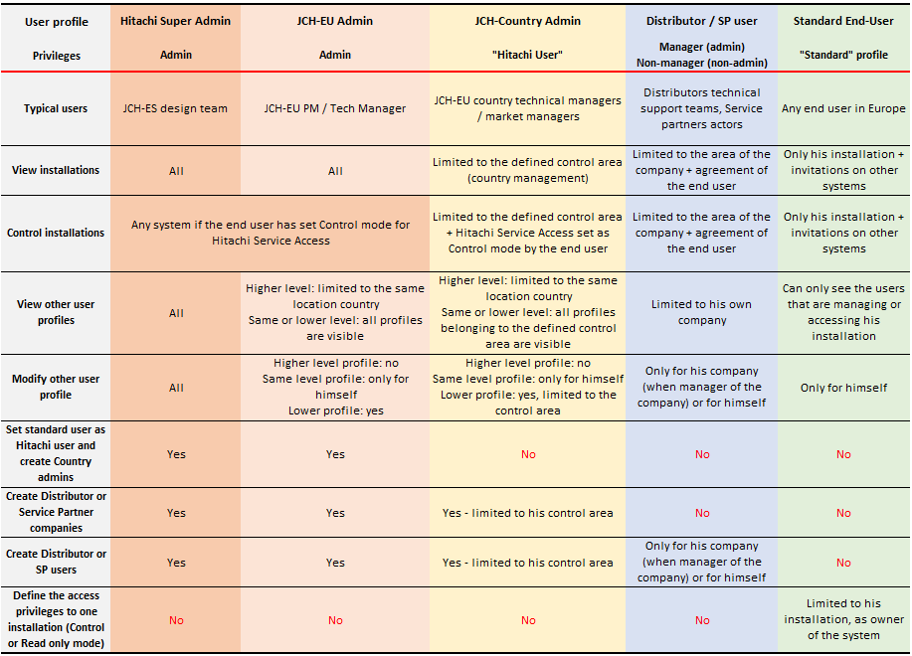
CSNET Home PRO: profiles and privileges
Simplified Profiles & Privileges table
This is a summary of the main possible actions per user profile.
Admins have the most important visibility on the system and on installations. The higher admin level is, the wider is the access to the installations.
Distributors and Service Partners have rights limited to their company and to the installations on which they have access (access granted by end-users).
Standard End users keep their installation under control, deciding who can access and control/monitor their system.

Slide 27
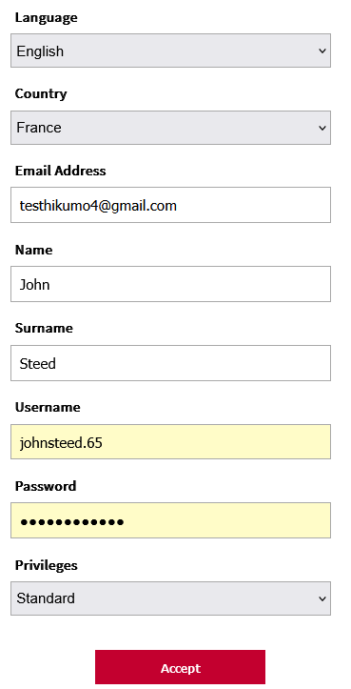
CSNET Home PRO: actors and profiles
CSNET HOME user profiles
How to configure the user profile ? (Hitachi user or standard user)
This is done from the user profile menu. When editing the user profile from an Admin account, the last setting is defining the “Privileges”: “Standard” or “Hitachi User” can be set.
A “Standard” user is the normal end-user with no access to PRO features.
When “Hitachi User” is set, the user is getting access to PRO features.
Once done, a control area shall be defined by affecting countries to this new Hitachi user. This is defining a Country Manager.
For Distributors and Service partners, the dedicated profiles shall be used.

Slide 28
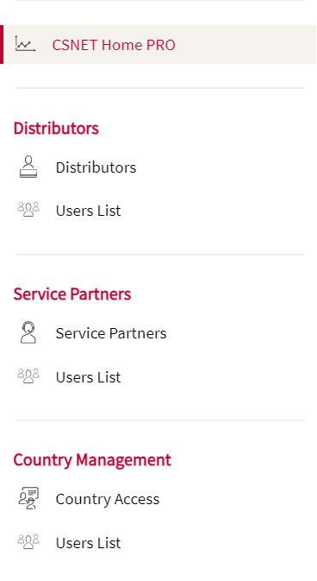
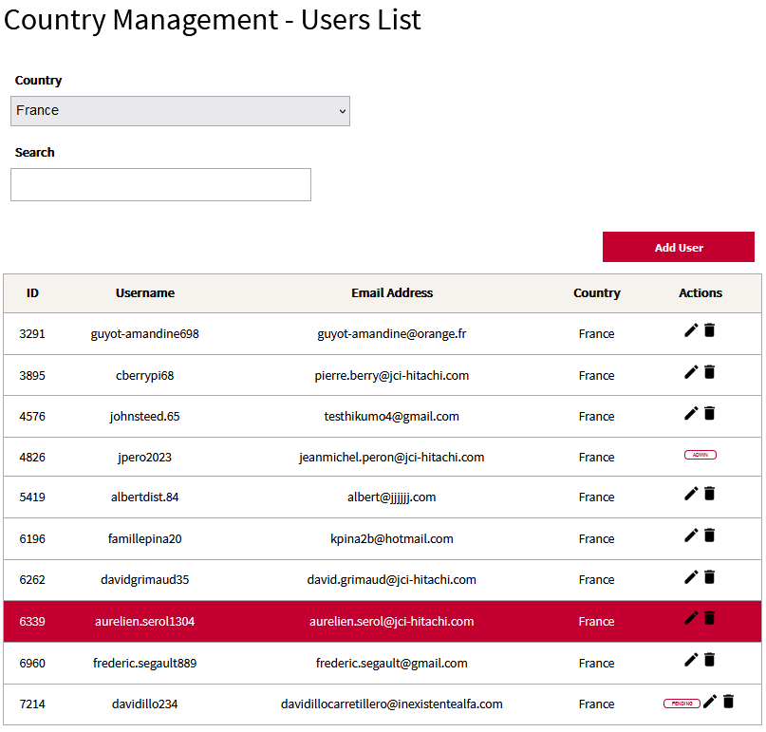
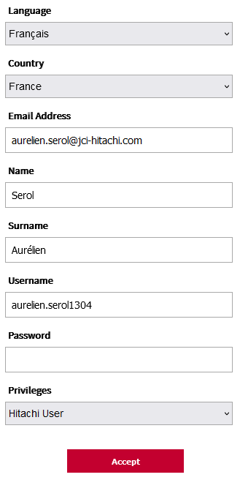
CSNET Home PRO: managing Country administrators
From a Super Admin or JCH-EU profile, select Country Management – User List
Select the location country and the existing user profile to be updated
Edit the privileges setting and activate “Hitachi User”
Notes:
Caution: trash icon is deleting the user profile and the related installation.
Admin : displayed for super admin or JCH-EU admin profiles, they cannot be edited by Country managers.
Privileges:
- Standard: standard end user profile (cannot be selected as Country Admin)
- Hitachi user: defining a Hitachi PRO user, can be selected as Country Admin

Slide 29
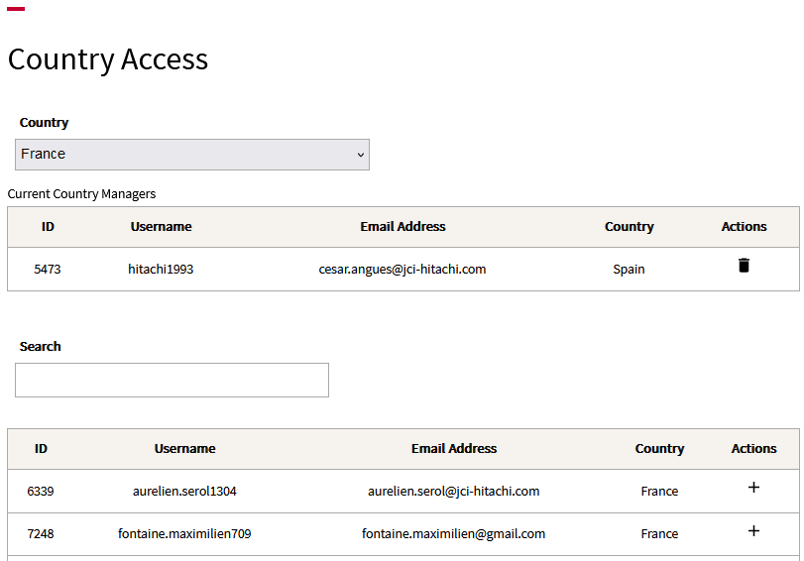
CSNET Home PRO: managing Country administrators
Select Country Access in the Country Management menu
Select the country to which the Admin will be added
Click on “+” in the user list to affect this Hitachi user to this country: a new Country Admin is created!

Slide 30
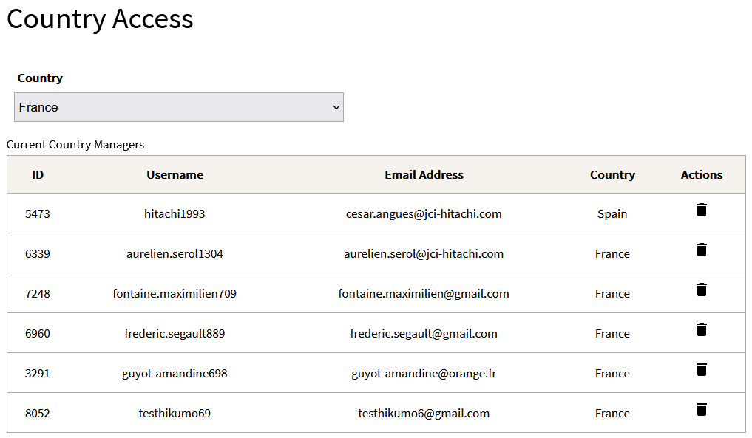
CSNET Home PRO: managing Country administrators
Select Country Access in the Country Management menu
Select the country to which the Admin will be added
Click on “+” in the user list to affect this Hitachi user to this country: a new Country Admin is created!
Notes:
This operation can be repeated for several countries, when a user manages a large area with several countries.
There is no limitation on the number of countries that one Country Admin can manage / get access to.
The “country” information given in the list of users above is the “location country” of the related user, not the countries they are managing (this will be improved in a next update of CSNET Home).

Slide 31
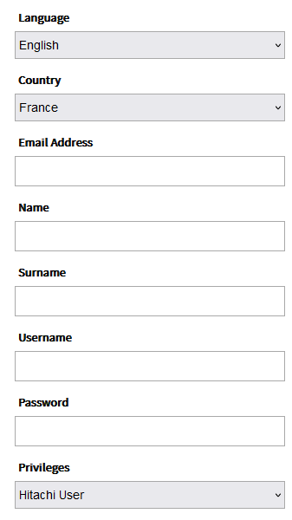
CSNET Home PRO: managing Country administrators
Requirement for JCH-EU regions to get Country Admin accounts
Step 1: Create your user profile on CSNET Home App
Step 2: inform JMP about your username and email address + list of countries to be managed
Step 3: the indicated profiles will be upgraded and linked with the related countries
In cases issues are faced when creating your account, admins can also create user profiles from scratch… but this shall not occur!!

Slide 32
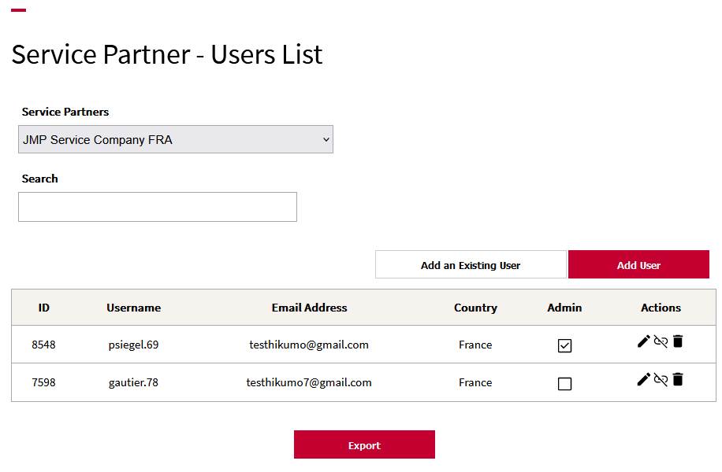
CSNET Home PRO: Distributors or Service Partners accounts
Creating companies and users
Here are the steps :
One admin has to first create the related company
Once done, users of the company can be created in 2 ways:
By the user himself, creating first a standard user account, then being affected to the related distributor or service company by an admin or by the manager of the related company (add an existing user)
By an Admin, using the email address of the related user (add user)

Slide 33
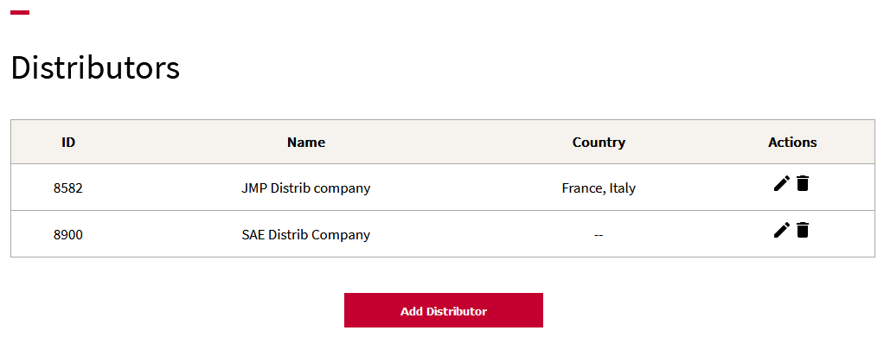
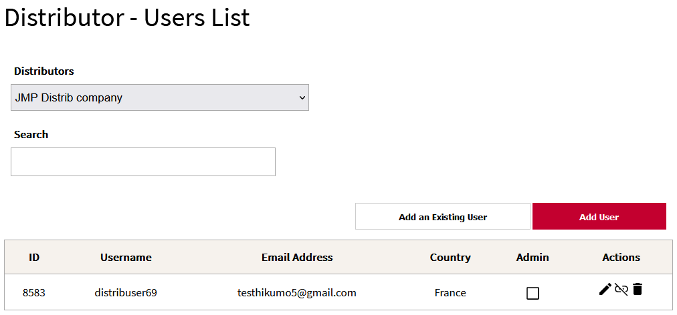
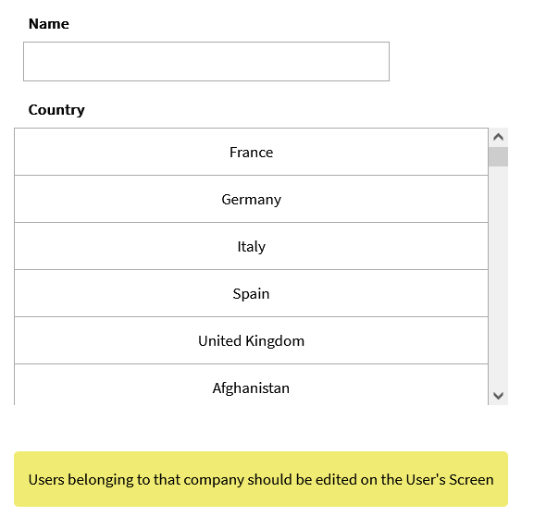
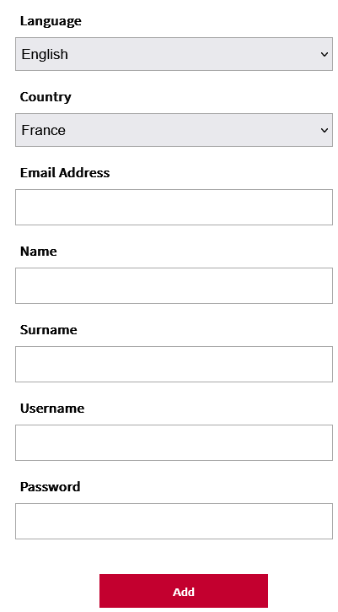
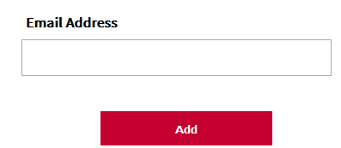
CSNET Home PRO: Distributors or Service Partners accounts
Creating Distributor or Service Partner companies
Creating Distributor or Service Partner users
One company can be linked to several countries.
Adding an existing user: only input the related email address to affect this user to the selected company.
Adding a new user: all the following details are necessary. Once created from that interface, this user profile is automatically setup as a Distributor or Service Partner user.

Slide 34
CSNET Home PRO: Distributors or Service Partners accounts
Creating companies and users
“Admin” check box option on the Service Company user profile: to set this user as Manager of the company, so that he can create additional user accounts for his company.
The word « Admin » will be replaced by « Manager » in the next revision, to avoid confusion with the system Admins.
Note: Distributors and Service Partners profiles are managed in the same way, with the same privileges and functions. Only the name of these profiles is different.
Access to the installations for Distributors is managed in the same way as Service Partners, contrary to Hi-Kumo PRO.

Slide 35
CSNET Home PRO: Distributors or Service Partners accounts
Requirement from JCH-EU regions to get Distributors or Service Partners accounts
Step 1: Ask the related user to create their own user account using CSNET Home App
Step 2: Collect the user details (Company name, username and email address) and send this information to your Country Admin (or JCH-EU Admin)
Step 3: The Admin can create the Company and affect the existing users to this company.
Admins can also create user profiles from scratch, but it is not recommended.
The method explained above is recommended so that the external user will approve the Terms & Conditions + Privacy notice, which is required to comply with regulations (GDPR).
Cost related to the PRO features: unless Hi-Kumo Pro, no license cost or connection fees are required. These features can be proposed by the JCH-EU regions to their customers according to their commercial policy. The only remaining cost is the one related to the ATW-IOT-01 gateway.

Slide 36
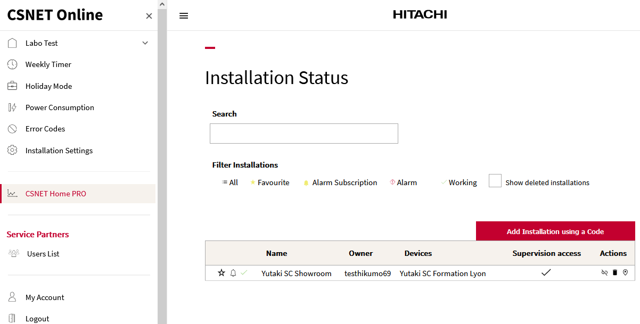
CSNET Home PRO: Distributors or Service Partners accounts
Distributor or Service Partner Manager – CSNET Home PRO menu
From his account and the CSNET Home PRO menu, a Service Partner Manager can:
See the associated installations and related data
Add new installations to his company
Remove (unlink ) an installation from his company
See one selected installation on Google Map (click on the location icon )
If the end user has allowed the “Control” mode on his installation for this Service Company, these users can also:
Delete one installation and release the related IOT devices, using the trash icon
Control the installation by getting logged-in if the end user has granted Control rights.
In this case, “Supervision access” is checked on the installation table.
When one installation is added to the company, it can be seen and accessed by all the users of this company.
The available options are the same for a Distributor Manager user.
When the installation is in “Read-only” mode, actions for the Service Partner and distributor users are limited (Delete and Control functions are not available).

Slide 37
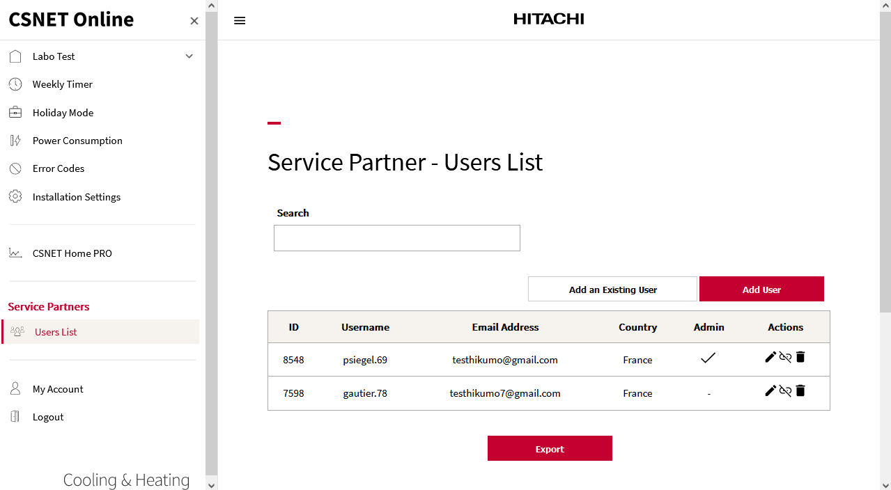
CSNET Home PRO: Distributors or Service Partners accounts
Distributor or Service Partner Manager – Users List menu
From his account, “Users List menu”, a Service Partner Manager can:
Create a new user account for his company (Add user)
Add an existing CSNET Home standard user account to this company (Add and Existing User)
Edit his user profile (pen icon )
Edit the profiles of the other users of his company
Remove (unlink ) a user profile from his company, without deleting this CSNET Home user profile (only removing it from the company)
Delete his user profile (trash icon )
Delete the user profiles of the other members of his company (complete deletion, )
A non-manager user profile can only manage his account, the Users List menu is not available in that case.
The available options are the same for a Distributor Manager user and for a non-manager Distributor profile.

Slide 38
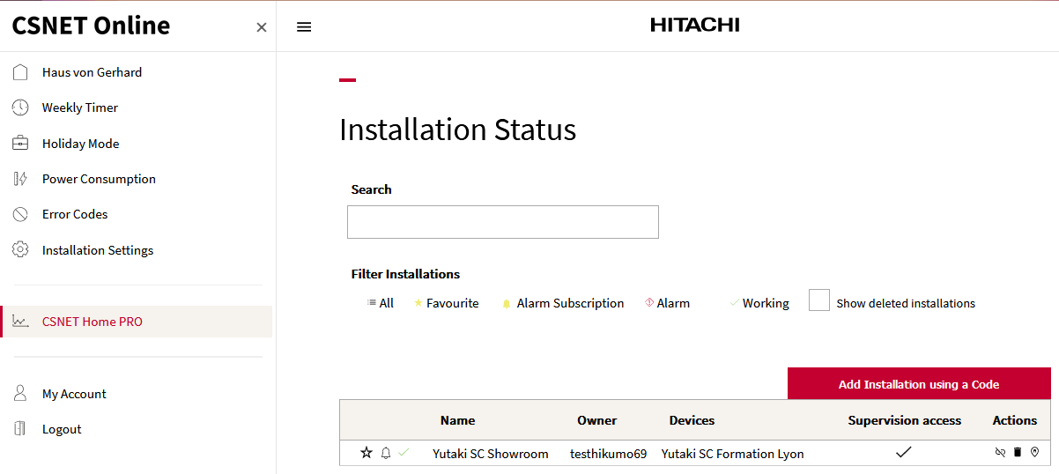
CSNET Home PRO: Distributors or Service Partners accounts
Distributor or Service Partner non-Manager users – CSNET Home PRO menu
From his account and the CSNET Home PRO menu, a Service Partner non-manager user can:
See the associated installations and related data
Add new installations to his company
Remove (unlink ) an installation from his company
See one selected installation on Google Map (click on the location icon )
If the end user has allowed the “Control” mode on his installation for this Service Company, these users can also:
Delete one installation and release the related IOT devices, using the trash icon
Control the installation by getting logged-in if the end user has granted Control rights.
In this case, “Supervision access” is checked on the installation table.
When one installation is added to the company, it can be seen and accessed by all the users of this company.
The available options are the same for a Distributor Manager user.
Non-Manager users:
Same actions as Manager users for the installations
Cannot manage the user profiles of the other company members

Slide 39
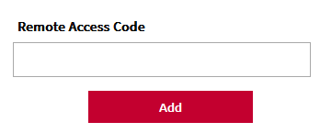
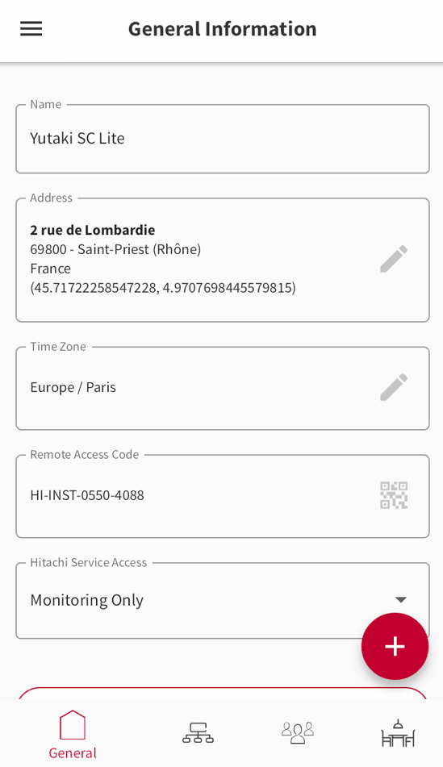
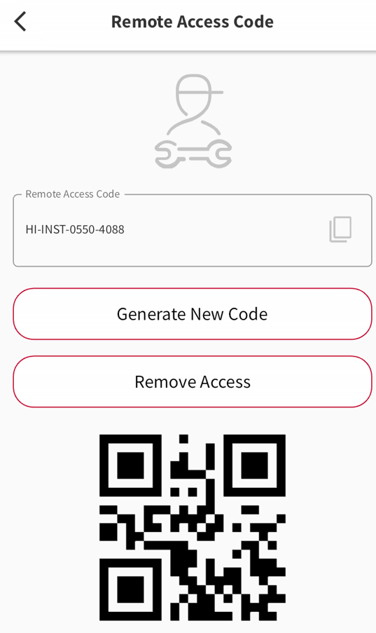
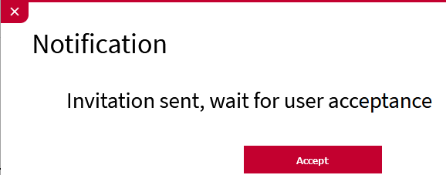
CSNET Home PRO: Distributors or Service Partners accounts
Distributor or Service Partner users – Requiring access to one installation
Click on
« Add Installation using a Code »
Get the remote access code from the end user
Submit the request and wait for the answer from the end user
Remote Access Code is available on the end user account, mobile app and Web App. It can be shared easily by mail, what’s App etc.… using copy/paste or QR code functions.

Slide 40
CSNET Home PRO: Distributors or Service Partners accounts
Distributor or Service Partner users – Requiring access to one installation
End user is notified by email and on the App when a new access request is submitted
Demand managed by the end-user from CSNET Home App (mobile or Web)
Access type defined as “Control” or “Read only”

Slide 41
CSNET Home PRO: Distributors or Service Partners accounts
Distributor or Service Partner users – Requiring access to one installation
Demand is approved or rejected by the end-user
Email notification is sent to the solicitant
Solicitant can access to the installation or submit a new request

Slide 42
CSNET Home PRO
Detailed rights and privileges table – 1#3
Note: This table is a preliminary version subject to changes and updates in the coming months - FOR INTERNAL USE ONLY.

Slide 43
CSNET Home PRO
Detailed rights and privileges table - 2#3
Note: This table is a preliminary version subject to changes and updates in the coming months - FOR INTERNAL USE ONLY.

Slide 44
CSNET Home PRO
Detailed rights and privileges table - 3#3
Note: This table is a preliminary version subject to changes and updates in the coming months - FOR INTERNAL USE ONLY.

Slide 45
CSNET Home PRO Preview of the next release – October 23
3

Slide 46
CSNET Home: next update preview
April 2023:
ATW-IOT-01: First pre-production of ATW-IOT-01 for field test purposes
Mobile Apps: Field tests + first versions release on App stores
Web App with end user features only: beta release in April, to be finalized within May 23
May 2023:
Product NEWS for the official release
ATW-IOT-01: first mass production and stock deliveries (by mid-May)
Web and mobile Apps: beta tests and homologation of level 1 PRO features
June 2023:
Web and mobile Apps: official update to release level 1 PRO features
Update of ATW-HCD-01 to get the compatibility of Yutampo with ATW-IOT-01
Production plan: 2000 pieces of ATW-IO-01 shall be manufactured and delivered
Summer 2023:
Web and mobile Apps: test and homologation of level 2 PRO features
October 2023:
Web and mobile Apps: official update to release level 2 PRO features
Compatibility with cascade controllers and multiple Yutaki systems (to be confirmed)
Second round of features for CSNET HOME PRO – October 2023
Many minor improvements are being prepared, about the way to display data, the pop-up messages, translation corrections…
Some new functions and new data about the units or related to the management of Service Partners and Distributors
Adding the Yutaki unit settings to the system, to update remotely most of the settings (but not all the Yutaki settings).
Update of ATW-HCD-01: still underway, rework of JCH-EU stock under discussion with JCH-ES.

Slide 47
CSNET Home: next update preview
Second round of features for CSNET HOME PRO – October 2023
New menus related to the management of Distributors, Service Partners and Country Managers, to have a clear overview of the managed installations / managed countries.

Slide 48
CSNET Home: next update preview
Second round of features for CSNET HOME PRO – October 2023
More accurate descriptions of the device parameters
Web App: new installation menu, similar design and organization as the mobile Apps.

Slide 49
CSNET Home: next update preview
Second round of features for CSNET HOME PRO – October 2023
New System parameters – to remotely update the Yutaki configuration

Slide 50
CSNET Home: next update preview
Second round of features for CSNET HOME PRO – October 2023
New System parameters – Water control settings – Space heating zones

Slide 51
CSNET Home: next update preview
Second round of features for CSNET HOME PRO – October 2023
New System parameters – Water control settings – Circuit 1

Slide 52
CSNET Home: next update preview
Second round of features for CSNET HOME PRO – October 2023
New System parameters – Water control settings – Space cooling circuit 1

Slide 53
CSNET Home: next update preview
Second round of features for CSNET HOME PRO – October 2023
New System parameters – Water pump settings

Slide 54
CSNET Home: next update preview
Second round of features for CSNET HOME PRO – October 2023
New System parameters – Room compensation factors

Slide 55
CSNET Home: next update preview
Second round of features for CSNET HOME PRO – October 2023
New System parameters – Room Thermostat configuration

Slide 56
CSNET Home: next update preview
Second round of features for CSNET HOME PRO – October 2023
New System parameters – Optional functions – Emergency operation

Slide 57
Documents about CSNET Home and ATW-IOT-01
The following documents can be found on the EU Share Point :
Advanced Product News: Share Point link
Press release: Share Point link
Instruction manual: Share Point link
Pictures ATW-IOT-01: Share Point link
Application screenshots: Share Point link
Features & Benefits presentation: Share Point link
Sales brochure: Share Point link
CE certificate for ATW-IOT-01: Share Point link
Note: all documents are now available!

Slide 58
Thank you!

