Slide 1
CSNET Home New IoT solution for Heating range
April 2023
PRODUCT DEVELOPMENT EUROPE

Slide 2
Content
General Concept
Product Presentation
Installation
Creating & managing one User Account
Unit discovery
Installation settings
Standard control features
Advanced functions
Other functions
CSNET Home Web App
PRO features preview

Slide 3
General Concept
01

Slide 4
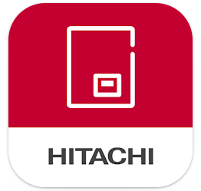
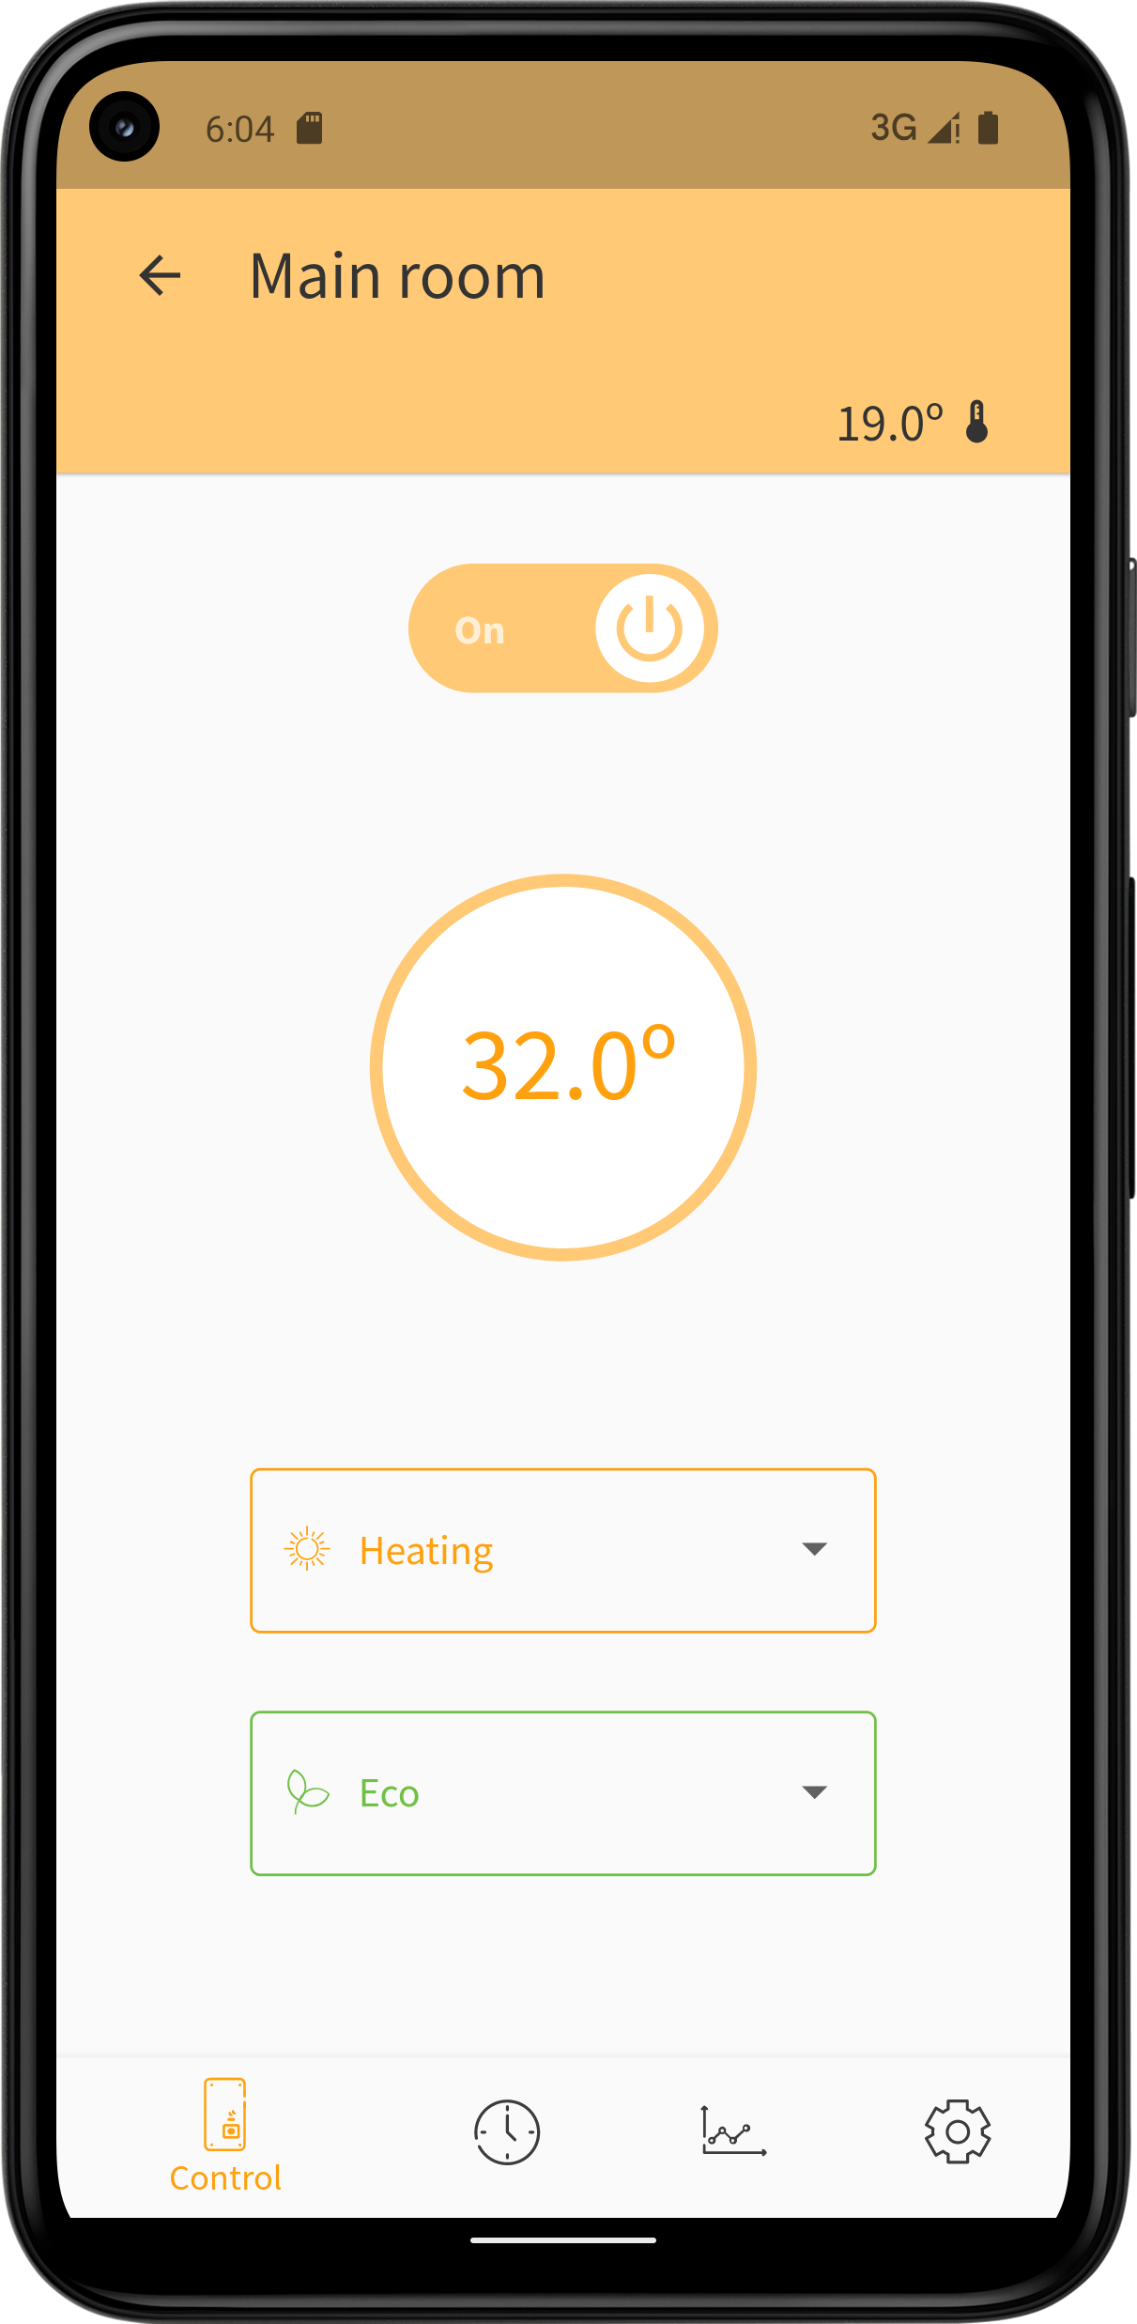
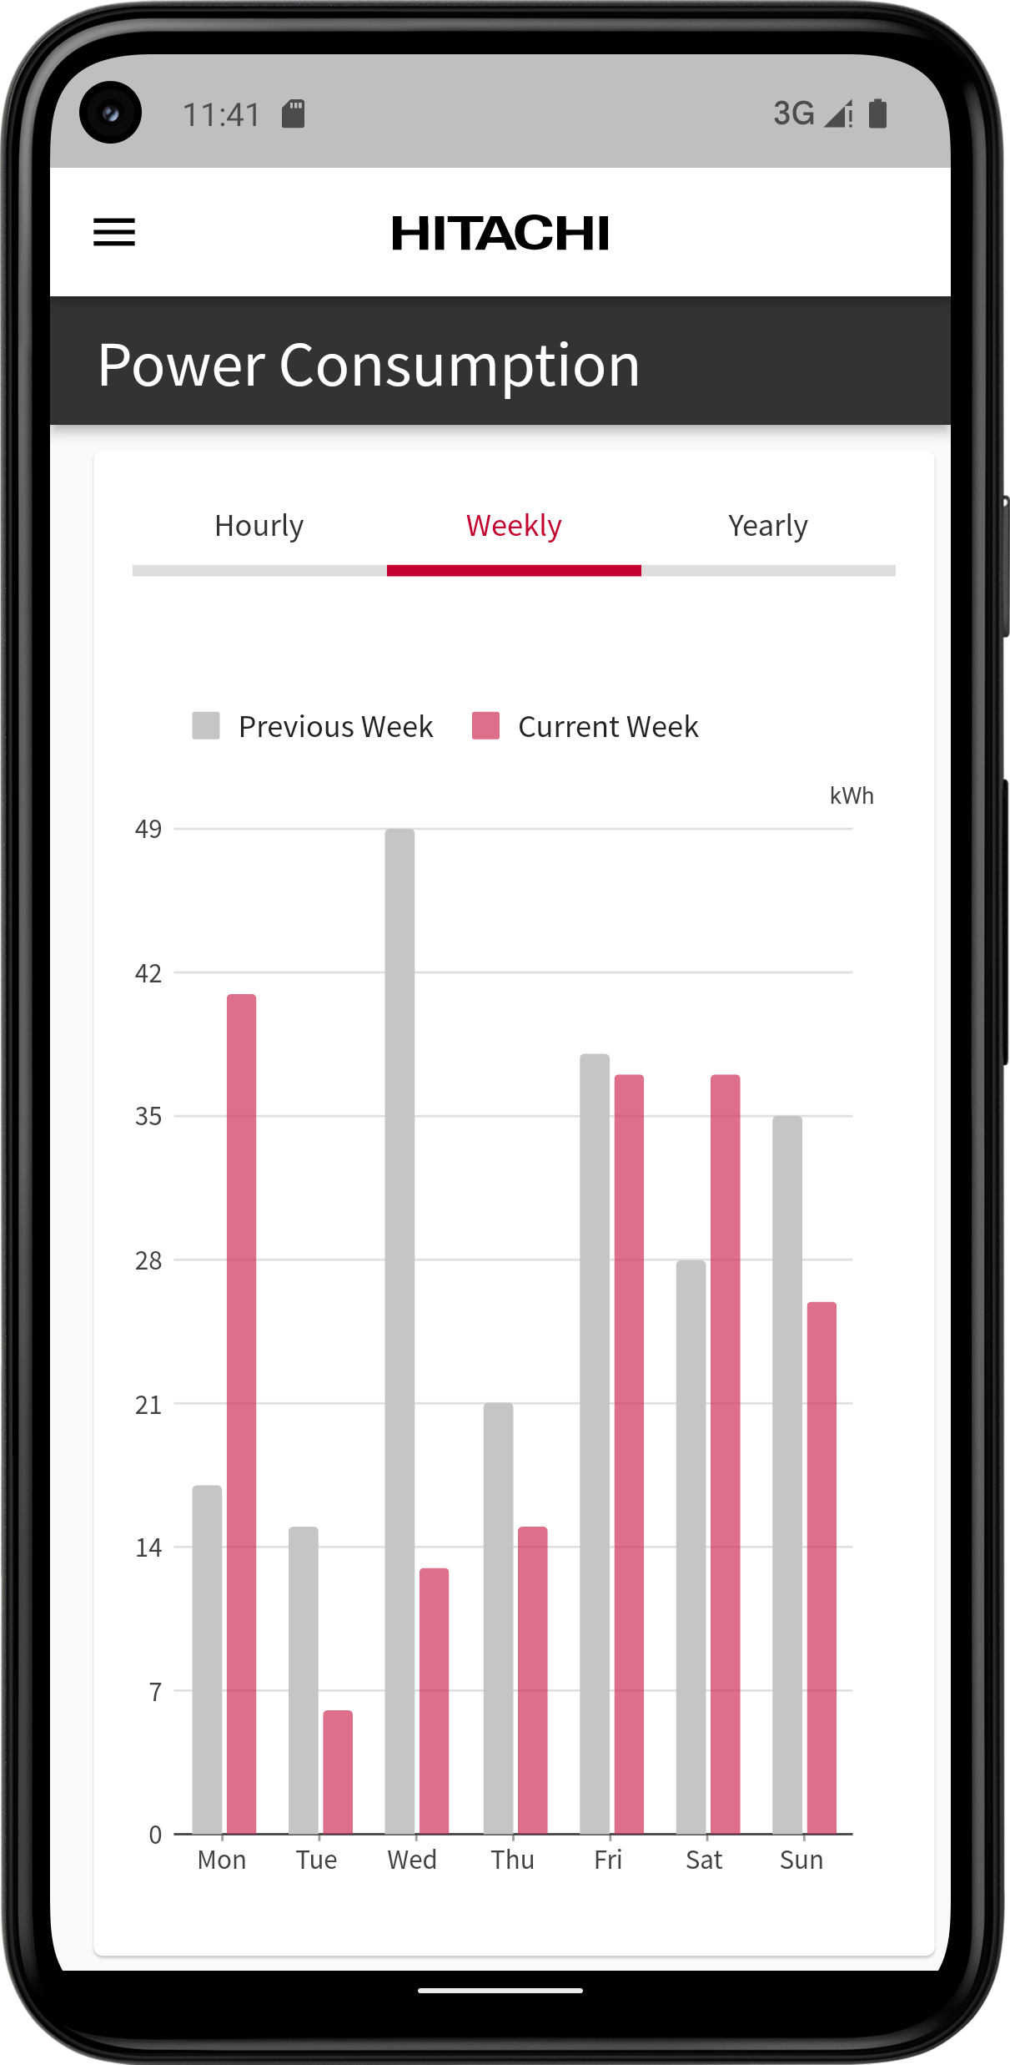
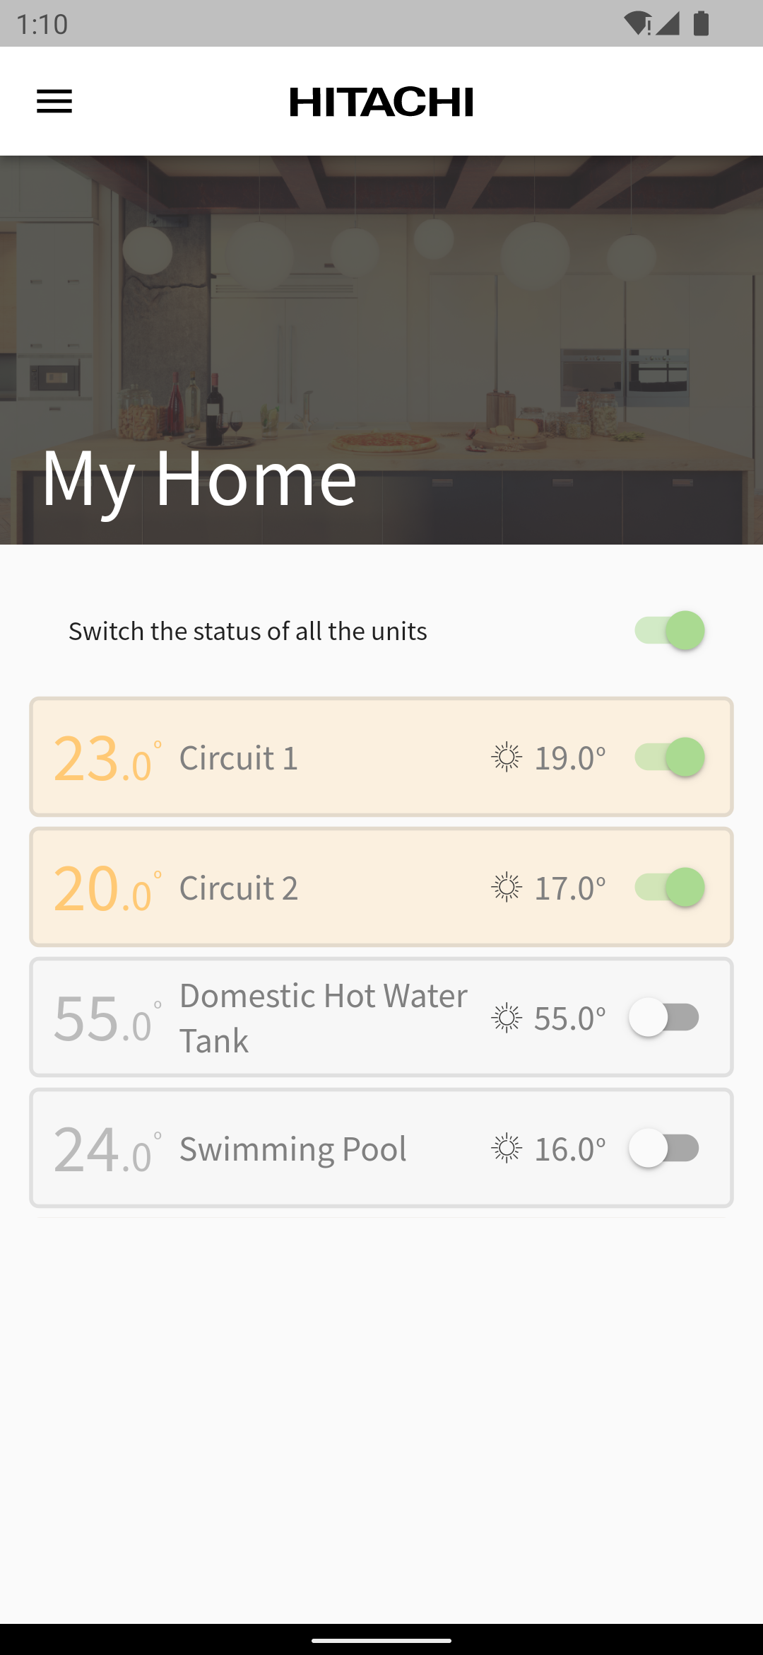
FY23 IoT solution for Heating range
New IoT solution for our Air-to-Water range: CSNET Home App + ATW-IOT-01
New gateway ATW-IOT-01:
Same aspect as ATW-TAG-02 but with a new device inside
WiFi gateway developed by JCH-ES
Only one gateway to connect the Yutaki unit to the cloud
Pairing procedure to the house WiFi using Bluetooth
No physical action required on the gateway to reset it / set pairing mode
Remote update is possible
Competitive cost
New App: CSNET Home
Web and mobile Apps dedicated to end user (like Hi-Kumo)
Apps dedicated to Yutaki units only in a first step
Standard end user features in a first step (~Hi-Kumo)
Features dedicated to Service & Maintenance (like Hi-Kumo Pro) in a second step within June 2023 (testing in progress…)
Additional features and extended setting functions will be released in a 3rd step, with the new Yutaki R32 range (to be confirmed for FY24-Q1)

Slide 5
FY23 IoT solution for Heating range
A new home automation solution developed and managed by JCH-ES
Wi-Fi gateway hardware and firmware developed by JCH-ES
ATW-IOT-01 is manufactured in Spain by a supplier of JCH-ES
Cloud solution based on AWS services and managed by JCH-ES
Mobile and Web applications developed internally by JCH-ES
ATW-IOT-01 and CSNET Home are dedicated to the Heating range:
Yutaki units in a first step (all models from 2016)
Yutampo can be managed with an updated ATW-HCD-01
Cascade controller and systems with more than 2 Yutaki units will be compatible in a second step (FY24-Q1)
No compatibility with any air-to-air unit (RAC, VRF etc.…)
1
2
3
1: ATW-IOT-01 gateway
2: new cloud developed by JCH-ES
3 : Web App for end user or service
4: Mobile Apps (iOS / Android)
4
CSNET Home Apps

Slide 6
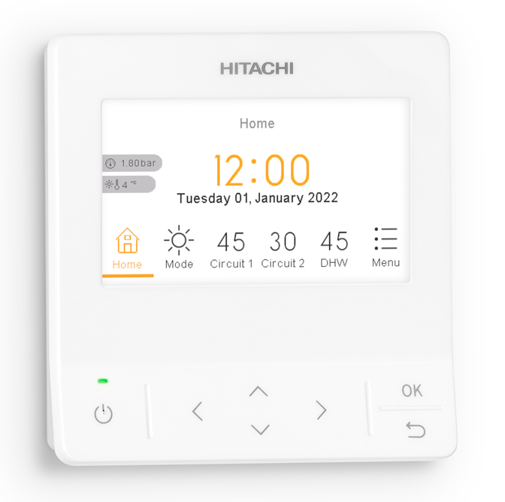
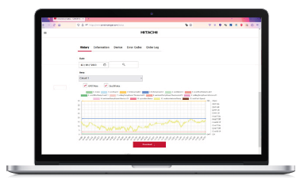
FY23 IoT solution for Heating range
Connection diagrams
Previous Hi-Kumo solution:
New CSNET Home solution:
PC-ARFH2E
PC-ARFH2E Wired room Thermostat
Powered by H-LINK
Powered by H-LINK
Only 1 device required!
H-LINK
H-LINK
New
Radio
receiver
Radio
receiver
ATW-TAG-02
2 devices necessary
ATW-IOT-01
CSNET Home Cloud
ATW-RTU-07
Hi-Box
ATW-RTU-07
New
Hi-Kumo
Hi-Kumo PRO
CSNET Home

Slide 7
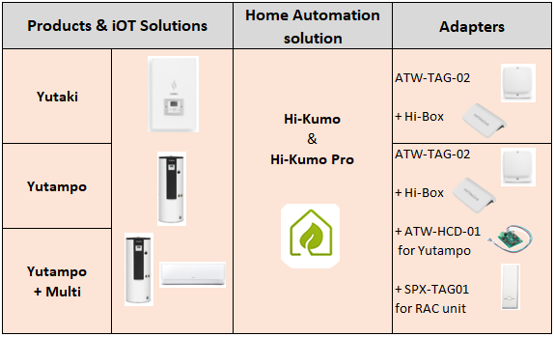
Reminder about Hi-Kumo – End of ATW-TAG-02
ATW-TAG-02 (gateway dedicated to Yutaki and Yutampo) is TERMINATED and NO LONGER AVAILABLE.
Hi-box (AHP-SMB-01) and SPX-TAG01 remain available on stock, until end of stock.
End of stock situation / forecast:
ATW-TAG-02: TERMINATED (stock finished during FY23-Q1)
SPX-TAG01: available until FY24-end
Hi-box: available until FY23-end
(a new stock order for AHP-SMB-01 is underway, Last Buy Order to the supplier)
Hi-Kumo and Hi-Kumo PRO server & App remain available for existing customers.
So far, there is no plan to stop these services or to migrate the existing Hi-Kumo customers to any other system.

Slide 8
Product Presentation ATW-IOT-01 gateway features CSNET Home App features
02

Slide 9
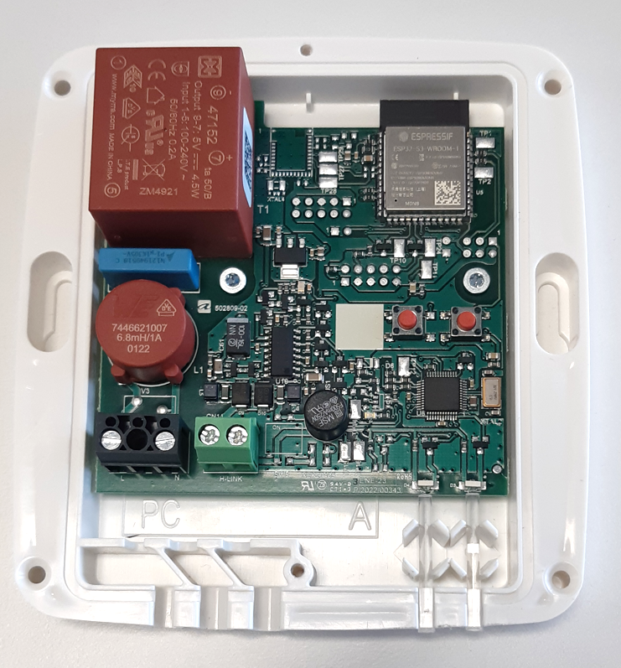
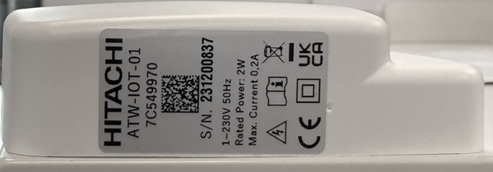
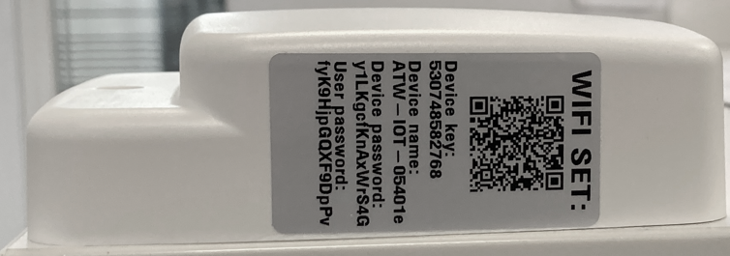
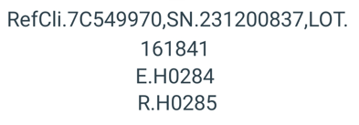
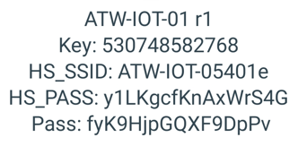
Presentation of ATW-IOT-01
New WIFI gateway developed by JCH-ES
The labels available on the gateway are gathering all the necessary information related to the device:
Left label: logistics details
Product factory code,
Serial number
Lot number
Software version for each CPU
Right label: WiFi details
Device key
Device name
Device password
User password

Slide 10
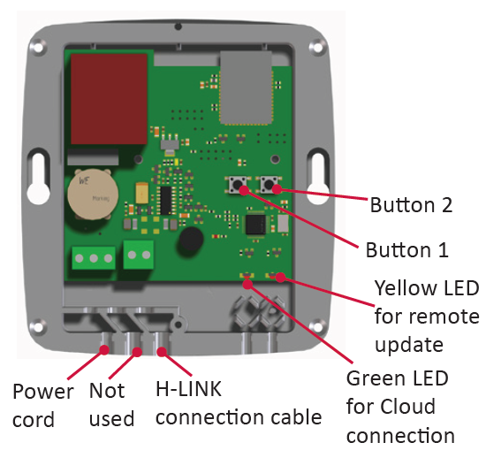
Presentation of ATW-IOT-01
Hardware details – push buttons
The push buttons on the gateway can be used as a secondary way to manage a gateway, especially when one device shall be installed on another site, after a first commissioning.
These actions are not necessary when trying to link one gateway with one user account.
Other actions can be done from CSNET Home App directly to manage one gateway:
Pair it to a new WiFi network
Discover again the unit / zones of the related Yutaki unit
Delete a gateway from one user account

Slide 11
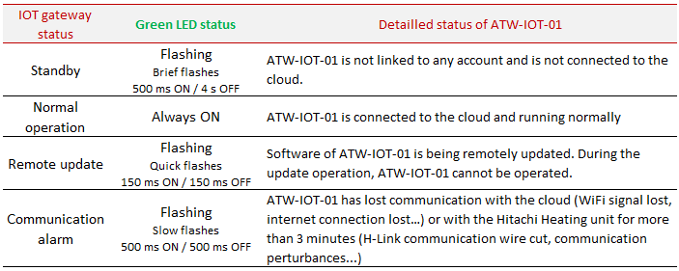
Presentation of ATW-IOT-01
Hardware details – Information about LEDs

Slide 12
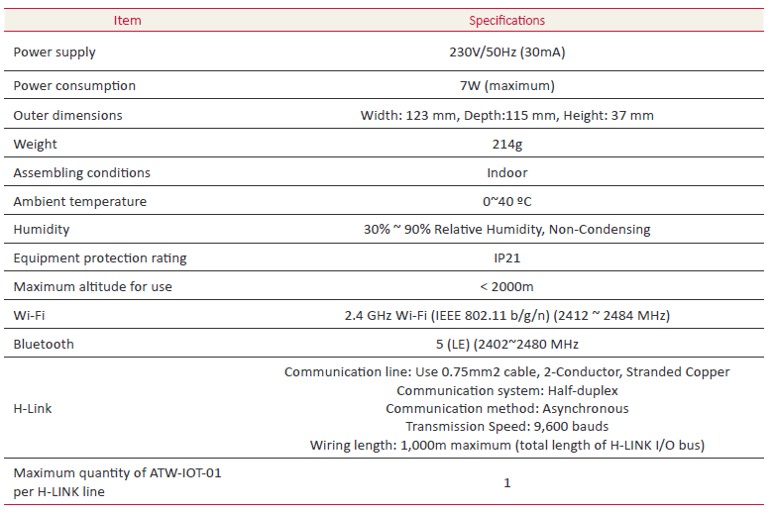
Presentation of ATW-IOT-01
Product details

Slide 13
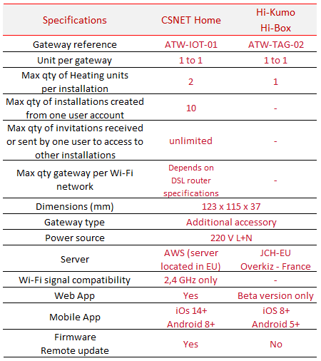
Presentation of ATW-IOT-01
Additional specifications
Servers:
The servers for CSNET Home and for Hi-Kumo are completely independent, without any link between them. Hence CSNET Home and Hi-Kumo are not compatible (Apps and gateways).
Gateway and maximum quantity of units per installation:
One gateway ATW-IOT-01 can control one Heating unit. From first release, CSNET Home App can manage 2 x ATW-IOT-01 gateways per installation, so up to 2 Yutaki units can be linked to the default installation of one user account (user’s home).
Users per account:
The owner of one account (main user) can create up to 10 installations, each installation containing up to 2 x Heating units.
One user can invite an unlimited quantity of users to his installation(s), and each user can be invited by other users in the same way. See next slide for details.
WiFi signal compatibility:
ATW-IOT-01 gateway is only compatible with WiFi networks based on the 2,4 GHz signal. This gateway cannot be paired to 5 GHz WiFi networks.
Nowadays, all the DSL routers are dual band devices, using both Wi-Fi Signals, meaning 2,4 GHz signal shall always be available.
If 5 and 2,4 GHz signals are mixed, using the same network name (e.g. the same SSID), ATW-IOT-01 can be paired to that signal, it is not necessary to separate the 5 and 2,4 GHz signals.
In case of WiFi 6 routers, make sure the 2,4 GHz signal is activated to let the gateway get connected to the related WiFi network.

Slide 14
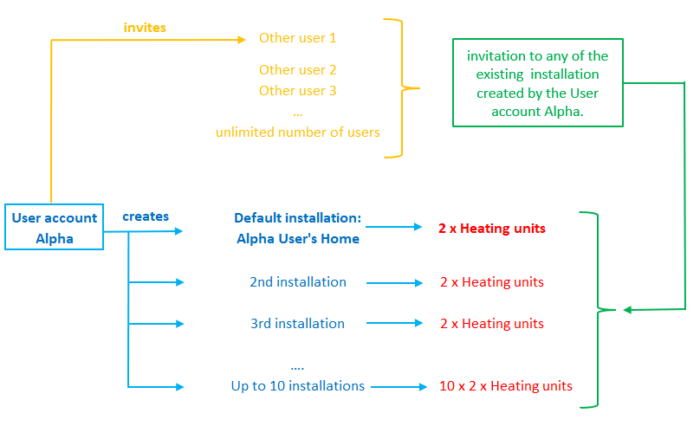
Presentation of ATW-IOT-01
Additional specifications
Gateway and maximum quantity of units per installation:
One gateway ATW-IOT-01 can control one Heating unit. From first release, CSNET Home App can manage 2 x ATW-IOT-01 gateways per installation, so up to 2 Yutaki units can be linked to the default installation of one user account (user’s home).
Users per account:
The owner of one account (main user) can create up to 10 installations, each installation containing up to 2 x Heating units.
One user can invite an unlimited quantity of users to his installation(s), and each user can be invited by other users in the same way.

Slide 15
Presentation of ATW-IOT-01
Compatibility list
From first release (April 2023), ATW-IOT-01 is compatible with the following YUTAKI units:
All Yutaki S, SCombi, S80 & M from 2016 (R410A and R32 units)
Hydrosplit units
Mirror for Yutaki M
Software updates are necessary for the following products:
Yutampo: ATW-HCD-01 must be updated, new software release to be confirmed (June 23 tbc)
Cascade controllers ATW-YCC-01/02/03, to control more than 1 Yutaki unit per HLINK line (FY24-Q1 tbc)
Refer to the APN for more details about the compatibility list.

Slide 16
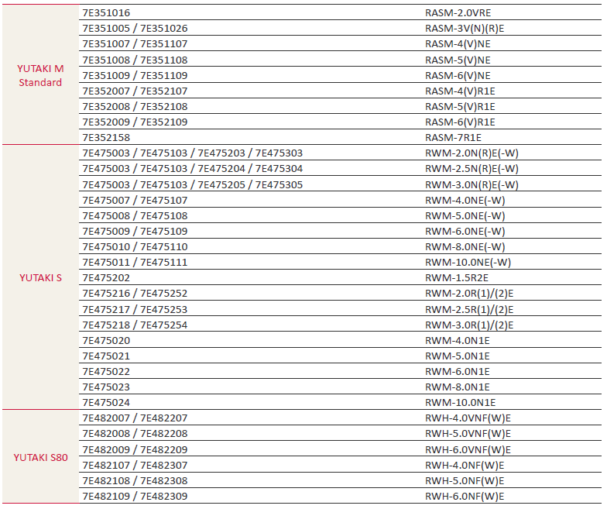
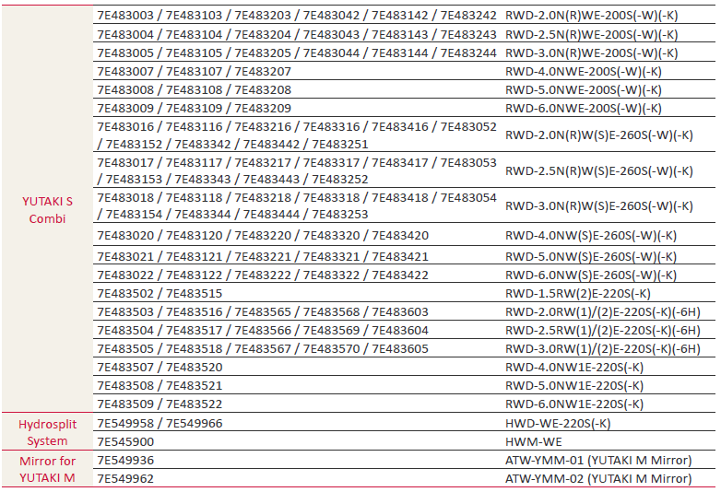
Presentation of ATW-IOT-01
Compatibility list

Slide 17
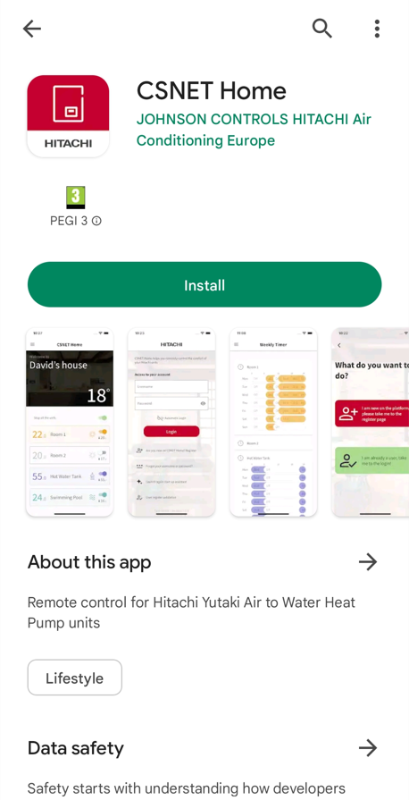
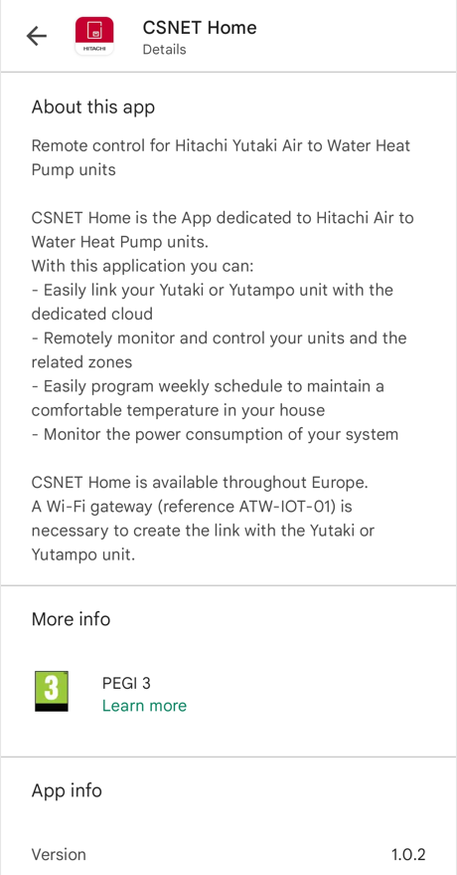
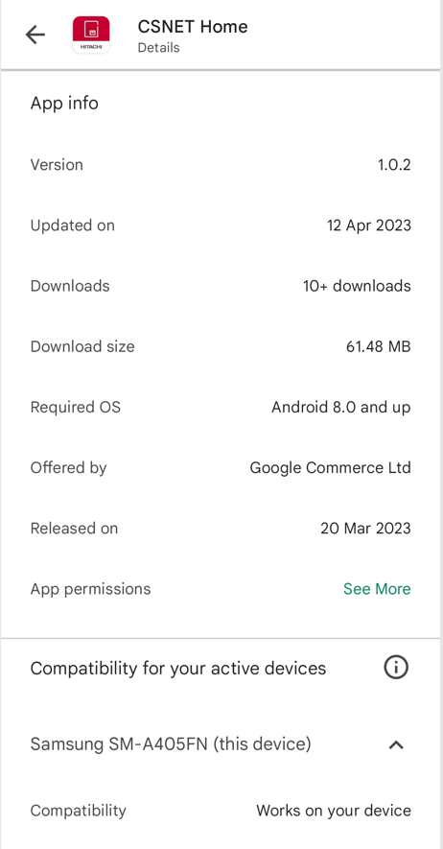
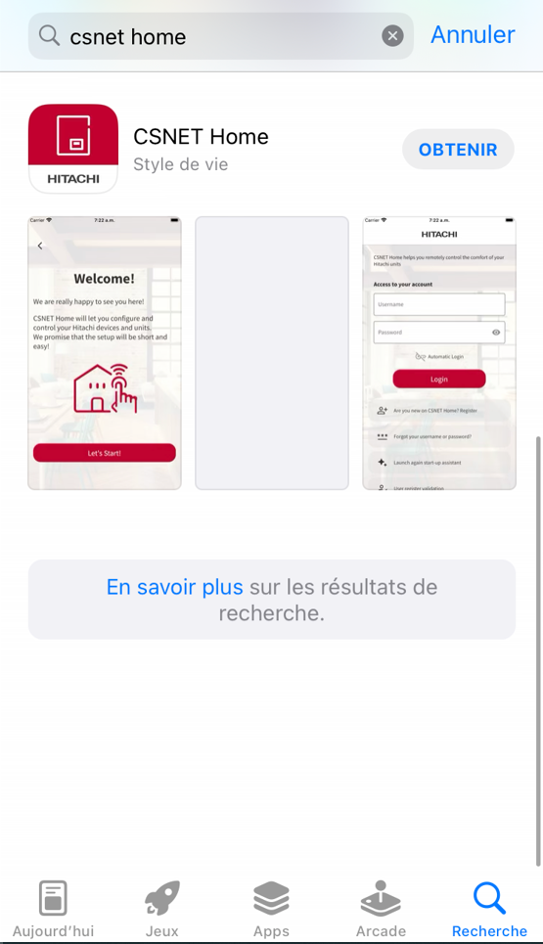
CSNET Home Apps
First release of mobile applications : April 2023
The mobile Apps are already available on Apple and Google Play stores. The current CSNET Home version is referenced 1.0.2.
The release is done without any limitation related to the country or area of the world (175 countries targeted for iOS, 174 for Android).

Slide 18
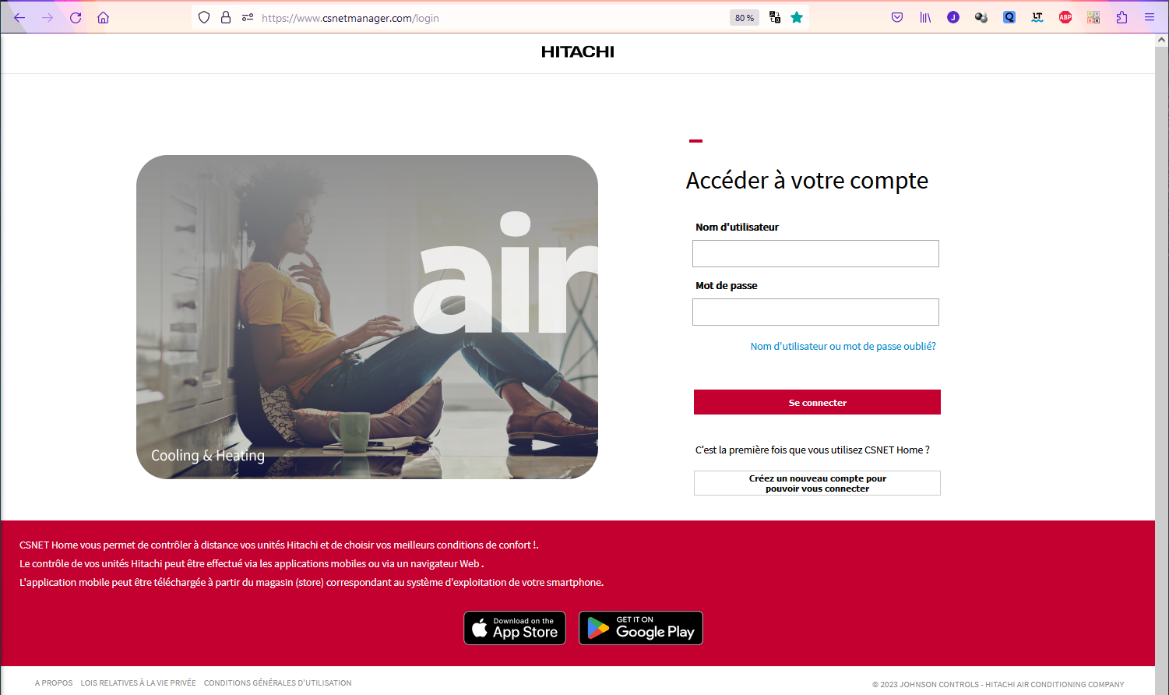
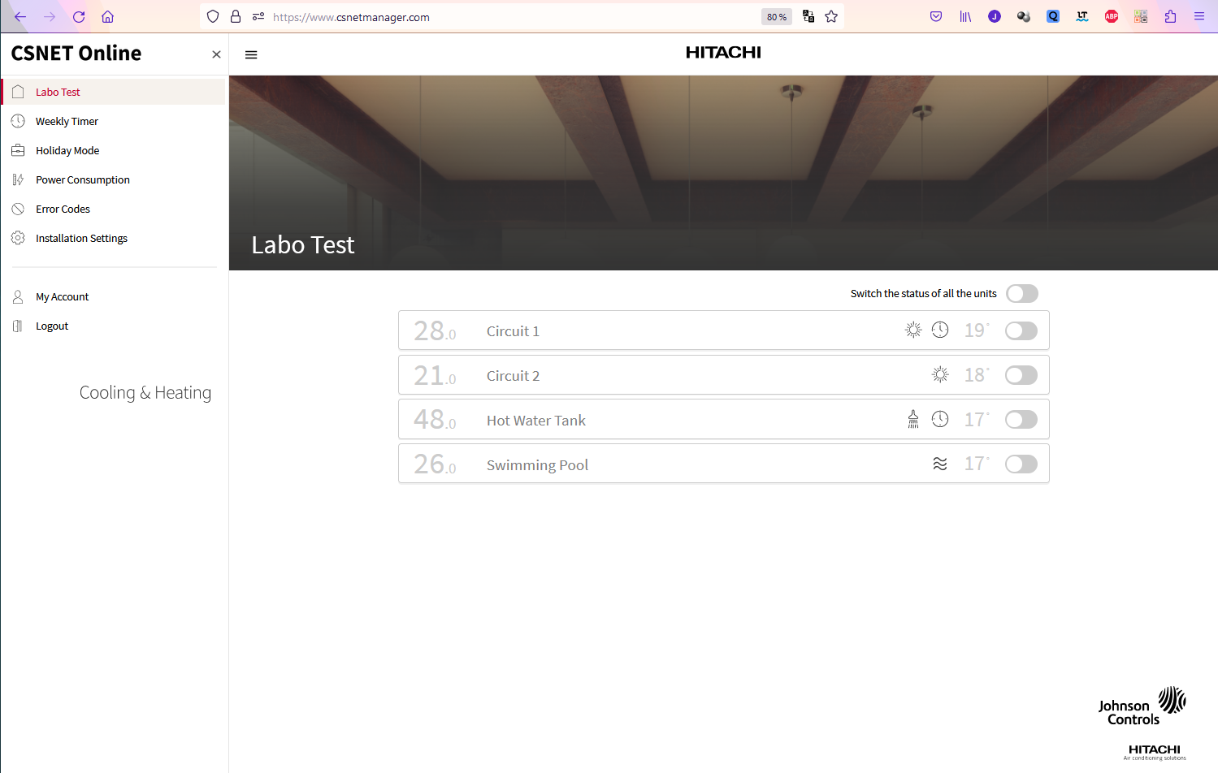
CSNET Home Apps
First release of Web App : May 2023
The Web App beta version is also already available from the following URL: https://www.csnetmanager.com/login
Limitations of the Web App for the first release:
Discovery of ATW-IOT-01 cannot be managed from Web App
Weekly Timer wizard is not available

Slide 19
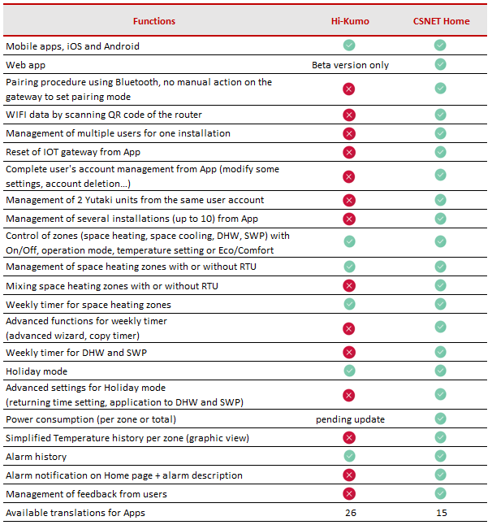
CSNET Home: features
First release April/May 2023:
Features dedicated to End Users
Account creation
Discovery of IOT devices using Bluetooth
Up to 2 gateways / Heating units per account
Standard control function of the zones
Simplified zone operation and temperatures history
Weekly timer for all zones (including DHW and SPW)
Advanced wizard and functions for the weekly timer
Holiday mode
Power consumption data
Alarm notification, description and history
Creation of several installations (up to 10)
Invitation of users to your installations
Management of user’s feedback
Apps managing 26 EU languages

Slide 20
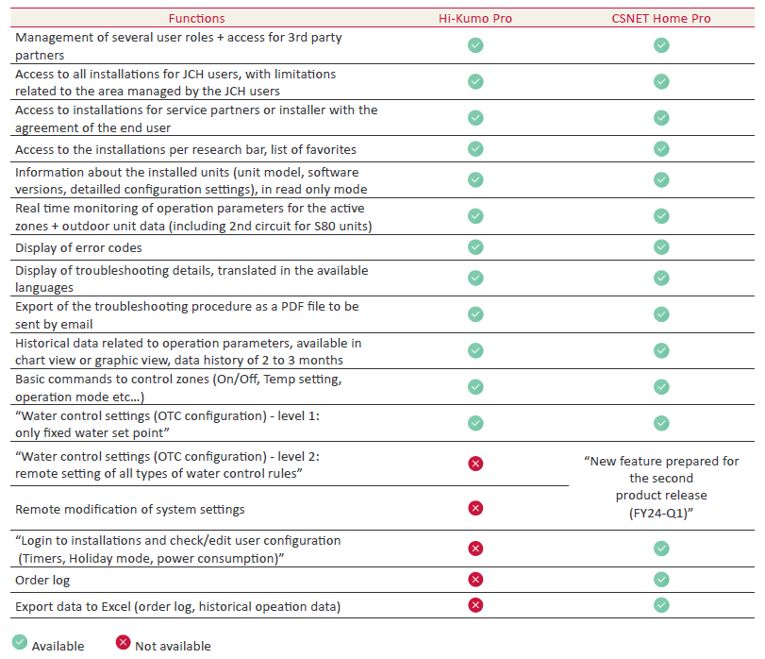
CSNET Home: features
App Update scheduled for June 2023: First level of PRO features
JCH users can access to installations of their areas
External users (recorded Installers / Service partners) can access to installation with the agreement of end users
PRO features on both mobile and Web Apps
List of installations with smart filters
Unit information (model, software version..)
System configuration details
Real time reading of operation parameters
Display of error code, troubleshooting details
Historical data with graphic view
Water control setting: only fixed water setting
Order log, alarm log
Connection to the installation with the end user view

Slide 21
Product planning – release to market
April 2023:
ATW-IOT-01: First pre-production of ATW-IOT-01 for field test purposes
Mobile Apps: Field tests + first versions release on App stores
Web App with end user features only: beta release in April, to be finalized within May 23
May 2023:
Product NEWS for the official release
ATW-IOT-01: first mass production and stock deliveries (by mid-May)
Web and mobile Apps: beta tests and homologation of level 1 PRO features
June 2023:
Web and mobile Apps: official update to release level 1 PRO features
Update of ATW-HCD-01 to get the compatibility of Yutampo with ATW-IOT-01
Production plan: 2000 pieces of ATW-IO-01 shall be manufactured and delivered
Summer 2023:
Web and mobile Apps: test and homologation of level 2 PRO features
October 2023:
Web and mobile Apps: official update to release level 2 PRO features
Compatibility with cascade controllers and multiple Yutaki systems
FY23
FY24

Slide 22
iOT solution designed with Security in mind: Cybersecurity facts
As all new commercial software products developed by Johnson Controls, CSNET Home has been developed under the governance of Johnson Controls’ cybersecurity policies.
That means during the development of the product (gateway and applications), several specific requirements must be fulfilled by the development teams:
JCI’s product security requirements and coding practices must be followed
Cybersecurity requirements are considered since the beginning of the project and are checked along the development process
Source codes are checked for vulnerabilities during development, when the product is released and during the life time of the product: permanent follow-up done by the Global Product Security Team.
JCH-ES design team and the Global Product Security Team have then conducted a variety of in-house and/or external security testing, being conducted as appropriate for the product’s target feature set and application, which may include source code assessments, vulnerability scans and penetration testing.
The Global Product Security Team is made of Certified cybersecurity experts (e.g. Certified Information Systems Security Professional – CISSP or other credentials) who work to validate designs using the latest recognized industry standards and practices. Security baseline requirements derived from established cybersecurity standards (e.g. OWASP, NIST SP 800-53r5, ISA/IEC 62443, UFC 4-010-06), tailored for operational technology domain.
This Team ensures an active participation as a member of several security organizations that serve the cybersecurity community including:
ISA Secure – Strategic Voting Member
ISA GCA - Founding member of the International Society of Automation’s Global Cybersecurity Alliance (GCA)
FIRST – Full member of the Forum of Incident Response and Security Teams (FIRST)
MITRE – CVE Numbering authority
These actions, combined with our internal product cybersecurity governance structure and policies, enables Johnson Controls to address product security holistically throughout the lifecycle of each product: CSNET Home gateway and Application are fully designed based on these security rules and processes of JCI, to be among the most secured products on the market.
Please visit the Johnson Controls Cyber Solutions page to learn more about JCI’s approach to cybersecurity.

Slide 23
Installation
03

Slide 24
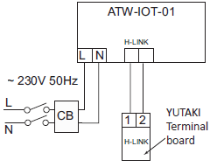
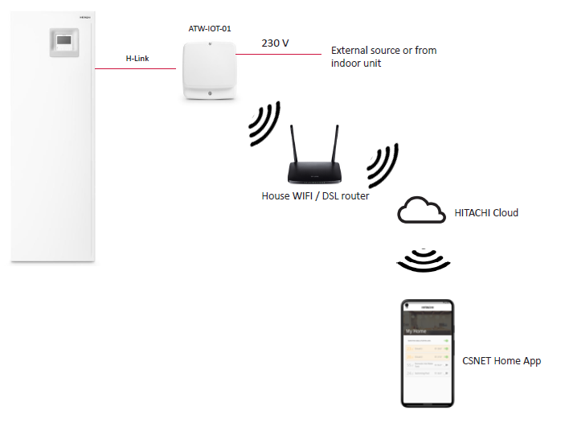
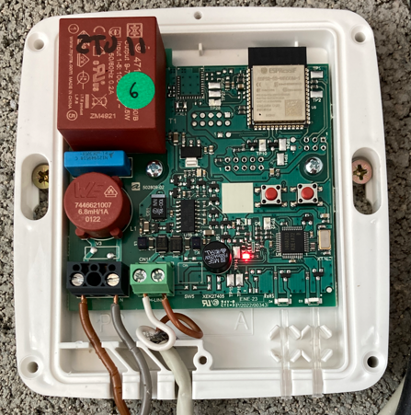
Installation of ATW-IOT-01
Same installation requirements as ATW-TAG-02
ATW-IOT-01
Equipment Protection rating: IP21
Indoor installation
HLINK connection to Yutaki terminals 1-2
Power supply 230 V L+N
external source or from indoor module
To use this space, a small plastic part of the cover must be cut manually!

Slide 25
CSNET Home Apps
Installing mobile Apps
Mobile Apps are already available on Apple and Google Play stores.
The current CSNET Home version is referenced 1.0.2.
The release is done without any limitation related to the country or area of the world:
175 countries targeted for iOS, 174 for Android
CSNET Home Apps can be installed on the following devices:
Apple devices running iOS 14 or more recent versions (currently version 16.4)
Android devices running Android 8.0 or more recent versions (currently version 10-11-12-13 are widely used, a version 14 is under development)
Compatible with most of the recent Smartphones (larger screens are more comfortable to use)
Operation with tablet / iPad is possible, the display of the app is adapted to the large screens.
URL of Web App: https://www.csnetmanager.com/login

Slide 26
Creating & Managing one User Account
04

Slide 27
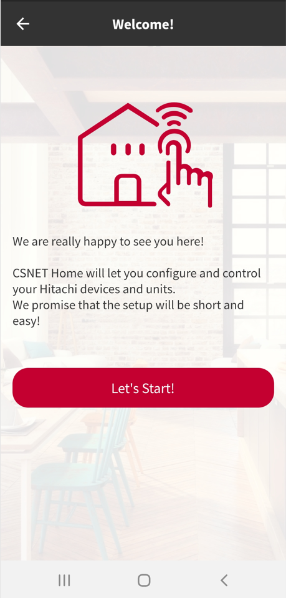
Creating one User account
For a good startup…
Prerequisites: in order to create a user’s account with CSNET Home, prepare the following items:
Smartphone connected to Internet, via 4G or WiFi, with CSNET Home App installed
Email address of the owner of the account
Access to the related email box to receive an email
With CSNET Home, the account creation is an independent step, like using Hi-Kumo with Hi-box.
This account creation can be done anywhere and anytime by the user.
The discovery of the ATW-IOT-01 gateway and of the related Yutaki unit is done in a second step, once the user account is created.
Open the App, follow the welcome steps!

Slide 28
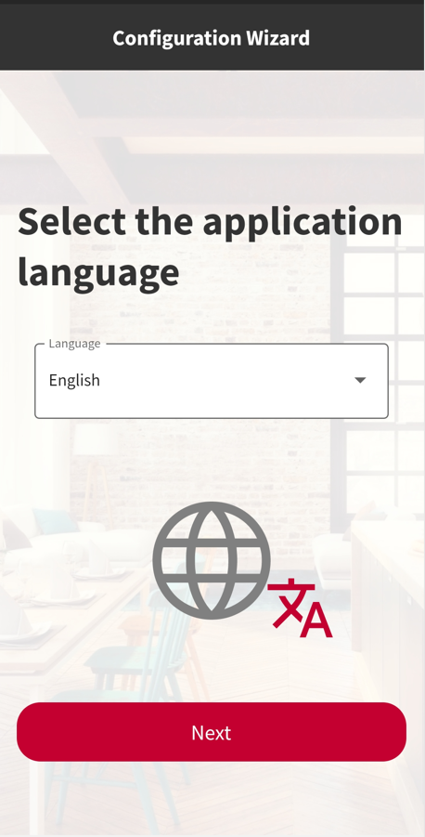
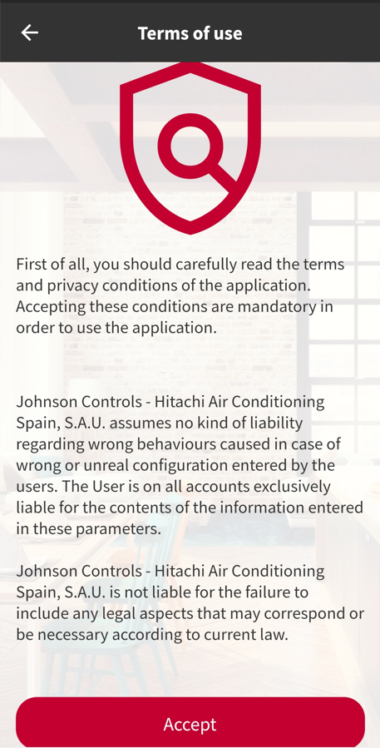
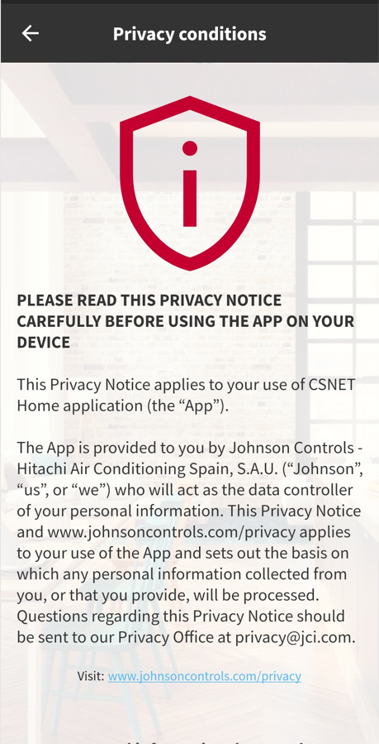
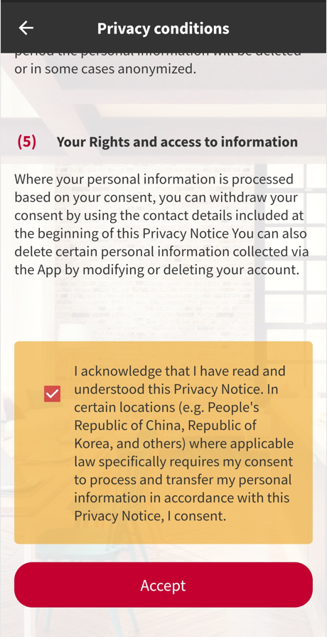
Creating one User account
Account creation sequence #1
Application language can be selected from the first screen. It can be changed latter on in the App. The language used for the App can be different that the language used on the Smartphone.
Welcome screen!
Introduction to Terms of Use and Privacy Agreement.
User shall read the document and approve it by ticking the check box at the bottom side of the screen (scroll down).

Slide 29
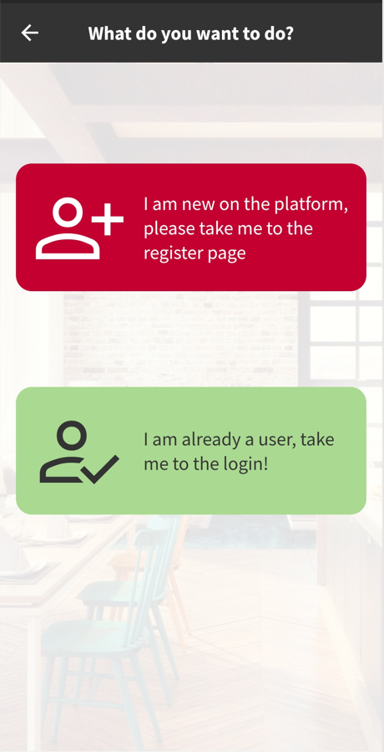
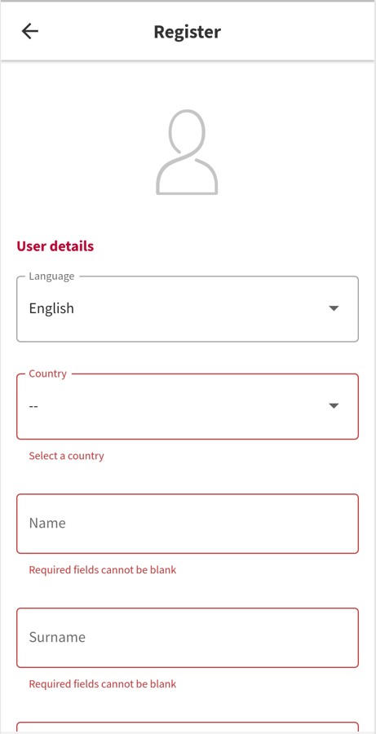
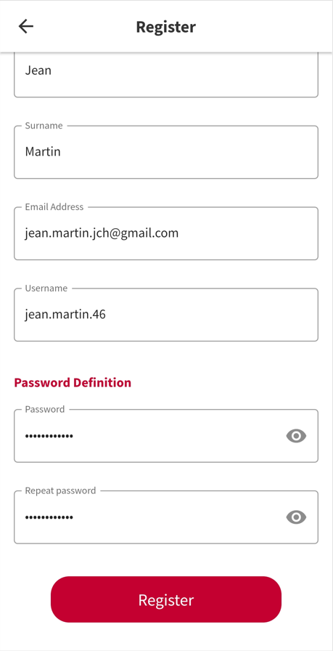
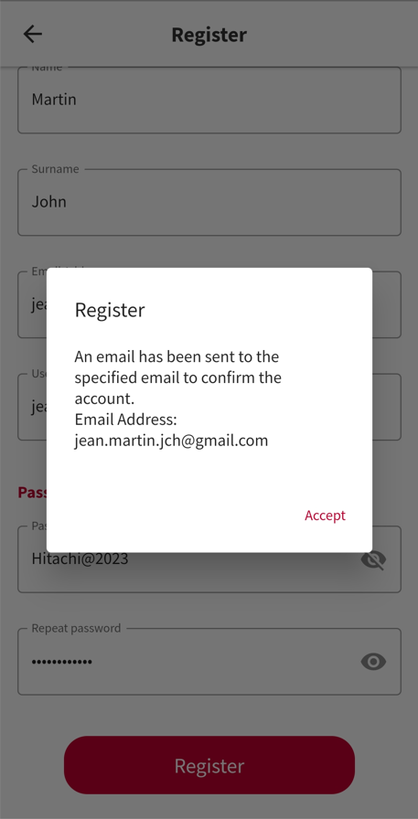
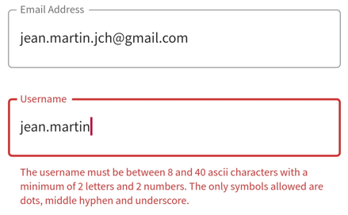
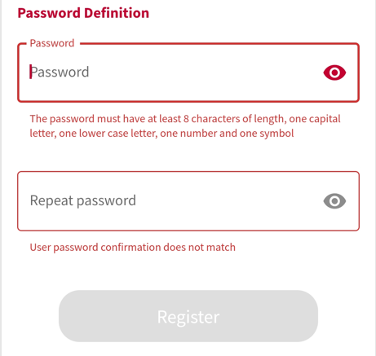
Creating one User account
Account creation sequence #2
Push the red button to create a new user account.
Start filling the required fields!
Define your username and password
Requirements:
User name: 8 to 40 characters, with at least 2 letters and 2 digits.
Password: 8 characters minimum, 1 capital letter, 1 lower case letter, 1 number and 1 symbol.
Once everything is input correctly, you can proceed with the registration.
Check the related email box to get the confirmation code / link.

Slide 30
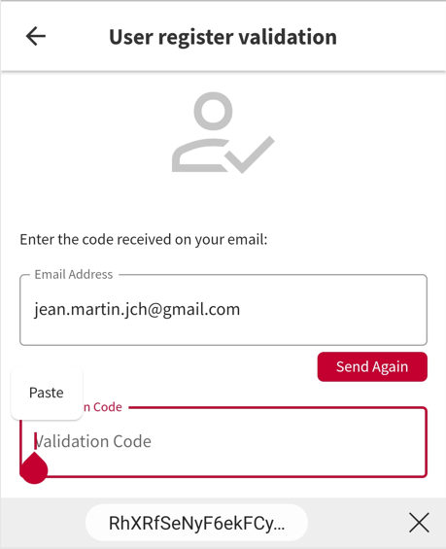
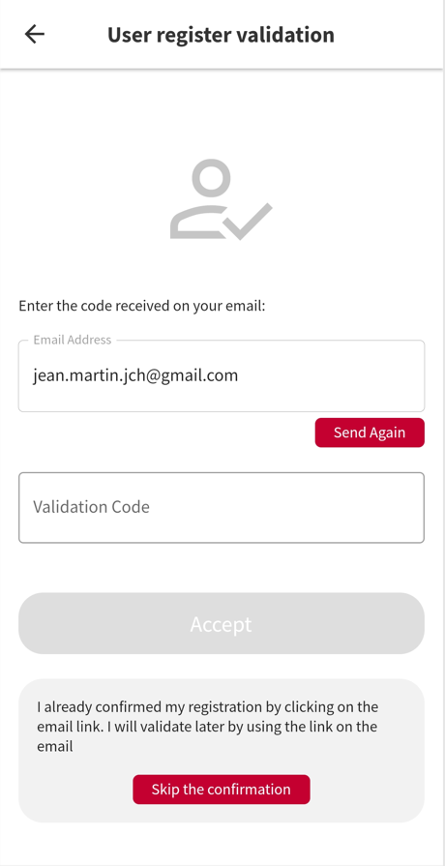
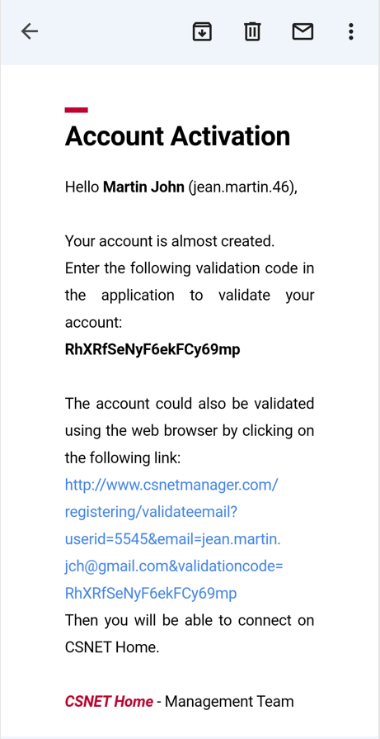
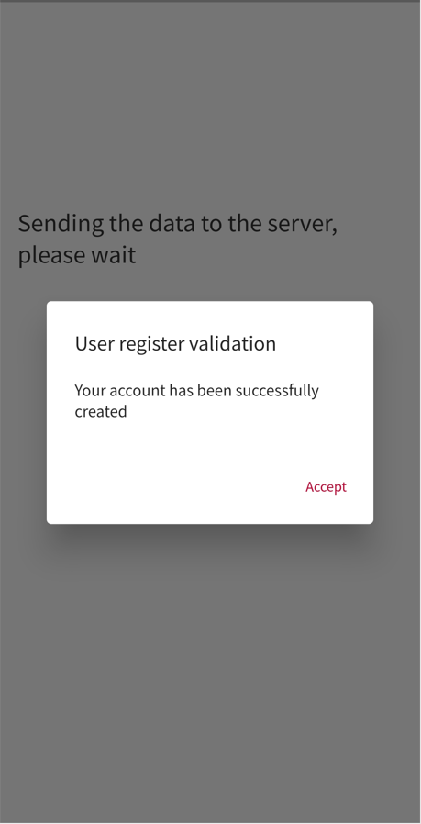
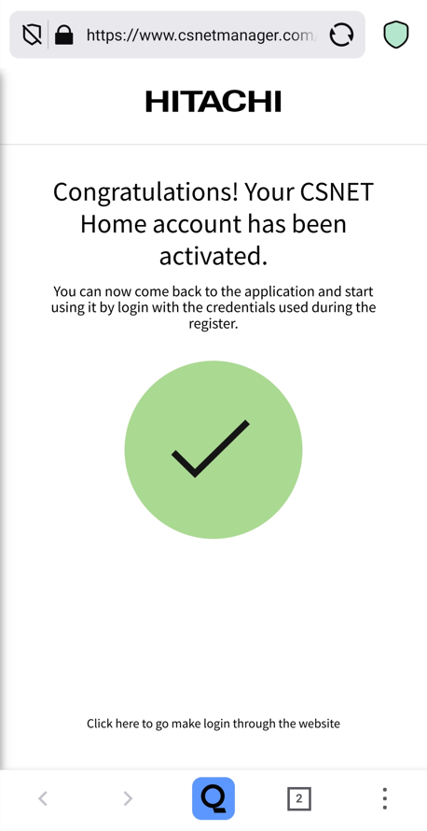
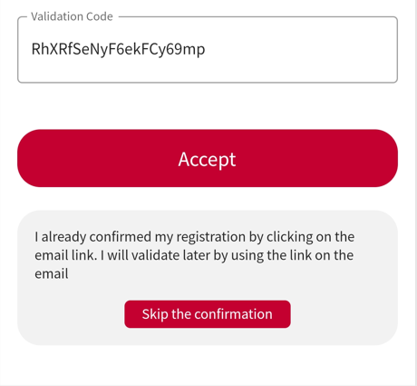
Creating one User account
Account creation sequence #3
Once the confirmation email has been sent, App is displaying that screen.
From there, 2 options are possible to confirm the account creation:
1- Input the code read on the email (manual input, or copy/paste)
2- Confirm the account by clicking the link sent by email, so use the “skip confirmation button” from this screen.
Confirmation email checked from the same mobile phone.
User can either copy/paste the confirmation code or use the link.
Using the confirmation code on App, copying the code from the email.
In case the confirmation email has not been received within a few minutes, use the “Send Again” button to resend the confirmation email.
Once the validation code is input, proceed with the confirmation.
By clicking the confirmation link sent by email, a web page is open on the related device. Confirmation is done in a few seconds. Come back to the mobile App once done to login (skip the confirmation on mobile App in that case).

Slide 31
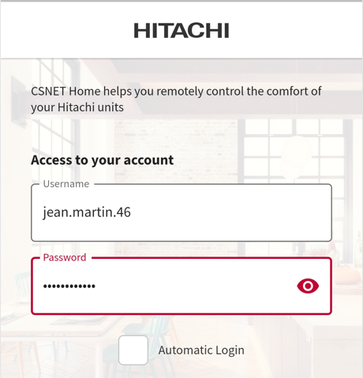
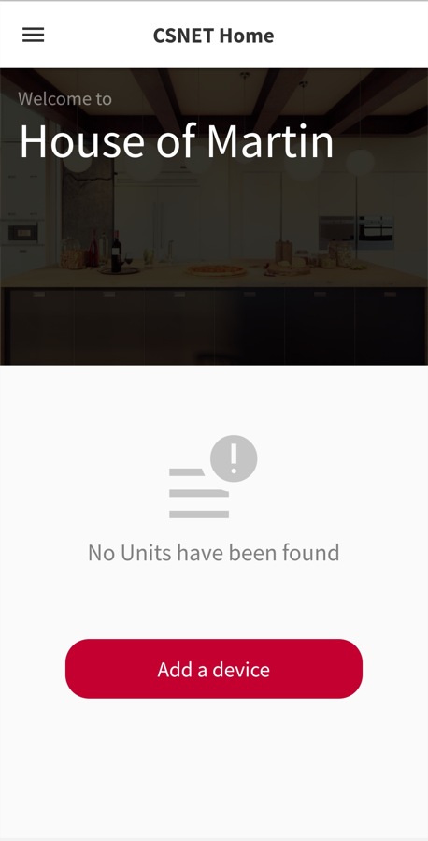
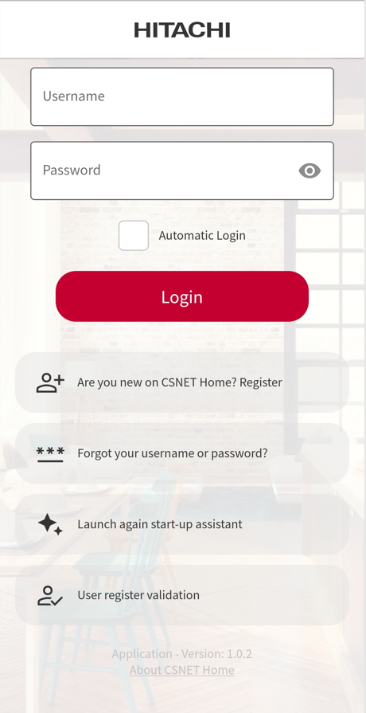
Creating one User account
Account creation sequence – useful tips #1
Once the account is confirmed, input your login and password to get logged in.
Tick the “Automatic Login” checkbox to get logged in automatically next time the App is open (user should not disconnect from his account to get this automatic login).
Once logged in, here is the first view of the home page. Proceed with the discovery of a device as next step.
For any reason, if the registration procedure is stopped or cancelled, it is possible to restart it or to come back to the validation procedure from this menu.
Startup assistant can be run again, as well as going back directly to the “User registration validation” screen.
When validating the user account, if the email used for the registration has already been used / pending validation, the message above may be displayed.
Go back to the User Register Validation screen (next screenshot) to continue.
From that page, input the email address used, send again the confirmation email if necessary and proceed with the confirmation as explained on the previous slide (confirmation code or link).

Slide 32
Creating & Managing one User account
Account creation sequence – useful tips #2 – Deleting one user account
When creating a new user account, if the email address input is already linked with an existing user account, an error message will be displayed (see next screenshot).
Error message if the address input is already linked to an existing user account. In this case, return to previous screen and use another email address.
Alternatively, the existing user account can be deleted directly from App.
From the main menu, go to “My Account” to get options to edit the user account.
All the fields can be updated from the App, except the username.
Changing the user’s password and deleting the user account can also be done directly from App.
To delete one user account, access to the dedicated menu, input the related password and proceed.

Slide 33
Unit discovery Link one ATW-IOT-01 to your installation Check the WiFi strength on site Update the WiFi settings of ATW-IOT-01 Read the zone configuration of the Yutaki unit
05

Slide 34
Unit discovery
For a good start-up, check the following points before starting the discovery procedure
ATW-IOT-01 is well connected to the HLINK terminals of the Yutaki unit
The configuration of the Yutaki units from its main controller is already done
Power supply is turned ON for the Yutaki unit and ATW-IOT-01
The WiFi network is available at the installation place, with a 2,4 GHz signal and a good signal strength.
Credentials for the WiFi network are available: QR code or written information (SSID, password)
Bluetooth is activated on the Smartphone used for the discovery procedure
This Smartphone is connected to Internet (4G or any WiFi network).
Notes:
No physical action is necessary on ATW-IOT-01 to set it to pairing mode.
The Smartphone must be in the Bluetooth range of the ATW-IOT-01 device to run the procedure (1~5 m).
It is not mandatory to get the Smartphone connected to the same WiFi network as the ATW-IOT-01 device.
Push Add a device to start the procedure!

Slide 35
Unit discovery
Device discovery sequence #1
Start by scanning the WiFi QR code of the ATW-IOT-01 device.
Manual input is also possible as backup option.
Mind the spelling.
Information of ATW-IOT-01 shall be read instantaneously scanning the QR code.
For the next steps, Bluetooth is necessary, a reminder is displayed in case BLE is not activated on the Smartphone (pop-up message).
The next step is related to the target WiFi, to get the related credentials.
Android App is proposing 2 options:
Select the target WiFi network in a list and input manually the password
Scan a QR code to get the WiFi Network details
iOS App is proposing a different display, as the list of WiFi networks cannot be displayed (not allowed by iOS).
From the same screen, the user can:
- Scan a QR code to get the WiFi Network details
- Input manually the WiFi SSID and password

Slide 36
Unit discovery
Device discovery sequence #2
Once the WiFi details are loaded, press configure to proceed.
Now Bluetooth is going to be used to connect the smartphone to the ATW-IOT-01 gateway.
The smartphone must be in the BLE range of the gateway for this step (1 ~ 5 m).
Once launched, the configuration is automatic. Wait a few seconds to reach the end of the configuration.
If everything is fine, configuration is completed and the zones of the Yutaki unit are displayed on Home page.
During that sequence, the smartphone is getting connected to ATW-IOT-01 through Bluetooth. Details about the WIFI connection are sent to the gateway. Once done, the IOT gateway will try to get connected to the indicated WiFi network and to the server. When the connection is established with the server, details about the zones of the unit are loaded on the server. Once all the steps are completed, configuration is done and the success message is displayed.

Slide 37
Unit discovery
Device discovery sequence – troubleshooting #1
In case the IOT gateway is already linked to an existing installation, this error message will be displayed.
In this case, the IOT gateway should be deleted from the existing installation. This can be done from App (Installation settings menu), using the related user account.
For this first release, this cannot be done using the factory reset of the gateway with push buttons. Data can be erased from the server by factory if necessary.
Device may not be found, mainly for the following reasons:
Bluetooth is not activated on the Smartphone
ATW-IOT-01 is not powered ON
The smartphone is not in the BLE range
The gateway is rebooting, being updated or busy
In this case, try again the procedure, checking activation of BLE and status of the gateway. With Android devices, from the Bluetooth menu, you can detect the IOT device if it is powered ON (not working with iOS devices).

Slide 38
Unit discovery
Device discovery sequence – troubleshooting #2
In case WiFi details are input manually, pay attention to the spelling.
If the WiFi password input is wrong, the gateway will not be able to get connected to the WiFi network and to the server, the procedure will fail.
In this case, go back to the previous step, check the WiFi details and try again.
To avoid this matter, the best thing to do is to scan the QR code of your WiFi Network.
The QR code format is now used to easily share the WiFi connection.
This QR code can be read from:
App used to configure your DSL router or access point
The administration webpage of the router, WiFi settings.
Sticker on the router (caution if the password has been updated!)
On the DSL router itself, from its LCD screen (depending on the model of router!)

Slide 39
Unit discovery – Checking the WiFi configuration on site
How to check the characteristics of the WiFi network?
Arriving on site, it may be helpful to check the WiFi details using an App like Fing or FRITZ!App WLAN, especially with Android smartphones (more details are available, there are limitations with iOS).
Thanks to these Apps, you can check the strength of the WiFi signal and its characteristics (channels, quantity of devices connected etc…)
Using Fritz WLan App, you can also check if your smartphone is connected to a 2,4 GHz or 5 GHZ signal.
Remember that 5 GHz signals have a greater bandwidth (speed), but a weaker connection range: in a building or house using a dual band signal (merged signals), depending on your position in the building, your smartphone may be connected to the 5 GHz signal or to the 2,4 GHz signal. In addition, the smartphone can switch to the each signal automatically without notification.
In case of mixed WiFi signal (2,4 GHz + 5 GHz with the same SSID): ATW-IOT-01 can be connected to the 2,4 GHz signal using CSNET Home App even if the Smartphone is connected to the 5 GHz signal. It is not necessary to separate the WiFi signals.

Slide 40
Unit discovery – Checking the WiFi configuration on site

Slide 41
Unit discovery – Checking the WiFi configuration on site
Acceptable signal strengths (from https://www.metageek.com/training/)
WiFi Analyzer
App on Android
Recommendation: do not use WiFi signals with a strength lower than -70 dBm.
Communication issues may be faced, or answer of the unit may be delayed when orders are submitted.
If necessary, WiFi repeaters should be used to increase the strength of the WiFi signal.
Easy-to-use tool to assess the strength of a WiFi network from your smartphone

Slide 42
Changing the WiFi configuration of the IOT device
If the WiFi configuration on site is changed (WiFi settings updated, DSL router changed, new Internet service provider…), the configuration of the IOT gateway can be easily updated from the Installation Settings menu:
Device menu
Select “Update WiFi settings”
This function is just using the same screens and procedure as the first discovery procedure:
Scan the QR code of the gateway to get its details
Input or Scan the QR code of the new WiFi settings
Apply the changes to the IOT gateway
It is not necessary to delete or reset the IOT gateway before running this procedure.

Slide 43
Unit discovery – Reading the configuration of the Yutaki unit
The configuration of the Yutaki unit is read during the discovery procedure
In case of changes done to the configuration of the unit after the discovery procedure, configuration is automatically updated on CSNET Home.
Example above: DHW and SPW circuits are deactivated from the main controller. After a few seconds, display on App is updated to match with the system configuration.
Behavior is the same if a circuit or a RTU is added.
If necessary, the configuration of the Yutaki unit read by ATW-IOT-01 device can be refreshed by launching a new “Auto Discovery” procedure.
From the Installation Settings menu, go the Devices menu, select your device and push “Launch Auto Discovery” button.

Slide 44
Unit discovery – Reading the configuration of the Yutaki unit
Starting the Auto discovery procedure…
After a few seconds, the Device menu is displayed again, but the procedure is in fact still running.
Coming back to home page, the user can see that the auto procedure is still running.
After a few seconds (30 s~ 1 min), the list of units / zones is updated on home page.

Slide 45
Installation settings Manage installation Manage gateways / devices Manage users Manage zones / areas
06

Slide 46
Installation Settings menu
Menu gathering setting related to the “installation site”, to manage sites, devices, users and areas.
Position of the “Installation Settings” menu to manage details about your installation(s), your devices and users of your system.
The General menu is displaying basic details about your installation:
Name of the house / installation as displayed on home page
Address details, for weather information
Time zone (weekly timer operation)
Remote Access Code and Hitachi Service Access: to grant access to the installation to 3rd party users (PRO feature)
Devices menu: to manage ATW-IOT-01 devices.
Select a device to see its details (pin code, passwords etc.)
Possible actions:
Launch auto configuration
Update WiFi configuration
Delete the device
Add a device
Users menu lets you invite other users to your installation. Once done, you can manage the privileges of each user.
Only users with an existing CSNET Home account can be added to one installation, using the related username.
Zones or “areas” can be added to installations, such as:
Floors
Specific rooms: kitchen, living room…
Once created, the circuits (or zones) of the Yutaki units can be affected to these areas of the installation.
These areas will be displayed on Home page for a personalized navigation.

Slide 47
Installation details
Editing user details, adding location for weather forecast
Open the Installation Settings menu to manage details about your installation(s), your devices and users of your system.
The General menu is displaying basic details about your installation.
All the fields can be edited.
Add the location information to get the weather forecast displayed on Home page. Use the automatic location function with the “Find me” button or input manually the details.
When validating the user account, if the email used for the registration has already been used / pending validation, the message above may be displayed.
Go back to the User Register Validation screen (next screenshot) to continue.
Once the location details are added (latitude and longitude), current weather icon is displayed on Home page.
Without location details, the current average outdoor temperature read from the outdoor unit is displayed on Home page, without weather icon.

Slide 48
Managing installations
Adding one installation to one account
Press the “+” button to add one installation to your account.
Input the name of this new installation.
Once added, you can check and update the new installation settings.
From the main menu, the user can select which installation he wants to control or monitor.
Each installation should be configured as previously explained (add unit, configure settings…)
As reminder, one user can create up to 10 installations and can be invited to an unlimited quantity of installations.
The “Delete Installation” function can be used to erase one installation:
If deleted by the owner: this installation is fully erased
If deleted by one user invited to that installation: installation is then only removed from the related user account, it is not completely deleted.
Deleting the only installation of one user is erasing all the settings of this installation and restoring a new default installation.

Slide 49
Managing installations
Deleting installations
This user has 2 installations, one main house and a holiday house.
Holiday house is owned by this user (he was not invited to this Holiday house).
Holiday house can be deleted, this will remove all the data related to this house from the system.
Once done, only main house is remaining, Holiday house has disappeared.
Main house is the only installation of the user. It can be deleted. In this case, deletion will erase all the settings of this installation and restore a new default installation.
When a user has been invited to one installation, deleting this installation means removing it from the invited user account (leaving the installation).
Only the owner of one installation can effectively delete it.

Slide 50
Managing IOT devices
Check device information, update data and remove them from your account.
Use the devices menu to manage
ATW-IOT-01 devices.
For this first release, up to 2 ATW-IOT-01 devices can be managed per installation.
If necessary, the configuration of the Yutaki unit read by ATW-IOT-01 device can be refreshed by launching a new “Auto Discovery” procedure.
If the WiFi configuration on site is changed (WiFi settings updated, DSL router changed, new Internet service provider…), the configuration of the IOT gateway can be easily updated from the “Update WiFi settings” menu.
Removing a gateway for one installation. This operation is deleting all the unit and zones details from the installation.

Slide 51
Inviting users
Adding one installation to one account
Press the “+” button to invite one user to your installation.
Input the username of this user.
This user must already have an account on CSNET Home.
In case the username input is not valid, an error message is displayed. Check spelling of the username, confirm that this user account is well active.
An email is sent to this user.
A notification is also displayed on the Home page of CSNET Home.
Once confirmed, the invited user can access to the installation.
Use the drop list at the top of the main menu to select the installation to be controlled.
Actions and functions are limited for invited users on the non-owned installations.
As reminder, one user can be invited to an unlimited quantity of installations.

Slide 52
Managing users
Set one user as owner of your installation or delete it
Check the details of one user by pushing the related line
Any invited user can be set as Owner of the installation.
It is also possible to remove one user from the installation, by using the “Delete” command.
From this list of users, the Owner cannot edit his own user account (go to My Account menu)
From this list of users, the invited user cannot check any details of the existing users of that installation.

Slide 53
Managing users
Possible actions for the Owner and Invited users
There are 2 profiles available:
Owner
Invited user (guest)
The rights of each profile cannot be customized.
The table on the right side is summarizing the limitations of the invited user.
As summary, the invited user…
Can see all the zones and send orders to the zones
Cannot change the configuration of the zones (name…)
Can define a Timer and modify the schedules
Can use Holiday mode
Can see power consumption
Can see error codes, but cannot clear the error log
Can see the installation settings but cannot add or remove anything
Can manage his own user account as any user

Slide 54
Creating and managing zones
Zones or areas can be created on any installation. The circuits of the Yutaki unit can be affected to one area.
Press the “+” button create an installation zone (or area)
Input the name of the zone
Created zones are displayed
Several zones can be created
Select again a zone to delete it, if necessary. Zones can be deleted even if units are affected to them.

Slide 55
Creating and managing zones
Zones or areas can be created on any installation. The circuits of the Yutaki unit can be affected to one area.
From home page, select one circuit to open the circuit focus menu
From the settings menu, assign the circuit to a zone / an area.
Once affected to at least one circuit or unit, the new zone (area) is displayed on home page
Units or circuits that are not affected to a zone are gathered in one common area (not assigned to any zone)
Users can create several zones and assign different units or circuits to each zone.

Slide 56
Standard control commands Controlling zones Weekly Timer
07

Slide 57
Controlling units and zones
Display of circuits / zones and manual control from App
Main menu
Name of the installation
(can be edited from Installation Settings menu)
Outdoor temperature
(read from ODU)
+ current weather icon (requires accurate location information in Installation Settings menu, Address field)
Global On/OFF command
To start or stop all the circuits in one go
Temperature setting
Push the circuit card to open the setting menu
Current operation mode
Sun icon + orange color = Heating mode
Snow crystal icon + blue color = cooling mode
On/Off shortcut
+
Current zone temperature (requires a RTU or a temp. sensor)
Vertical bar = Circuit in Demand-On status
Zone in grey = OFF status
Weekly timer icon
Home page description

Slide 58
Controlling units and zones
Zone/Circuit focus
Circuit setting menu
On/Off command
Temperature setting
Operation mode
Weekly timer setting page, dedicated to the selected zone / circuit
Weekly timer page is also available from the main menu
Simplified historical data view
Operation and temperatures related to the selected zone / circuit
Settings for the zone / circuit
A similar menu is available for each zone / circuit (above, for Domestic Hot Water)

Slide 59
Controlling units and zones
Current zone temperature
(requires a RTU or a temp. sensor)
Zone/Circuit focus
Circuit setting menu
On/Off command
Temperature setting
Operation mode
Use the + and – buttons to change the temperature setting
The user can also push the temperature setting area and slide horizontally or vertically to setup the temperature setting.
Select operation mode
Warning to the user about too frequent operation mode changes
Display in cooling mode

Slide 60
Controlling units and zones
Zone/Circuit focus – Space heating / cooling zones, DHW, SWP.
Control of Circuit 1
Control of Circuit 2
Control of DHW
Control of SWP

Slide 61
Controlling units and zones
Weekly timer menu
Heating / Cooling selection
Define a timer in heating mode and another timer in cooling mode
The operation mode of the unit is set manually, on the control setting panel.
Timer is following the current operation mode, timer do not impose the operation mode.
Weekly timer activation selector
Activates or deactivates the weekly timer operation
When activated, the clock icon is displayed on home page, for the related zone.
Shortcut to launch the timer wizard
Week day selection
Select the day to program the related timer.
Weekly timer summary
Schedules for the selected day
Schedules can be defined automatically with the wizard and/or edited manually.
Weekly Timer menu
Weekly timer setting page, dedicated to the selected zone / circuit
Weekly timer page is also available from the main menu
Notes:
When a timer is defined, if it is deactivated (set Off), settings remain displayed on App.
All settings are stored on the server.
The next time timer is set On, all the previous settings will be available again.
The IOT device must be online (connected to Internet and to the WiFi) to get the time schedules applied.

Slide 62
Controlling units and zones
Weekly timer menu
Start Timer assistant
Copy the schedules of the current day to the other selected days
Copy the whole timer to another zone (same type of circuit)
Erase all the schedules of the selected day
Erase all the timer for the selected zone/circuit

Slide 63
Controlling units and zones
Weekly timer assistant: new list of questions to easily set and fine tune the weekly timer
Nobody at home from 08h03: Eco set point applied!
Lunch time!
Default duration time of lunch break: 1h
Back at home!
Time to sleep…
Settings are applied to all days, week days and week end. Week end days can be edited manually easily to remove the useless schedules or adjust them.
This assistant can be applied to Heating and Cooling timers: questions are the same, the user has to set the right set point for cooling operation mode.

Slide 64
Controlling units and zones
Split button adds an order between the selected scheduled and the next one, dividing the time between the 2 current consecutive orders in 2.
Weekly timer menu – manual settings
Delete button Removes the selected schedule.
Off/On toggle button defines the On or Off order sent by this schedule.
Select an empty schedule to add one line to the Timer.
Up to 10 schedules per day can be created
Minimum time between 2 consecutive orders: 1 minute
Define the time and the order to be sent: Operation On/Off and temperature setting.
1 schedule = 1 order + time
Example of Off order scheduled at 22h39.
Edit the schedule to set unit On and define a set point.
For units without RTU, timer is setting On/Off and Eco/Comfort mode.
When erasing one day, all the schedules are deleted, the default schedule is displayed.

Slide 65
Controlling units and zones
Weekly timer – main menu and timer for DHW
Weekly Timers can be checked from the main menu
All the circuits are listed.
An overview of the activated timers is displayed for each circuit.
Weekly Timer details for DHW
Weekly Timer menu for DHW
Weekly Timer wizard for DHW.
By default, App is defining a 4 hours operation time to heat the water tank at the maximum set point.
Notes:
A weekly timer can be defined for swimming pool.
There is no wizard for this circuit
All the other settings are the same as DHW.

Slide 66
Controlling units and zones
Simplified historical data per circuit
Simplified historical data view
Operation and temperatures related to the selected zone / circuit
Temperatures and system operation for one day, from 00h00 to 23h59.
A one-week history is available from App, for the end user.
Press the screen to get detailed values at the required time.
Use the zoom buttons to zoom in or out and define the best view.
The same data history is available for DHW and SWP circuits.

Slide 67
Controlling units and zones
Circuit settings
Settings menu is gathering a few settings related to each circuit
The name of the circuit/zone can be edited from the first field.
If zones/areas have been defined in the Installation Settings menu, it is possible to assign one circuit to these zones/areas.
Eco / Comfort mode for water circuit can be set from this menu for zones with RTU.
The same settings menu is available for DHW and SWP circuits.

Slide 68
Advanced functions Holiday mode Power consumption
08

Slide 69
Advanced control functions
Holiday mode
Concept:
User can define a holiday period during which the house will be unoccupied.
During that period, zones can be set off or operating with a reduced set point in heating mode (freeze protection, low power consumption operation)
For this first release of CSNET Home, zones are managed as follows:
Simplified historical data view
Operation and temperatures related to the selected zone / circuit
Temperatures and system operation for one day, from 00h00 to 23h59.
A one week history is available from App, for the end user.
Note:
These specifications of Holiday mode are for the first official release 1.0.x of CSNET Home.
For the next major update (v1.1.x), changes may be applied.

Slide 70
Advanced control functions
Holiday mode
Define the settings of Holiday mode for each circuit before starting the holiday period.
Holiday mode is started as soon as the settings are validated.
Warning message in case Weekly Timer is activated on one zone.
This message shall be updated for the official release version, as it is not so clear.
After a few seconds, Holiday mode settings are applied to the selected zones.
See the Holiday mode icon on the selected zones:
Holiday mode can be stopped at any time by the user, from the setting page.
Set return date and time.

Slide 71
Advanced control functions
Power consumption
Power consumption data are displayed as bar charts, with 3 display modes (daily, weekly, yearly).
When there is enough data, comparisons can be done between today / yesterday, this week / last week, this year / last year.
A disclaimer message is displayed at first connection to the power consumption page, each time the user is getting disconnected and reconnected to his user account (not displayed again if App is closed, keeping the connection to the account).
Power data can be displayed globally, or per main usage: space heating, space cooling, DHW and SWP.
Space heating power data, daily, weekly and yearly.
Power data are updated on App every hour : at 01h, 02h, 03h… up to 23h00 and midnight (24h00).
Users have to wait 1 hour (maximum) to get power data displayed on App.

Slide 72
Advanced control functions
Power consumption – how does it work?
Enabling input power function from PC-ARFH2E controller, without configuring the external power meter => self estimation by the unit is activated.
Power data are read from the Yutaki unit by ATW-IOT-01 in the same way the LCD controller is doing that task.
LCD controller and ATW-IOT-01 operates as independent devices for this feature, IOT-01 is NOT just reading the power data from LCD controller.
Data read from App and from the LCD controller should be the same if the ATW-IOT-01 gateway is always operating (otherwise some data will not be recorded properly).
Getting power data: with or without external power meter
The most recent Yutaki and Yutampo units can display power data without any external power meter: an estimation is done by the main PCB of these units.
How to activate this feature? Just enable the input power function from the main controller, without configuring the external power meter.
For the older Yutaki units (2016-2021), the external power meter is mandatory to get data.

Slide 73
– Domestic systems – YUTAKI
Displaying power consumption
External power meter configuration
PC-ARFH2E
Main controller
Connect the pulse signal output from power meter to the terminals 16 (common line) and 21 (input 7) of Yutaki unit.
Confirm the setting of input contact 7 dedicated to Power metering
The power consumption data from the power meter are recorded and displayed by the LCD controller:
Electric box
Main terminal board
Yutaki Power source
Yutaki main terminal board
Configure the Energy settings
Measuring tension, running current, power factor => measuring the input power
Caution: power factor should be correctly measured and not set as a fixed value.
External pulse power meter
Power consumption data can be displayed per day/week/month/year, per operation mode (Cool, Heat, DHW, Total), graphic or chart view!

Slide 74
– Domestic systems – YUTAMPO
Displaying power consumption
External power meter configuration
PC-ARFTE
LCD controller
ATW-OFC-01
accessory
The power consumption data from the power meter are recorded and displayed by the LCD controller:
Configure the input contact to activate the Power Metering function
Electric box
Main PCB
Input contact
Pulse signal connected to one Input contact of Yutampo PCB
Yutampo Power source
Configure the Energy settings
Measuring tension, running current, power factor => measuring input power
Caution: power factor should be correctly measured and not set as a fixed value.
External pulse power meter
Power consumption displayed per month or as total value, chart view.

Slide 75
Other functions Management of alarms User feedback About CSNET Home
09

Slide 76
Other functions
Management of alarms – notification in case of alarm on the unit, alarm history
In case of alarm, a notification appears on home page a few seconds after the alarm is triggered on the unit.
Operation mode icon is also replaced by a warning icon.
Checking the circuit setting page, details about the alarm can be found.
From the main menu, the error code history can be checked.
All the alarms detected on the units are listed, with the related description and date / time of occurrence.
Alarm history can be clearer using the trash icon.

Slide 77
Other functions
Management of alarms – communication alarm if connection to the WiFi network / to the server is lost
In case of communication issue with the gateway, a notification will be displayed after 10 minutes without connection.
Push the notification on Home page to access to the details of the devices.
When a device is offline, some guidelines are given to let the user manage the situation. If the matter is due to the replacement of the DSL router, the user can easily reconnect his device to the new WiFi network using the Update WiFi Settings function.
Several notifications can be displayed on Home page.

Slide 78
Other functions
Management of user feedback
From the main menu, users can submit their feedback or suggestion.
The main purpose of this function is to push users that are happy with CSNET Home to submit a positive feedback, instead of getting comments only from unhappy users.
When opening this menu, this simple question is asked.
This question will also be raised automatically to the user after having used the app for a while (~2 weeks after having created the user account).
If the user answers YES, 2 options are possible:
Write a review on the store (direct link to the store)
Send a message with a suggestion.
These messages are received by factory team. If necessary, factory team may contact the related JCH-EU local technical support team.

Slide 79
Other functions
Management of user feedback
From the main menu, users can submit their feedback or suggestion.
The main purpose of this function is to push users that are happy with CSNET Home to submit a positive feedback, instead of getting comments only from unhappy users.
When opening this menu, this simple question is asked.
This question will also be raised automatically to the user after having used the app for a while (~2 weeks after having created the user account).
If the user answers No, only 1 option is proposed:
Send a message with comments about the matter faced.
Again, these messages will be received directly by factory team.
If necessary, factory team may contact the related JCH-EU local technical support team.

Slide 80
Other functions
About CSNET Home application
From the main menu, users can submit their feedback or suggestion.
The main purpose of this function is to push users that are happy with CSNET Home to submit a positive feedback, instead of getting comments only from unhappy users.
Info page is gathering details about the App and server versions.
These details may be required in case of service issues with the App.
Reminder of terms of use
From the privacy conditions menu, the user can find a reminder of the Privacy Notice, as well as answers to the most asked questions.

Slide 81
CSNET Home Web App End user App overview
10

Slide 82
CSNET Home Web App
Official release of Web App : May 2023
The Web App is also already available as beta version from the following URL: https://www.csnetmanager.com/login
Limitations of the Web App for the first release:
Discovery of ATW-IOT-01 cannot be managed from Web App
Weekly Timer wizard is not available

Slide 83
CSNET Home Web App
For the first release: limited to end user functions, as mobile apps.
Home page overview

Slide 84
CSNET Home Web App
For the first release: limited to end user functions, as mobile apps.
Home page overview
with main men

Slide 85
CSNET Home Web App
For the first release: limited to end user functions, as mobile apps.
Circuit control panel
Weekly timer settings

Slide 86
CSNET Home Web App
For the first release: limited to end user functions, as mobile apps.
Power consumption display

Slide 87
PRO features preview
11

Slide 88
CSNET Home: PRO features
General concept:
From the same mobile or Web App, the user with a “PRO” profile will be able to access to the relate PRO features of the Apps.
This privilege is granted by the administrators of the system, Super Admin or Country Admin when creating the related profile (in the same way distributors or service partners profiles are created using Hi-Kumo Pro App).
The key difference is that the same App (mobile or web) is used for both types of users: end users or professional users.
It is as if Hi-Kumo and Hi-Kumo PRO were merged in a single application available on smartphones and laptops.
Main functions:
When a PRO user get logged in, he can get the same functions and features as Hi-Kumo Pro:
General dashboard, list of favourite installations,
Possibility to log in on the system (if access is granted by end user):
Focus on installation with details about the unit model, operation status…
Data history
Alarm log, order log (like on CSNET Manager)
Commands and settings (in a second step, October 2023).

Slide 89
CSNET Home: PRO features
Mobile app preview
When a PRO user is logged in, he can use the standard features to control one system and access to the PRO features from the same App.
Standard features – “End user” features
Standard features – “PRO” features
The web app is working in the same way, with the same design concept.

Slide 90
CSNET Home: PRO features preview
Web App PRO preview
General dashboard with a list of favorite features

Slide 91
CSNET Home: PRO features preview
Web App PRO preview
List of installations sorted by favorite
Selection of one system
Overview of the first information available about the system (still in development)

Slide 92
CSNET Home: PRO features preview
Web App PRO preview
List of installations sorted by favorite
Selection of one system
Overview of the first information available about the system (still in development)

Slide 93
CSNET Home: PRO features preview
Web App PRO preview
Gateway details
Remote update can be managed from this menu, depending on the user’s rights.
System operation summary

Slide 94
CSNET Home: PRO features preview
Web App PRO preview
Operation data history

Slide 95
CSNET Home: PRO features preview
Web App PRO preview
Alarm history

Slide 96
CSNET Home: PRO features preview
Web App PRO preview
Order log

Slide 97
As a conclusion…

Slide 98
Product planning – release to market
April 2023:
ATW-IOT-01: First pre-production of ATW-IOT-01 for field test purposes
Mobile Apps: Field tests + first versions release on App stores
Web App with end user features only: beta release in April, to be finalized within May 23
May 2023:
Product NEWS for the official release
ATW-IOT-01: first mass production and stock deliveries (by mid-May)
Web and mobile Apps: beta tests and homologation of level 1 PRO features
June 2023:
Web and mobile Apps: official update to release level 1 PRO features
Update of ATW-HCD-01 to get the compatibility of Yutampo with ATW-IOT-01
Production plan: 2000 pieces of ATW-IO-01 shall be manufactured and delivered
Summer 2023:
Web and mobile Apps: test and homologation of level 2 PRO features
October 2023:
Web and mobile Apps: official update to release level 2 PRO features
Compatibility with cascade controllers and multiple Yutaki systems
FY23
FY24

Slide 99
Documents about CSNET Home and ATW-IOT-01
The following documents can be found on the EU Share Point :
Advanced Product News: Share Point link
Press release: Share Point link
Instruction manual: Share Point link
Pictures ATW-IOT-01: Share Point link
Application screenshots: Share Point link
Features & Benefits presentation: Share Point link
Sales brochure: Share Point link
CE certificate for ATW-IOT-01: Share Point link
Note: all documents are now available!

Slide 100
Thank you!

