Slide 1







数据中心产品/Data Center Products
市场部/Marketing Dept.
顿汉布什 中国/Dunham-Bush China
- Since 1894 -
Dunham-Bush, Your Comfort Specialist!

Slide 2


1
中小型机房空调/Cabinet Type Precision Air Conditioning
2
房间级机房空调/Room Class Precision Air Conditioning
3
列间级机房空调/In-Row Type Precision Air Conditioning
4
机房空调工程设计选型/Computer Room Air Conditioning Design & Selection

Slide 3
中小型机房空调
Cabinet Type Precision Air Conditioning

Slide 4
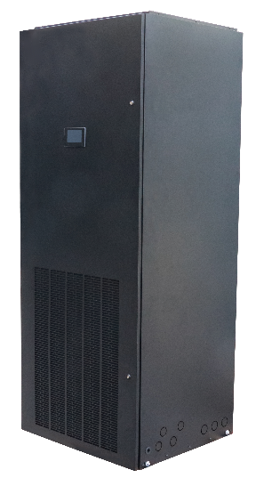
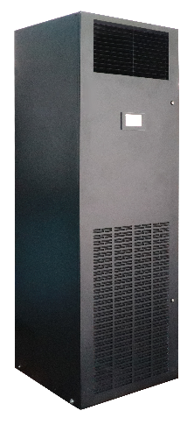
中小型机房空调介绍/Cabinet Type Precision Air Conditioning
中小型机房空调/Cabinet Type Precision Air Conditioning
冷量范围：风冷 5.6~20kW（MSHCU06/08/12/16/20）
Cooling capacity range: Air cooled 5.6~20kW(MSHCU06/08/12/16/20)
机组型式：单冷型、单电加热型、恒温恒湿型
Model: Only cooling, Only e-heating, Constant temp. and humidity
送风方式：带风帽前送风、上送风（接风管）
Air supply model: With air hood front supply, Up flow(connect with duct)
适用场合：小型数据机房、通信基站、服务器机房等
优势特点：/Advantage: high efficiency, intelligent control system, multi protection, R410a refrigerant, 0.9 sensible heat factor, auto re-start after power failure
高效节能
智能控制系统
多种保护功能
环保型冷媒R410A
0.9以上高显热比
来电自启动

Slide 5
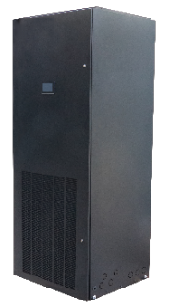


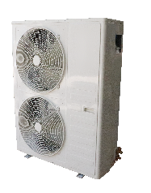
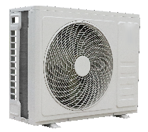
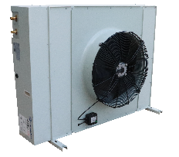
中小型机房空调外观/Cabinet Type PAC Outline
IDU Model | MSHCU06 |  | MSHCU08 | MSHCU12 | MSHCU16 |  | MSHCU20
IDU PIC
Footprint | 0.25㎡ |  |  | 0.36㎡ | 0.56㎡
ODU Model | MSACU06S | MSACU08S |  | MSACU12S | MSACU16S | MSACU20S
ODU PIC

Slide 6
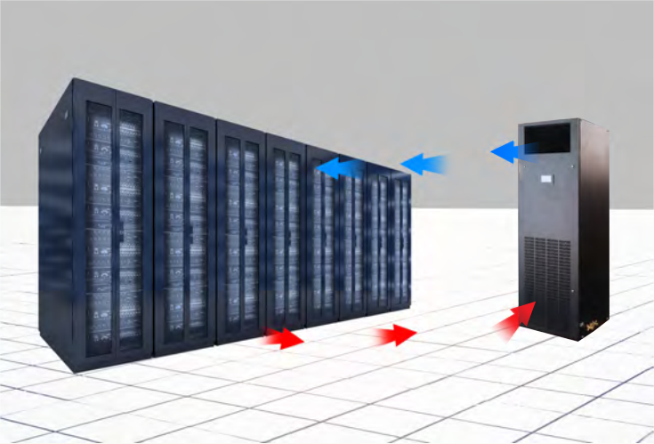
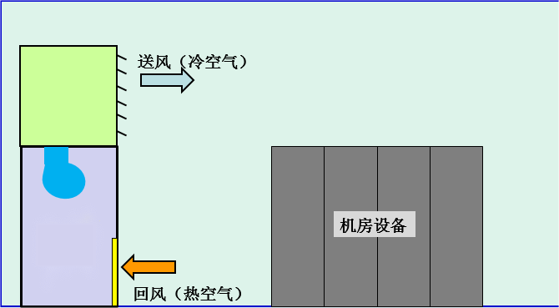
中小型机房空调应用方案/Cabinet Type PAC Solution
Air hood supply
MSHCU06/08/12
MSHCU16/20 Optional
带风帽前送风
With air hood front supply
Supply air
Return air
Equipment

Slide 7
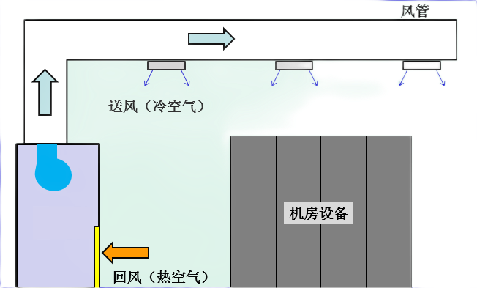

中小型机房空调应用方案/Cabinet Type PAC Solution
上送风（接风管）
Up flow(connect with duct)
Duct
Supply air
Return air
Equipment
Duct air supply
MSHCU16/20

Slide 8
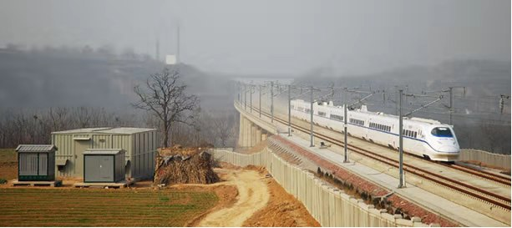

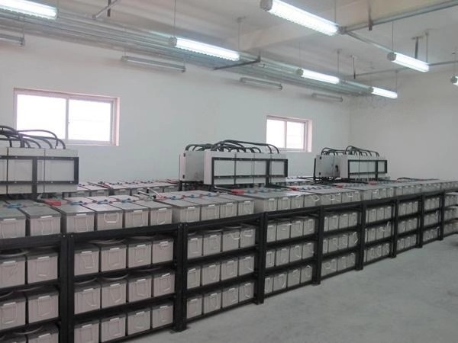
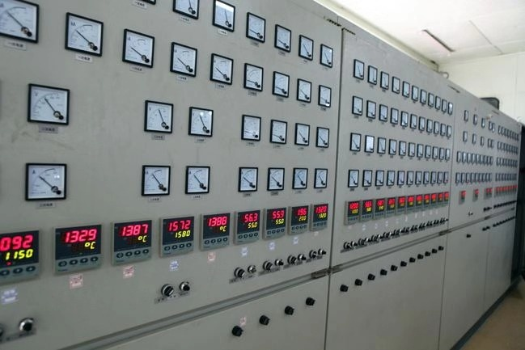
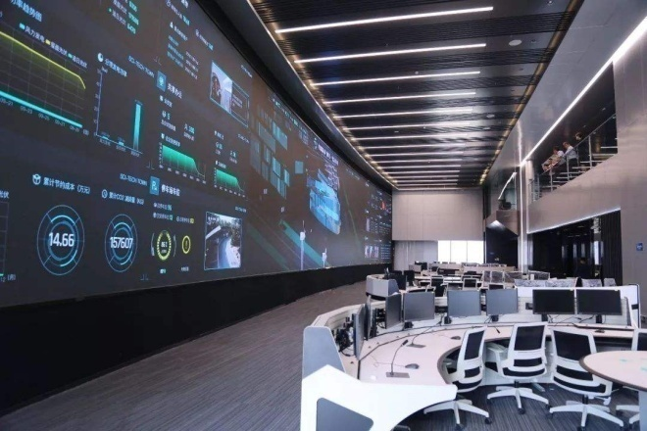
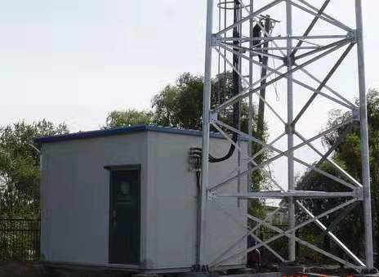
中小型机房空调应用场合/Cabinet Type PAC Application
中继站
Rely station
IDC机房
IDC Room
UPS室
UPS Room
配电所
Distribution substation
控制中心
Control Room
沿线基站
Base station

Slide 9
中小型机房空调优势特点/Cabinet Type PAC Advantage
全系列一级能效/First class efficiency
大风量，小焓差，高显热比/High air flow, small enthalpy difference, high sensible heat factor
高效环保型R410A制冷剂/R410a refrigerant
01
高效节能
High efficiency
Engery saving
02
占地面积小，全正面维护/Small size, front maintenance
最低满足-40℃运行环境温度/Lowest operating ambient -40C
灵活配置
Felixable
configuration
03
故障自诊断，多种保护和告警/Fault self-diagnosis, multiple protection and alarm
掉电参数记忆，来电自启动/Power failure parameters memerized, auto re-start
365天×24小时不间断运行/365 day x 24 h continuous operating
高可靠性
High
Reliability

Slide 10
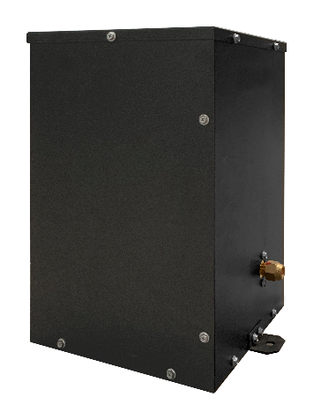
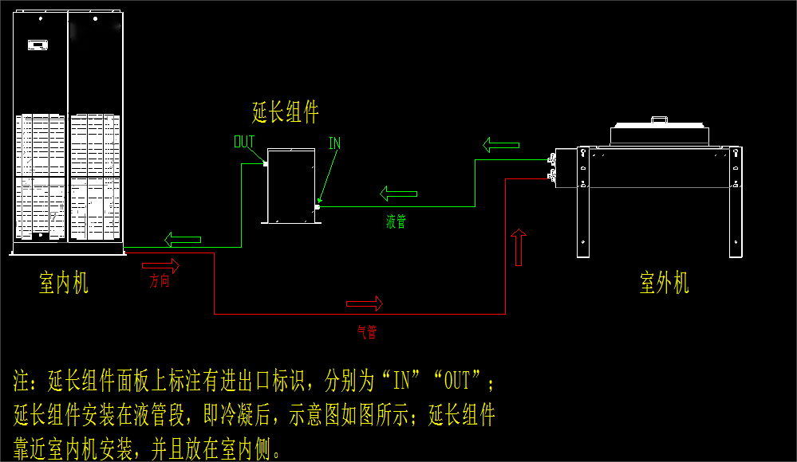
中小型机房空调注意事项/Cabinet Type PAC Notification
延长组件、低温组件（选配）
Extension kit, low ambient kit(optional)
延长组件：MSHCU06/08等效连管长度最长满足30m，MSHCU12/16/20等效连管长度最长满足50m。
由于考虑压缩机回油和冷媒管液柱问题，内外机高差超过5m请与厂家确认。
Extension kit: MSHCU06/08 max. equivalent pipe length 30m, MSHCU12/16/20 max. equivalent pipe length 50m.
Considering the issue of compressor oil return and refrigerant pipe liquid column, if the vertical distance between IDU and ODU exceeded 5 m, please consult factory.
低温组件：室外温度低于-15℃时需选配，最低能满足-40℃的环境下机组正常运行。
Low ambient kit: Outdoor ambient lower than -15C need this option, the lowest operating ambient is -40C.

Slide 11
竞品对比/Competitive Analysis
Components | DB | CANATAL | Envicool | Hisence | Midea | Gree | DunAn
Throttling | EEV | TXV | EEV | / | TXV | EEV | TXV
Circuit | Single | Single | Single | Single | Single | Single | Single
Refrigerant | R410A | / | R410A | R410A | R22/R410A | / | R22/R410A
Supply/return air type | Front supply&return Up supply, front return | Front supply&return Up supply, front return | Up/down flow | Front supply&return | Front up supply/Wide angle supply | Front supply&return Down flow | Front supply&return Down flow
Temp. control range | 16~30±1℃ | / | / | / | / | 17~28±1℃ | 17~28℃
Humidity control range | 30~70±5% | / | / | / | / | 40~60±5% | /
Outdoor operating ambient | -15~48℃ （low ambient kit to -40℃） | / | -15~45℃（low ambient kit to -40℃） | / | -20~48℃ | -35~48℃ | -20~45℃（low ambient kit to -40℃）

Slide 12
竞品对比/Competitive Analysis
Components | DB | CANATAL | Envicool | Hisence | Midea | Gree | DunAn
Function | 1.H/L pressure protection 2.H/L temp. protection 3.H/L humidity protection 4.Motor overload 5.Phase protection 6.Manual control 7.Power failure memorize 8.Regular rotation 9.ModBus RS485 protocol 10.Timing on/off 11.Auto re-start up | 1.Phase protection 2.ModBus RS485 protocol 3.Auto re-start up | 1.ModBus RS485 protocol, TCP/IP、SNMP as option 2.GPRS module as option, auto message function 3.Phase protection 4.Auto re-start up 5.Time-lapse start up | 1.Phase protection 2.Auto alarm 3.Diagnose function | 1.H/L pressure protection 2.H/L temp. protection 3.H/L humidity protection 4.Motor overload 5.Phase protection 6.Manual control 7.Power failure memorize 8.Timer 9.Anti-lighting option 10.ModBus RS485 protocol | 1.Power failure memorize | 1.Leakage alarm as option 2.ModBus RS485 protocol

Slide 13
房间级机房空调
Room Class Precision Air Conditioning

Slide 14
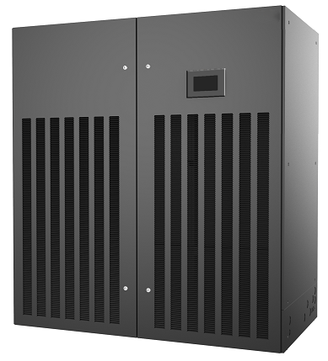
房间级机房空调介绍/Room Class Precision Air Conditioning
房间级机房空调/Room Class Precision Air Conditioning
冷量范围：风冷/水冷25~100kW 冷冻水30~200kW
Cooling capacity: AC/WC 25~100kW CHW 30-200kW
机组型式：单冷型 恒温恒湿型
Model: Only cooling, Constant temp. and humidity
冷却形式：风冷 水冷 单/双盘管冷冻水 双冷源
Cool mode: AC WC Signle/duel CHW Dual cold source
送风方式：上送风 下送风 下沉风机送风
Air supply mode: Up flow, Down flow, Underground supply
适用场合：中大型数据机房 工业控制室 精密配电室
Application: Big/medium data center, Industrial control room,
Precision power distribution room
优势特点：Advantage: high efficiency, 92% higher sensible heat factor,
modular design, front maintenance, multiply cool mode and air supply
一级能效
92%以上高显热比
模块化设计
100%正面维护
冷却方式灵活多样
送风方式多样

Slide 15
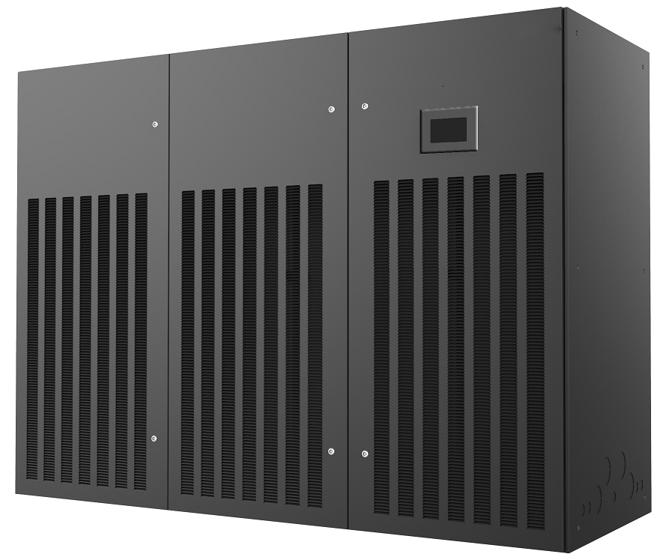
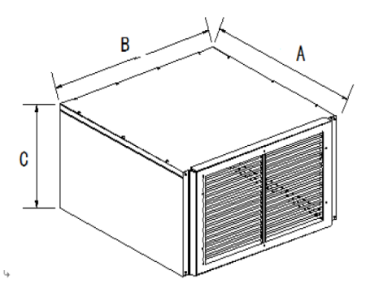
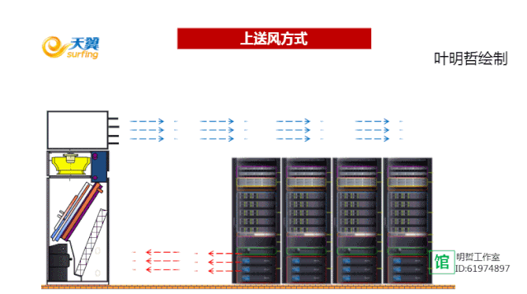
房间级机房空调应用场合/Room Class PAC Application
三种常规送风方式: 风帽上送风
Three types of air supply: Air hood front flow

Slide 16
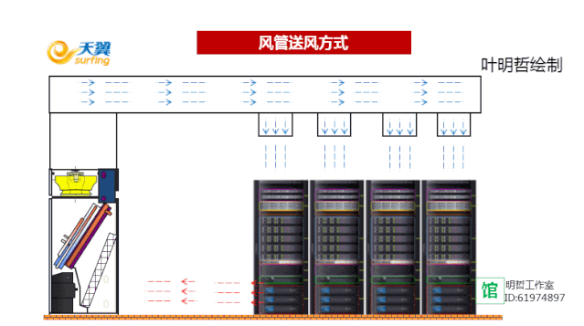
房间级机房空调应用场合/Room Class PAC Application
三种常规送风方式：风管上送风
Three types of air supply: Duct up flow
Duct supply

Slide 17
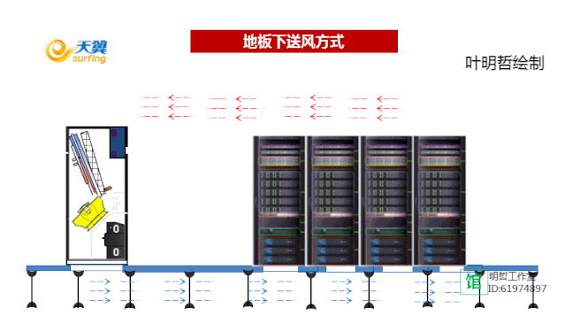
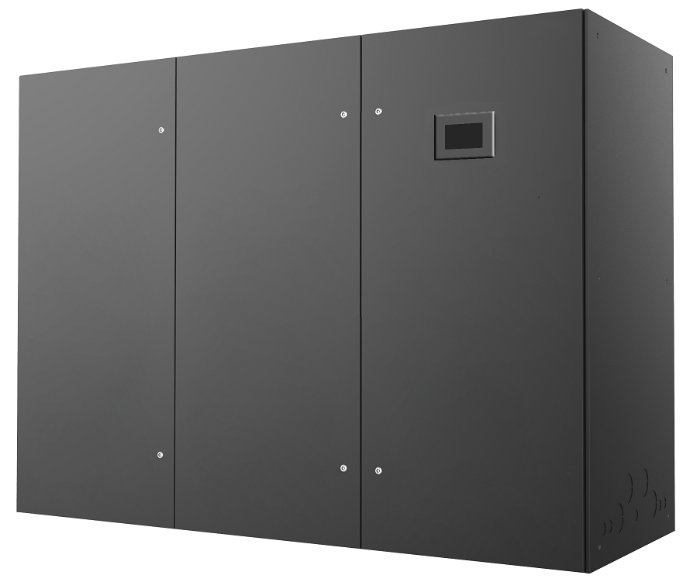
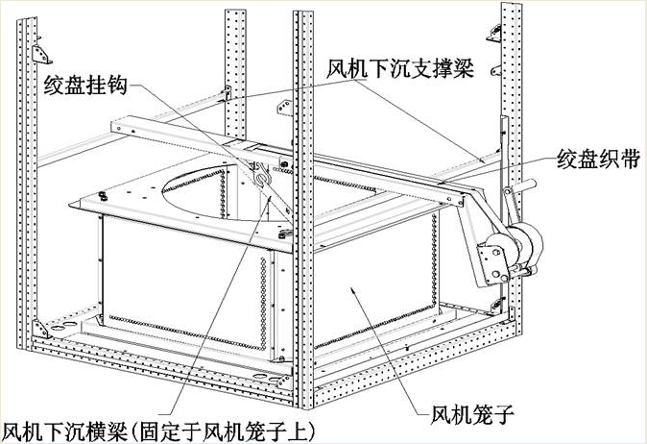
房间级机房空调应用场合/Room Class PAC Application
三种常规送风方式：下送风/下沉送风
Three types of air supply: Down flow/Underground flow
Underground flow

Slide 18

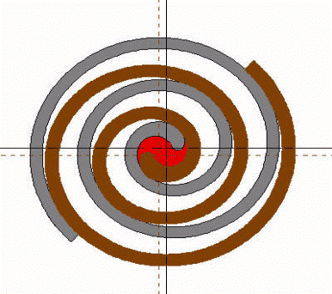
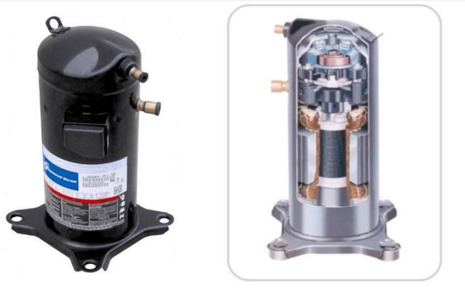
房间级机房空调特点/Room Class PAC Features
涡旋压缩机
Scroll Compressor
Less moving parts, lower noise and vibration
EMERSON
(COPELAND)
Low start up current
No H/L pressure valve, high reliability of liquid hammer
No clearance volume, high efficiency of compressor

Slide 19
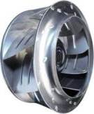
房间级机房空调特点/Room Class PAC Features
EC风机下沉送风设计，进一步节能5%
EC fan sinking air supply design, further energy saving 5%
高效EC风机
High efficiency EC fan
直联离心式EC风机
Direct link centrifugal EC fan
Large volume of air, long distance of air supply
EC fan can be fully adjustable, external static pressure 0-400Pa adjustable
风量大，送风距离远
EC风机可全调速，机外静压0-400Pa可调

Slide 20
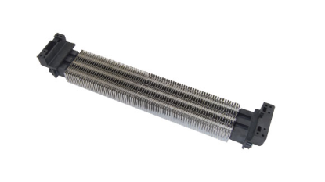
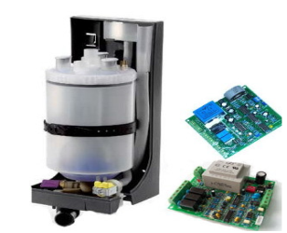
房间级机房空调特点/Room level air conditioning features
PTC电加热器
弥补除湿中的热损失
加热时不发红，无明火
PTC electric heater
Compensate for heat loss in dehumidification
No redness when heated, no open flame
插拔更换方便维护
温度自反馈调节
Easy maintenance
Temperature self-feedback regulation
电极加湿器
可拆卸 维护简单
体积小 便于拆装
Electrode humidifier
Removable for easy maintenance
Small size for easy disassembly
可冲洗 结构简单
加湿量大 效率高
Flushable structure is simple
High humidification capacity and high efficiency

Slide 21
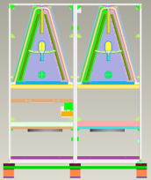
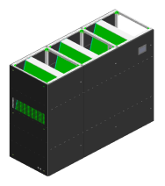

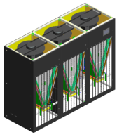
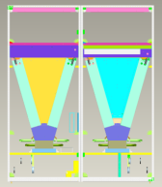

房间级机房空调特点/Room level air conditioning features
模块化设计/Modular design
功能模块化
Compressor module Evaporator module Electronic control module function independent, interference isolation
Functional modularity
容量模块化
Based on single module cooling capacity, increase module expansion cooling capacity
Capacity modularization
下送风机组/down floor air supply
结构模块化
The module structure is the same, reducing the structural cost and facilitating disassembly
Structural modularization
部件模块化
The main components of each module are the same, reducing the types of spare parts and maintenance costs
Component modularization
上送风机组/up floor air supply

Slide 22
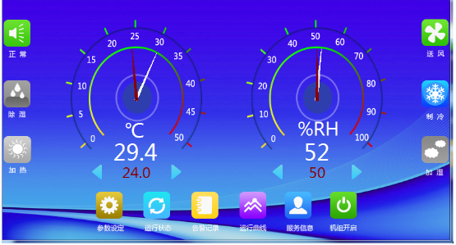
房间级机房空调特点/Room level air conditioning features
群组可达32台联动
定时轮巡、故障自动切换、避免竞争运行
按需群组最低能耗运行
先进智能控制器/Advanced intelligent controller
节能先进
Advanced in energy conservation
Groups can be up to 32 linkage units
Periodic rotation, automatic fault switching, avoid competitive operation
On-demand group operation with minimum energy consumption
网络管理
Network management
Easy maintenance
维护方便
标配RS485接口和 Modbus协议
Standard RS485 interface and Modbus protocol
Graphical display, human interface
Up to 500 alarms can be stored
Fault and maintenance information is automatically displayed
图形化显示，人性化界面
可储存500条告警信息
故障及维护信息自动提示

Slide 23
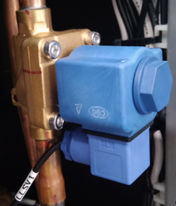
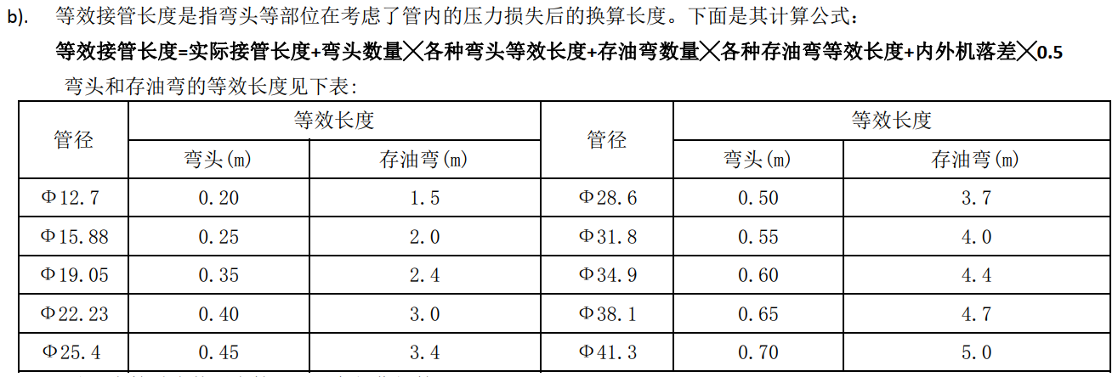
房间级机房空调特点/Room level air conditioning features
延长组件的电磁阀出厂已安装进内机，现场需安装单向阀在室外机的气管进口处。
内外机之间等效连管长度＞30m时需选配，最大可满足50m：
The electromagnetic valve of the extension component has been installed into the internal unit before leaving the factory, and a one-way valve needs to be installed on site at the air pipe inlet of the outdoor unit.
When the equivalent pipe length between internal and external machines is greater than 30m, it needs to be selected, and the maximum length can meet 50m:
由于考虑压缩机回油和冷媒管液柱问题，外机在内机上方最多20m，外机在内机下方最多-5m
Due to the consideration of compressor oil return and refrigerant pipe liquid column issues, the maximum height above the inner unit of the external unit is 20m, and the maximum height below the inner unit of the external unit is -5m
延长组件（选配）/Extension assembly (optional)
等效连管长度=实际接管长度 + 弯头数量*弯头等效长度 + 存油弯数量*存油弯等效连管长度 + 内外机落差*0.5 /Equivalent connecting pipe length=actual connecting pipe length+number of elbows * equivalent length of elbows+number of oil traps * equivalent connecting pipe length of oil traps+internal and external machine drop * 0.5

Slide 24
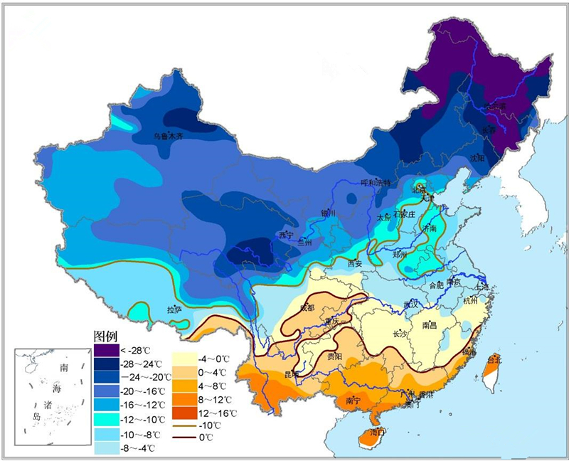
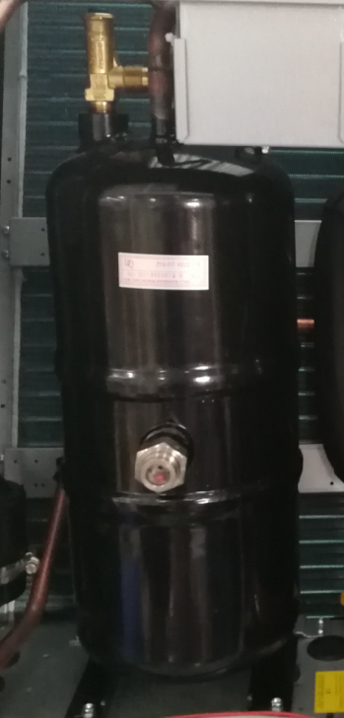
房间级机房空调特点/Room level air conditioning features
低温组件（选配）Low temperature components (optional)
When the outdoor temperature is lower than -15 ° C, it should be washed, and the unit can operate normally under the environment of -40 ° C
室外温度低于-15℃时需选配，最低能满足-40℃的环境下机组正常运行
包含储液罐、电磁阀、单向阀
Including liquid storage tank, solenoid valve, check valve
全国低温分布图/National low temperature distribution map

Slide 25
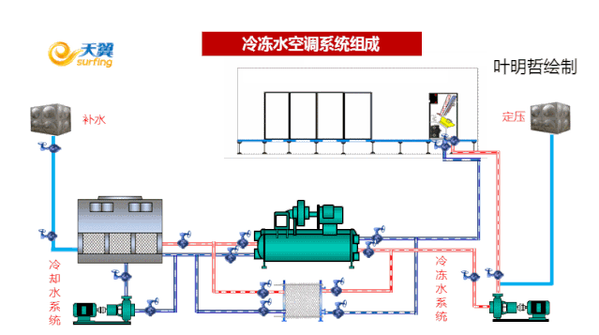
冷冻水房间级空调/Chilled water room level air conditioning
冷冻水房间级空调示意图/Chilled water room level air conditioning diagram
Constant pressure
Water replenishment
cooling water system
chilled water system

Slide 26

冷冻水房间级空调/Chilled water room level air conditioning
冷冻水房间级空调选型与环境工况很大关系，所以冷冻水房间级空调选型时需得知以下工况：
①回风工况
②冷冻水进出水温度
若考虑冷冻水主机，整体上冷冻水温度更高，整体的经济性会更好。冷冻水温度提升1℃，整体方案耗电量约降低3%
The selection of chilled water room level air conditioning is closely related to environmental conditions, so the following operating conditions need to be known when selecting chilled water room level air conditioning:
① Return air condition
② Temperature of chilled water inlet and outlet
If considering a chilled water host, the overall temperature of the chilled water is higher, and the overall economy will be better. Increasing the temperature of chilled water by 1 ℃ reduces the overall power consumption by approximately 3%

Slide 27
竞品对比/Comparison of competitors
部件 | DB | 佳力图 | 英维克 | 海悟 | 施耐德
节流装置 | 热力膨胀阀 | 电子膨胀阀 | 电子膨胀阀 | 电子膨胀阀 | 电子膨胀阀
压缩机 | 定频 | 定频/变频 | 定频/变频 | 定频/变频 | 定频/变频
电加热 | PTC | PTC | PTC | PTC | PTC
加湿 | 电极加湿 | 电极加湿/ 远红外加湿 | / | 电极加湿/湿膜加湿 | 电极加湿
温度控制范围 | 18~30±1℃ | / | 18~45±1℃ | / | /
湿度控制范围 | 40~70±5% | / | 20~60±5% | / | /
满足室外温度范围 | -15~45℃ （可选低温组件达到-35℃） | -20~45℃（可选低温组件达到-40℃） | -20~45℃（可选低温组件达到-40℃） | / | /

Slide 28
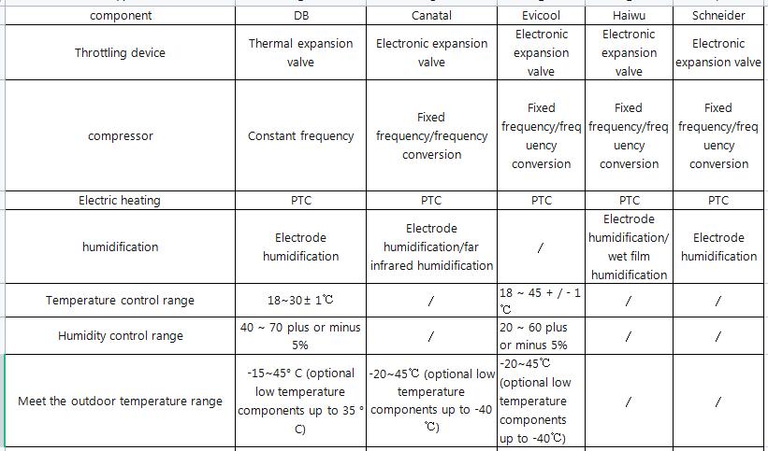
竞品对比/Comparison of competitors

Slide 29
竞品对比/Comparison of competitors
部件 | DB | 佳力图 | 英维克 | 海悟 | 施耐德
功能 | 1.高低压保护 2.高低温保护 3.高低湿度保护 4.电机过载保护 5.相序容错保护 6.手动控制 7.掉电记忆功能 8.定时轮值 9.标配RS485接口，提供ModBus协议 10.定时开关机 11.来电自启 | 1.双路电源输入 2.标配RS485接口 3. 手动、时序、自动延时启动 4.定时轮巡，互为备份 | 1.标配RS485接口，提供ModBus协议，支持TCP/IP、SNMP 2.掉电记忆功能 3.相序容错功能 4.来电自启 5.延时启动 | 1.相序容错 2.自动报警 3.诊断功能 | 1.高低压保护 2.高低温保护 3.高低湿度保护 4.电机过载保护 5.相序容错保护 6.显示主要部件运行时间 7.标配RS485接口，提供ModBus协议

Slide 30
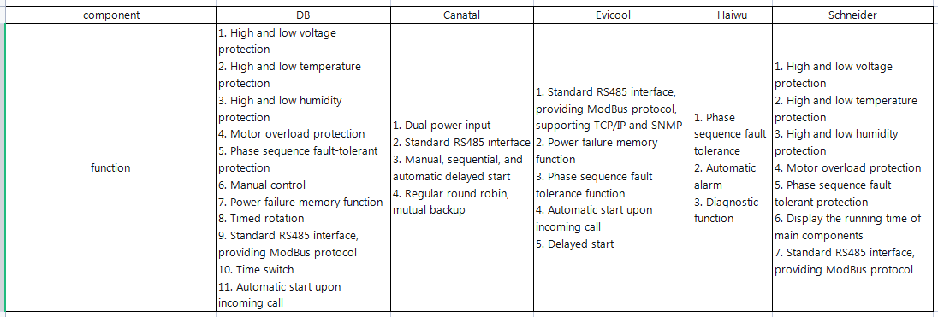
竞品对比/Comparison of competitors

Slide 31
Air conditioning in inter-row equipment room
列间级机房空调

Slide 32
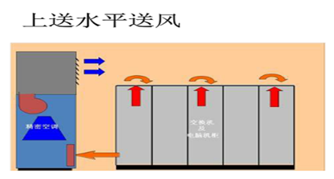
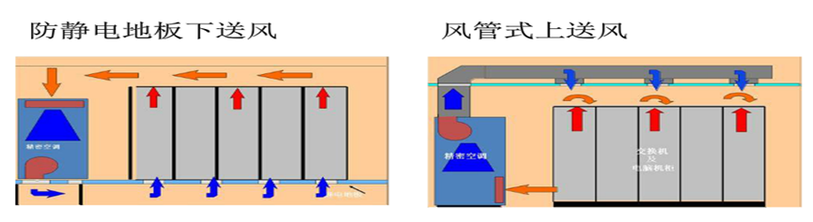
中小型数据中心现状/Status of small and medium-sized data centers
1
离热源远，换热效率低，耗电成本高
4
3
机房作为热通道，后期维护维修的环境温度较高
2
冷热风混合的区域多，热点多
机组尺寸较大，需要预留较大空间，美观性差
Far from the heat source, low heat exchange efficiency, and high power consumption cost
There are many areas where cold and hot air mix, and there are many hot spots
The computer room serves as a hot channel, and the environmental temperature for later maintenance and repair is relatively high
The unit size is large and requires a large space to be reserved, resulting in poor aesthetics
Horizontal air supply from the top Anti-static floor air supply from the bottom of the pipe air supply

Slide 33


机房空调设计趋势/Air conditioner design trends in the equipment room
Operation and maintenance standardization
Easy operation and maintenance, unified platform management, fault self-warning function, unattended
Green energy consumption
Environmentally friendly refrigerant, low PUE value, energy-saving technology, closed cold and hot channels;
Modular integration
Modular design, strong reserve, match the server cabinet, clean and beautiful
模块一体化
运维标准化
能耗绿色化
模块化设计，备用性强，匹配于服务器机柜，整洁美观
运行维护方便，可统一平台管理，实现故障自预警功能，可实现无人值守
环保冷媒，低ＰＵＥ值，采用节能技术，封闭冷热通道；

Slide 34
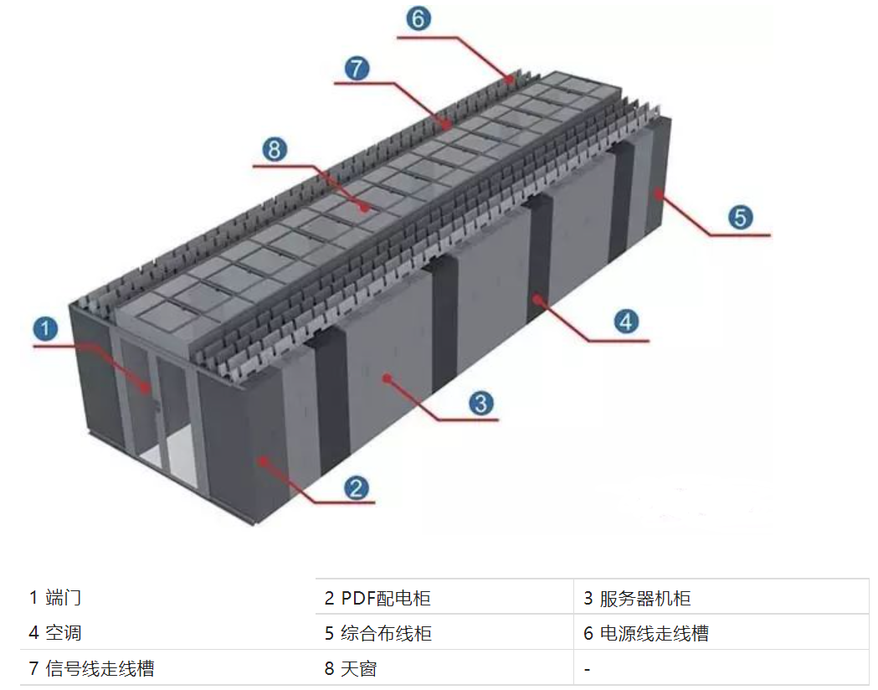
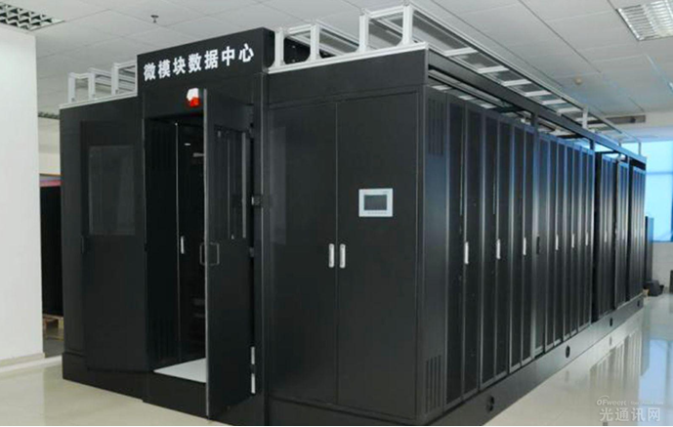
列间级机房空调应用场合/Application scenarios of air conditioning in an inter-column equipment room
应用场景/Application scenario
微模块数据中心/Micro-module data center
1 End door 2 PDF PDC 3 Server Cabinet
4 Air conditioner 5 General Cabling Cabinet 6 Power cable trough
7 Signal cable trough 8 Skylight

Slide 35
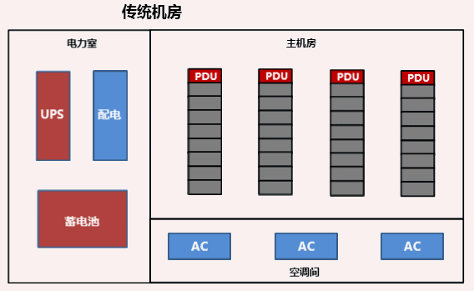
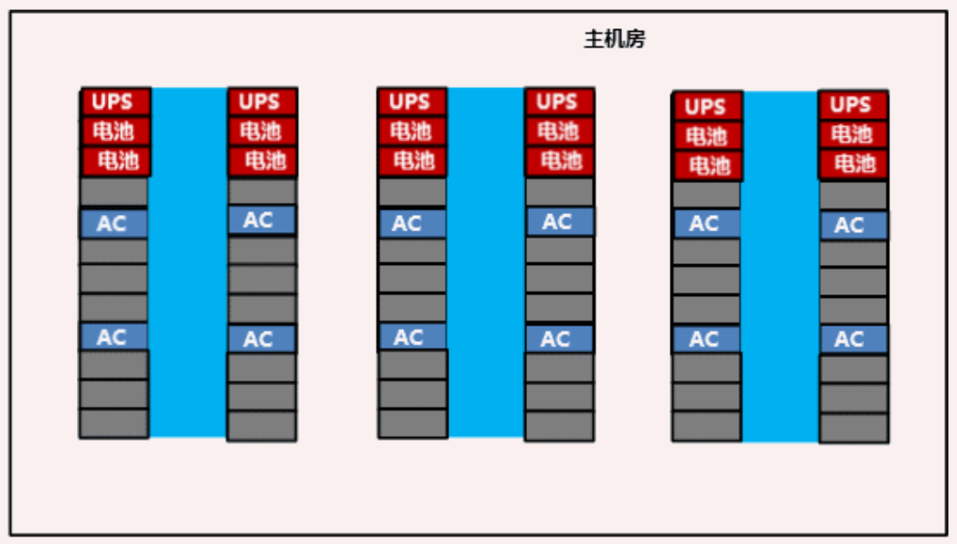
列间级机房空调应用场合/Application scenarios of air conditioning in an inter-column equipment room
传统房间级空调到微模块的演变
/· Evolution from traditional room-level air conditioning to micro-modules
Traditional machine room
Main machine room

Slide 36
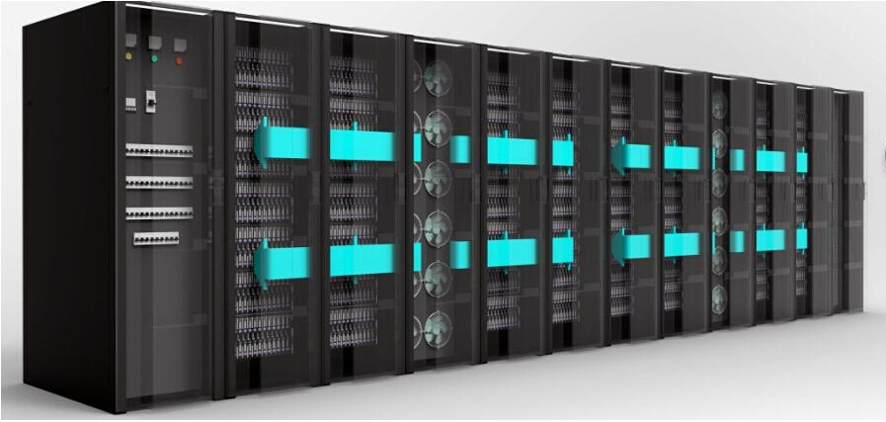
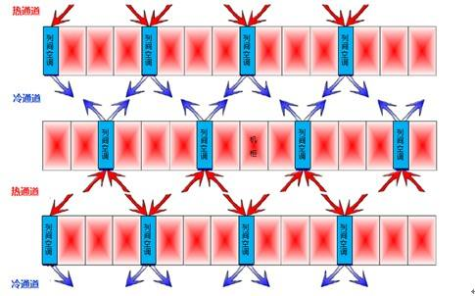
产品特点/.Product Features
紧靠热源，回风温度高，换热效率高
模块化设计，匹配于服务器机柜，美观性好
封闭冷通道，气流组织优，更好地减少热点产生
运行维护方便，可统一平台管理
Close to the heat source, high return air temperature, high heat exchange efficiency
Modular design, match the server cabinet, good appearance
Closed cold channel, excellent air flow organization, better reduce hot spot generation
Easy operation and maintenance, unified platform management

Slide 37
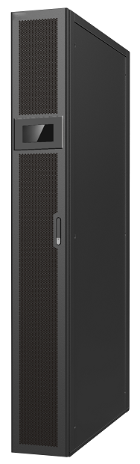

列间级机房空调/Air conditioning in inter-row equipment room
列间机房空调/Train room air conditioning
冷量范围：冷冻水25-70kW ；风冷25-60kW /Cooling capacity range: chilled water 25-70kW; Air cooled 25-60kW
机组型式：单冷型;恒温恒湿/Unit type: single cooling type; Constant temperature and humidity
冷却形式：冷冻水；风冷/Cooling form: chilled water; Air-cooled
压缩机形式：变频压缩机/Compressor type: variable frequency compressor
送风方式：水平前送风/Air supply method: Horizontal front air supply
机组尺寸：300/600 * 1100/1200 * 2000/2200/2500mm
Unit size: （宽*深*高）(width * depth * height)
适用场合： 中高密度机房、微模块数据中心等/Applicable occasions: medium to high density computer rooms, micro module data centers, etc
优势特点：
Advantages and characteristics:
高静压EC风机
全显热设计
紧靠热源设计
高效亲水铝箔膜
风机热拔插
可选双电源配置
High static pressure EC fan Full sensible heat design Designed close to heat source
High efficiency hydrophilic aluminum foil film The fan is hot removed and inserted Optional dual power supply configuration

Slide 38




列间级机房空调特点/Features of air conditioning in the inter-row equipment room
节能高效/Energy-saving and efficient
EC fan Variable frequency compressor Electronic expansion valve Stepless adjustment of outdoor units
EC风机
变频压缩机
电子膨胀阀
无级调节室外机
德国品牌风机EBM，安全可靠
根据环境温度调整负载，
高效节能
世界知名品牌：丹佛斯
反应速度快，
调节精度高
变频调速控制，节能降噪
German brand fan EBM, safe and reliable
Adjust the load according to the ambient temperature, high efficiency and energy saving
Frequency conversion speed control, energy saving and noise reduction
World famous brand: Danfoss has fast reaction speed and high adjustment accuracy

Slide 39

列间级机房空调特点/Air conditioning features of the inter-row equipment room
Low temperature component (optional) Extension Component (optional)
低温组件（选配）
延长组件（选配）
项目需求机组宽度是300mm还是600mm？是否应用于微模块里？
Is the width of the unit 300mm or 600mm? Is it used in micromodules?
需注意项目是需要上走管还是下走管
Pay attention to whether the project needs to be routed up or down
室外温度-15℃时需选配，最低能满足-40℃的环境下机组正常运行
内外机之间等效连管长度＞30m时需选配，最大可满足50m
选型时需注意微模块里是否有漏水检测
When selecting, pay attention to whether there is water leakage detection in the micro-module
Optional when the outdoor temperature is -15 ° C, it can meet the normal operation of the unit under the minimum environment of 40 ° C
Equivalent pipe length between inside and outside machine &gt; The maximum value is 50m

Slide 40
机房空调工程设计选型
Machine room air conditioning engineering design and selection

Slide 41


机房空调工程设计选型/Design and selection of air conditioning engineering in computer rooms
Accurate calculation based on residual heat and humidity, as well as changes in state
Heat dissipation of equipment in the computer room
Building maintenance structure heat gain
Solar radiation heat entering through external windows
Human body heat dissipation
Lighting device heat dissipation
Fresh air load
Latent heat generated during various dehumidification processes
Human body dehumidification
Fresh air load
根据余热余湿以及状态的变化进行准确计算
机房内设备的散热
建筑维护结构得热
通过外窗进入的太阳辐射热
人体散热
照明装置散热
新风负荷
伴随各种散湿过程产生的潜热
人体散湿
新风负荷

Slide 42

机房空调工程设计选型/Design and selection of air conditioning engineering in computer rooms
方法一：功率面积法
Method 1: Power area method
Qt=Q1+Q2
Qt 总冷负荷（kW）/total cooling load (kW)
Q1 室内设备冷负荷（=设备功率×（0.8~1））
indoor equipment cooling load (=equipment power × (0.8~1)
Q2 环境热负荷（单位面积冷负荷 ×机房面积）
environmental heat load (cooling load per unit area) × Machine room area)
注：单位面积冷负荷因实际使用城市的气候条件不同而不同，可按0.12～0.18kW/㎡估算。
Note: The cooling load per unit area varies depending on the actual climatic conditions of the cities used, and can be estimated at 0.12-0.18kW/㎡.

Slide 43
机房空调工程设计选型/Design and selection of air conditioning engineering in computer rooms
例如：某机房面积为30平方米，机房内布置8个机柜，单柜功率密度3.0kW，需配置多大冷量空调机组。/For example, a certain computer room has an area of 30 square meters and is equipped with 8 cabinets, with a single cabinet power density of 3.0kW. What is the required cooling capacity air conditioning unit.
Q1设备热负荷/Equipment heat load
机房内设备的耗电量最终均转化为热量，考虑到设备同时利用率、满负荷利用率等情况，一般取0.8－1系数。The power consumption of equipment in the computer room is ultimately converted into heat. Considering the simultaneous utilization rate and full load utilization rate of equipment, a coefficient of 0.8-1 is generally taken.
Q1=8*3.0×0.8＝19.2 kW
Q2 环境热负荷/environmental heat load
Q2＝30×0.15＝4.5 kW
Qt 总制冷量/Total cooling capacity
Qt =Q1+Q2=19.2+4.5=23.7 kW
配置建议：
Configuration suggestions:
机房内最少配置冷量为24kW的空调机组，建议采用3台12KW空调机组，2＋1备份。
The computer room should be equipped with a minimum cooling capacity of 24kW air conditioning units. It is recommended to use three 12KW air conditioning units with 2+1 backup.

Slide 44

机房空调工程设计选型/Design and selection of air conditioning engineering in computer rooms
方法二：面积法（当只知道面积时）
Qt= S×P
Qt 总制冷量（kW）
S 机房面积（ m2）
P 冷量估算指标
(根据不同用途机房的估算指标选取)
Method 2: Area method (when only the area is known)
Qt=S × P
Qt total cooling capacity (kW)
S machine room area (m2)
P cooling capacity estimation index
(Selected based on estimated indicators for different purposes of computer rooms)

Slide 45
机房空调工程设计选型/Design and selection of air conditioning engineering in computer rooms
不同使用场所冷负荷估算指标/Estimation index of cooling load in different places of use
Place of use
使用场所 | 估算指标（W/㎡）
电信交换机房、移动基站 | 350
数据中心 | 600~2000
计算机房、计费中心、控制中心 | 350
UPS、电池室、动力房 | 350
电子产品、仪表车间、精密加工车间 | 300
标准检测室、校准中心 | 250
医院和检测室、生化室、洁净室、实验室 | 200
博物馆、图书馆、档案馆 | 200
Estimation index
Telecommunication exchange room, mobile base station
Data center
Computer room, billing center, control center
UPS, battery room, power room
· Electronic products, instrument workshop, precision machining workshop
Standard testing room, calibration center
Hospitals and testing rooms, biochemical rooms, clean rooms, laboratories
Museums, libraries, archives

Slide 46

机房空调工程设计选型/Design and selection of air conditioning engineering in computer rooms
房间级空调方案展示/Room level air conditioning solution display
注意事项：
①依据现场条件选择机组形式：风冷型、水冷型、冷冻水型、双冷源型…
②建筑条件：内外机垂直落差、连管距离，室外机组布置条件，排水管、给水管（配电极加湿器）…
③环境条件：冷冻水型进出水温及回风工况、风冷型室外温度是否需配低温组件、海拔高度＜1000m…
④房间级空调建议单个房间N+1备用，具体根据机房规模及等级要求。
MSHCU
房间级空调
Precautions:
① Choose the unit type based on on-site conditions: air-cooled, water-cooled, chilled water, dual cooling source
② Building conditions: vertical drop between internal and external units, distance between connecting pipes, layout conditions of outdoor units, drainage pipes, water supply pipes (distribution pole humidifiers)
③ Environmental conditions: chilled water inlet and outlet water temperature and return air conditions, whether low-temperature components are required for air-cooled outdoor temperature, altitude<1000m
④ Room level air conditioning is recommended for a single room with N+1 backup, depending on the size and level requirements of the computer room.

Slide 47

机房空调工程设计选型/Design and selection of air conditioning engineering in computer rooms
列间级空调方案展示/· Display of intercolumn air conditioning solutions
MSHMC
列间级空调
MSHMC inter-row air conditioning

Slide 48
机房空调工程设计选型/Design and selection of air conditioning engineering in computer rooms
列间级空调方案展示
注意事项：
①依据现场条件选择机组形式：风冷型、冷冻水型、定制化方案…
②建筑条件：内外机垂直落差、连管距离，室外机组布置条件，排水管、给水管（配电极加湿器）…
③环境条件：冷冻水型进出水温及回风工况、风冷型室外温度是否需配低温组件、海拔高度＜1000m…
④封闭冷通道或封闭热通道
⑤建议一个微模块里列间级机房空调N+1备用 或 N+2备用,具体根据机房规模及等级要求。

Slide 49
机房空调工程设计选型/Design and selection of air conditioning engineering in computer rooms
列间级空调方案展示
/Display of intercolumn air conditioning solutions
Precautions:
① Choose the unit form based on on-site conditions: air-cooled, chilled water, customized plan
② Building conditions: vertical drop between internal and external units, distance between connecting pipes, layout conditions of outdoor units, drainage pipes, water supply pipes (distribution pole humidifiers)
③ Environmental conditions: chilled water inlet and outlet water temperature and return air conditions, whether low-temperature components are required for air-cooled outdoor temperature, altitude<1000m
④ Closed cold channel or closed hot channel
⑤ Suggest a micro module with N+1 backup or N+2 backup for air conditioning in a row level computer room, depending on the size and level requirements of the computer room.
1 End door 2 PDF PDC 3 Server Cabinet 4 Air conditioner
5 General Cabling Cabinet 6 Power cable trough 7 Signal cable trough 8 Skylight

Slide 50


THANK YOU
顿汉布什
唯进步，不止步！
Innovation…Never Ends!
顿汉布什 享誉世界的空调专家
DUNHAM-BUSH, YOUR COMFORT SPECIALIST！

