Slide 1
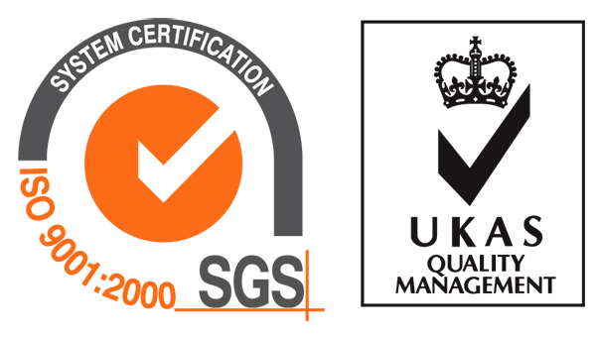
Clean Air Handling Unit
(CAHU)
Dunham-Bush (China) Co., Ltd.
- Since 1894 -
Dunham-Bush, Your Comfort Specialist!

Slide 2
Demands of Clean Environment

Slide 3
Demands of Clean Environment
Cleanliness Grade Standard (New Ed. GMP2010) Different Air Suspension Particles Standards
Grade | Static |  | Dynamic
 | Maximum allowed suspended particles per cubic meter air
 | ≥ 0.5μm | ≥ 5μm | ≥ 0.5μm | ≥ 5μm
A | 3520 | 20 | 3520 | 20
B | 3520 | 29 | 352000 | 2900
C | 352000 | 2900 | 3520000 | 29000
D | 3520000 | 29000 | N/A | N/A
Medical and Pharmaceutical Industry
Chinese new version of GMP standard requires no less than 10Pa pressure difference between clean and non-clean areas.
The temp. and relative humidity of A and B areas is 20-24C and 45-60%, C and D areas is 18-26C and 45%-65% respectively.
The general room noise level should be no greater than 60dB(A).
The air-conditioning purification system of the clean area which used for germfree drug production should be operating continuously.

Slide 4
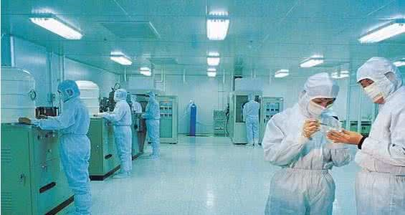
Demands of Clean Environment
Cleanliness Requirement of Electronic Workshop
Zone | Cleanliness Rating | ≥0.5um | ≥1um | ≥5um
SMT,OTP | N8.5 (300k grade) | 10,000,000 | 2,500,000 | 60000
AI/DIP workshop, marterial matching area, incoming inspection area, PCBA outgoing inspection area, original material warehouse，PCBA finished product hold area | N9 (1000k grade) | 35200000 | 8320000 | 293000
The Electronics Industry
According to the statistics, over ¼ of the global annual electronics rejects are related to humid environment.
In conductor device plant, the chip would be short out if there has a dust which size is only from 1/10 to 1/3 of the electrical route width falls on silicon substrate.
Static electricity occured when too low humidity and dry environment.
The rate of electronic finished products and stablility mainly depend on the purity of material and the cleanliness of manufacturing environment.

Slide 5
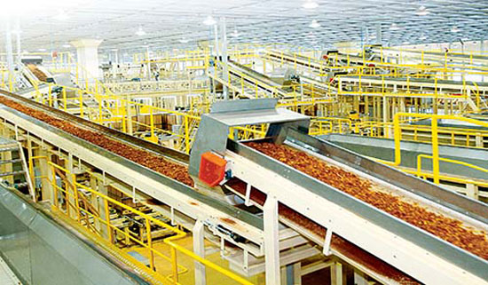
Demands of Clean Environment
Warehouse Indoor Air Temperature And Humidity
Name | Temperature (℃) | Relative Humidity (%)
Raw tobacco warehouse, flue-cured tobacco stem warehouse | ≤38* | ≤70*
Accessories warehouse | --- | ≤70*
Cigarette finished product warehouse | ≤32 | 50-70*
Flue-cured tobacco alcoholized warehouse | ≤38*，10-30** | ≤70*，55-65**
Note: “*” means safety store condition and “**” means condition of suitable alcoholization.
Tobacco Industry
The workshop machines generate a lot of heat. Tobacco and tobacco shred has a strict requirement on air humidity which the RH should be higher than 80%.
The storage temp. of tobacco should be 21-24C and RH 60%-70%. Once the humidity is lower than that, the tobacco will be start to dry out.
There has high dust concentration in workshop which the dust is sticky and corrosive.
The temp. and RH mearsuement of inner tobacco stack are hard to be in time, exact and stable.

Slide 6
Clean Air Handling Unit (CAHU) Characteristics

Slide 7
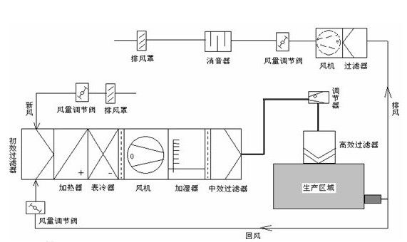
CAHU Operating Principle
In order to maintain the required indoor temp. and humidity, air velocity, pressure and cleanliness, the most common method is supplying a certain amount of treated air into the cleanroom continuously to eliminate hot and humid interference and dust pollution.
Industries that require clean air technology
Precision Machinery
Electronics
Aerospace
Chemical
Atomic Energy
Printing
Photograph
Food
Pharmaceutical
Medical
Zoo Facility
Biosecurity
Bearing
Integrated circuit
High reliability
High purity
High purity and precision, pollution prevention
Plate-making, ink, pollution prevention
Film production, photo, plate-making
Prevent metamorphic, bacteria and mold
High purity, sterile preparation
Operating room, leukemia treatment room, burn ward
Sterile animal breeding, clean laboratory
Biosecurity laboratory
Exhaust hood
Silencer
Air damper
Blower Filter
Preliminary filter
Adjuster
Air damper Exhaust hood
Exhaust air
Preliminary filter
HEPA
Heater Cooling coil Blower Humidifier Secondary filter
Product area
Air damper
Return air

Slide 8
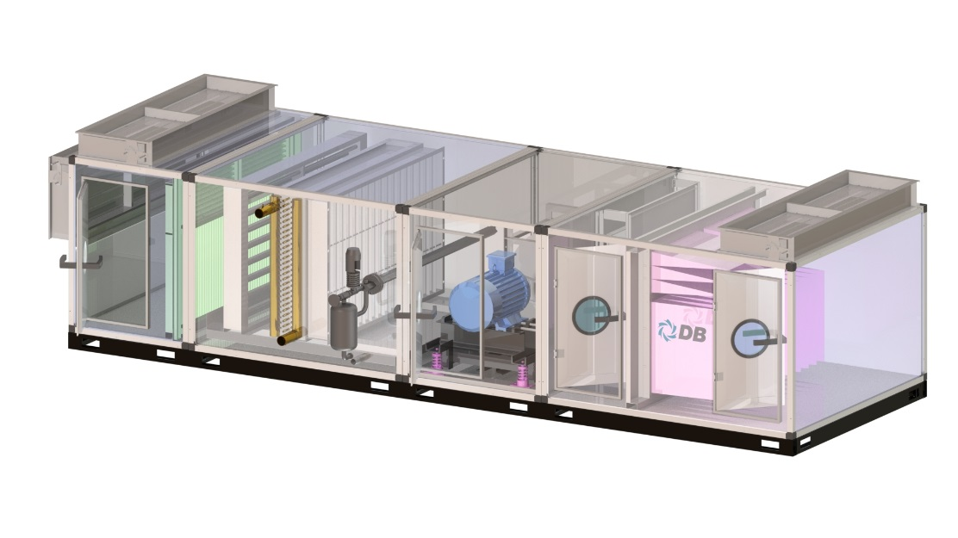
Product Overview
Ultra low Leakage Rate
Cold Bridge Resistant
45 degree panel splicing, aluminum sheet groove fastening with bolt nut connection, forming a tight labyrinth structure to ensure lowest unit leakage rate.
High-pressure polyurethane foam provides a full thermal isolation.
1500-120000m³/h
2.5Mpa Pressure Test
Smooth Inner Surface
High Mechanical Strength
45 degree panel splicing without gap, smooth inner surface no dust accumulation.
Groove fastening with bolt nut connection ensures a strength frame for torsion resistance.
Bare Stainless Steel Tube Electric Heater
Anti-rust Casing
Multiple Functional Sectors
Modular Design
Effectively inhibit bacterial on components and resistant to disinfectant cleaning.
127mm modular design for each sector, optional installation form: horizontal, vertical and ceiling.
Around the panel fully covered by aluminium alloy around the panel to isolate the wet air.
More than 30 kind sectors, such as cooling, heating, filtration, humidification, silencer, heat recovery, purification etc.

Slide 9
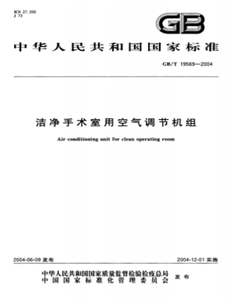
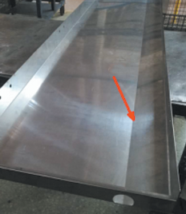
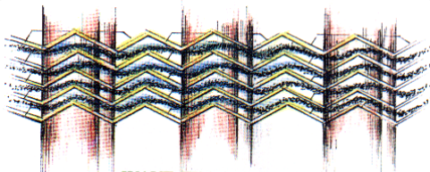
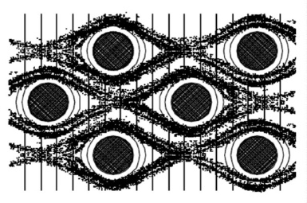
Purification Standard
Professional design based on the Chinese National Standard GB /T19569-2004 “Clean Operating Room Air Conditioning Unit”
Unique design of long drain pan with slope and drained cells ensures no hydrops and less bacteria.
Unique self-cleaning ripple structure, less dust accumulation and dramping on air flow and capacity for long term operating.
Heat exchange tube counter flow cross distributed enhanced air turbulent flow which improves the heat exchange efficiency.

Slide 10
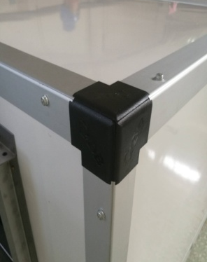
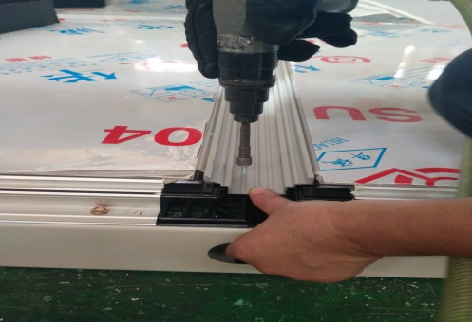
Labyrinth Casing Structure
Cold Bridge Resistant: Aluminum sheet, internal and external plate combined by high-pressure polyurethane foam as a whole. The gap between inner panel and aluminum sheet is sealed by insulated seal strip which fully isolated inner plate with outside avoiding the cold bridge.
Ultra Low Leakage Rate: 45 degree panel splicing, aluminum sheet groove fastening with bolt nut connection, forming a tight labyrinth structure to ensure lowest unit leakage rate.
High Strength Frame: Groove fastening with bolt nut connection ensures a strength frame for torsion resistance.

Slide 11
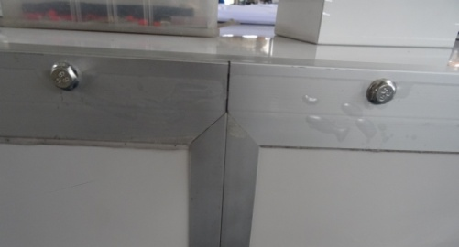
Labyrinth Casing Structure
Anti-rust Casing: To enhance the anti-rust performance, all panel parameters are by aluminum, sheet metal corners are completely isolated from wet air.
45 degree panel splicing without gap, smooth inner surface no dust accumulation. Standard sinusoidal anti-bacterial hydrophilic fin, effectively inhibit bacterial on components and resistant to disinfectant cleaning.

Slide 12
Positive Pressure Design
Adopting to positive pressure layout, filter, heat exchanger and humidifier are all in positive pressure section which strictly prevent external pollution and benefit for draining out condensing water to avoid bacterial breed.
Option1: Fan is in front of the two-staged filter
All sections are positive pressure at rear of the filter to avoid pollution by leakage.
The belt chips of blower won`t be caused pollution.
Diffuser is placed after the fan sector.
Option2: HEPA is rear of the fan
Rear of filter section is positive pressure to avoid pollution.
The belt chips of blower won`t be caused pollution.
Diffuser is placed after the fan sector.
Heat exchanger is in the front section.

Slide 13
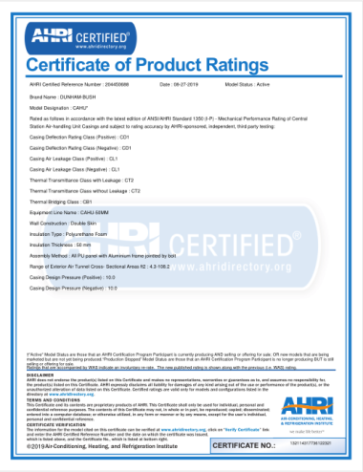
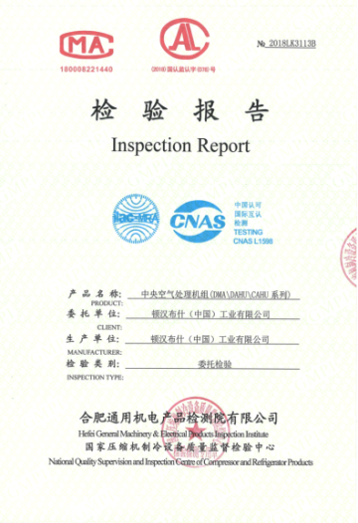
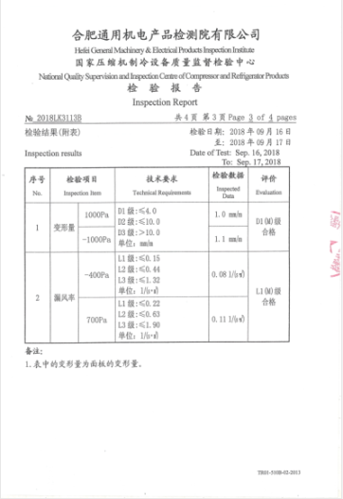
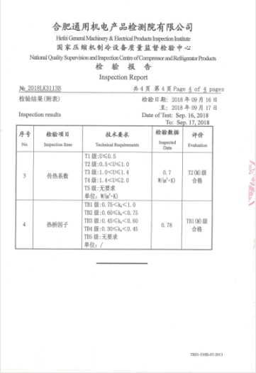
Certification and Test
AHRI Certificated Dunham-Bush Clean Air Handing Unit ensures the optimal performance and reliable quality for our customers.
Casing Mechanical Performance | EUROVENT EN1886 | USA AHRI 1350
Deformation Rate | D1 | CD1
Leakage Rate | L1 | CL1
Heat Transfer Coefficient | T2 | CT2
Hot Bridge Factor | TB1 | CB1
Hefei General Machinery Research Institute is a multidiscipline and comprehensive national class A scientific research institute under direct jurisdiction of China National Machinery Industry Corporation. According to EN1886:2007 standard, HGMRI tests the machnical characteristic of Dunham-Bush CAHU and the result is Dunham-Bush CAHU meets the EN1886:2007 standard.

Slide 14
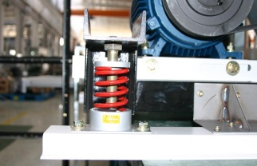
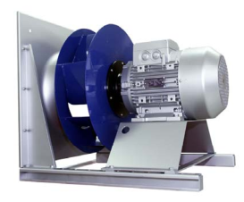
Low Noise Measures
Transmission parts are equiped with anti-shear spring vibration isolators
Plug fan (optional)
Low-noise three-phase asynchronous motor, protection class IP55, insulation class F
Air flow outlet connected with canvas
Insulated panel and silencer (optional)

Slide 15
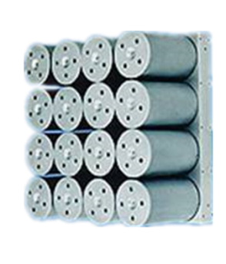
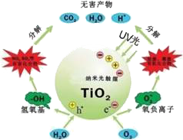
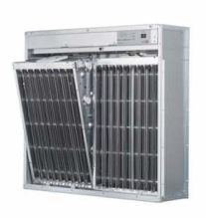
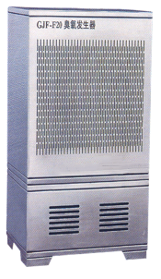
Fully Purification Options
Ultraviolet Light
Photohydrogen Purifier
Nano-Photocatalyst
High-pressure Static
Electrical Air Purifier
Ozone Generator
Formaldehyde Filter
Activated Carbon Filter
Primary Filter(G2~G4)
Medium Filter(F5~F8)
Sub High Efficiency Filter(F9~H11)
HEPA(H12~H17)

Slide 16
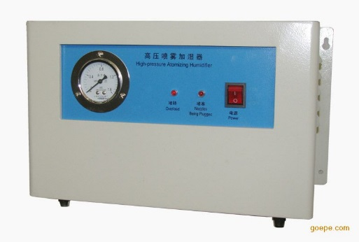
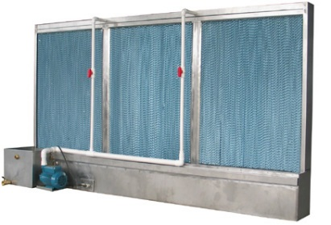
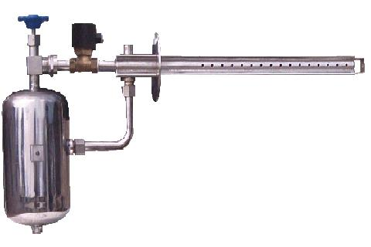
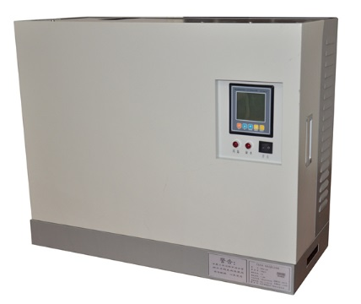
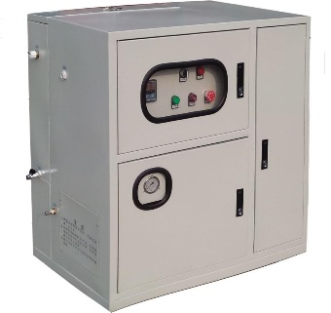
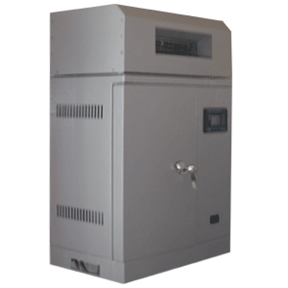
Humidity Control
Wet film humidifier
Dry steam humidifier
High-pressure spray humidifier
High-pressure micro-fog humidifier
Electrode humidifier
Electric humidifier

Slide 17
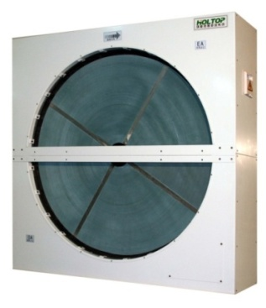
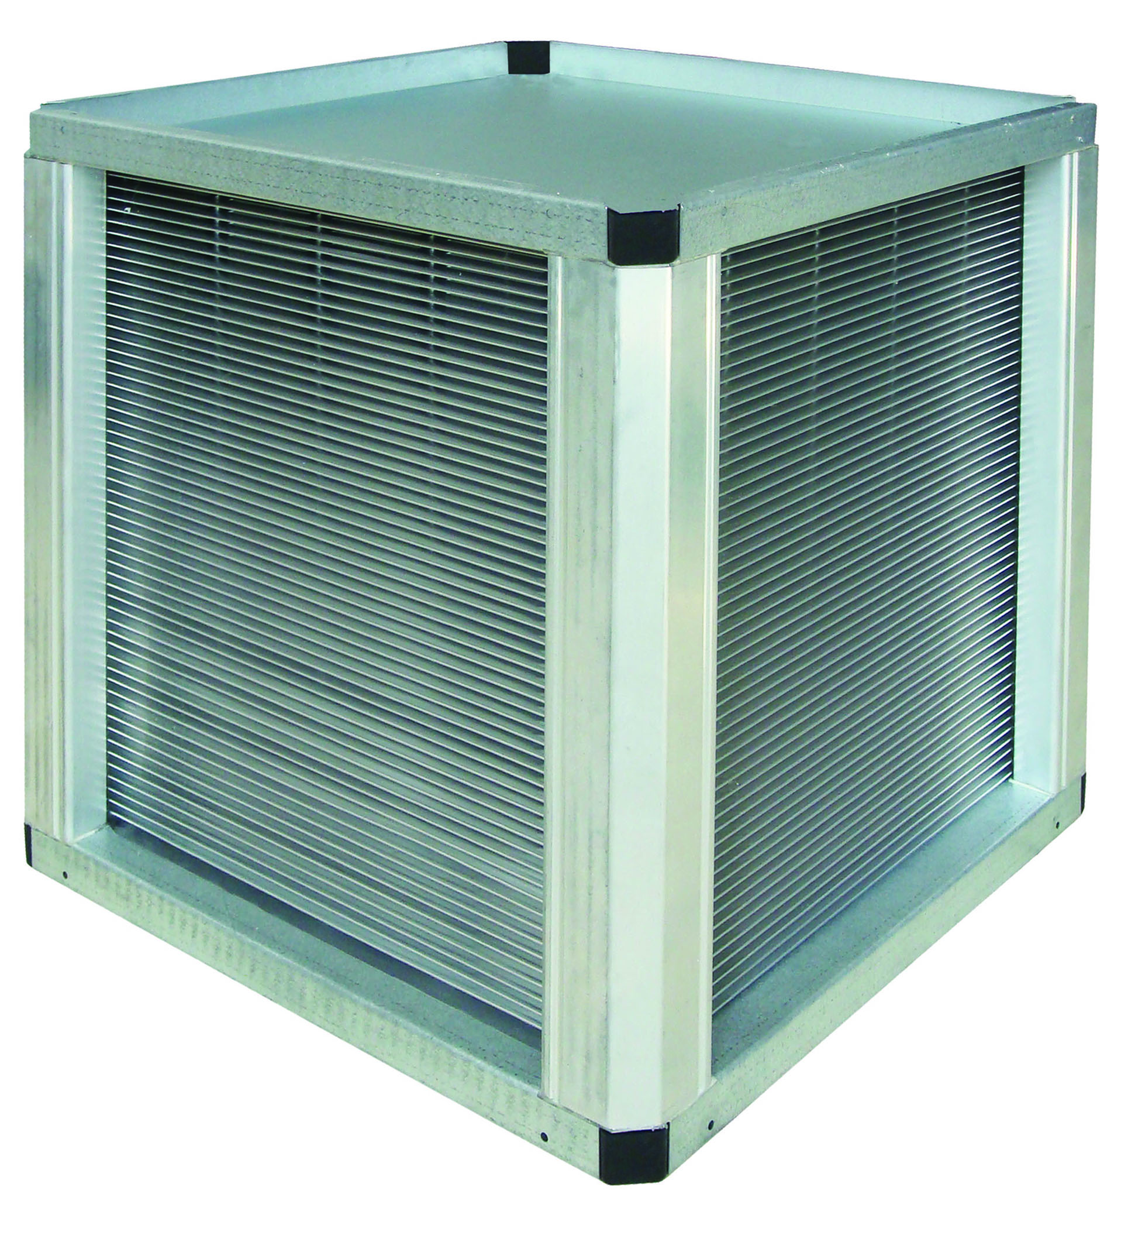
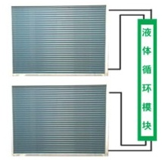
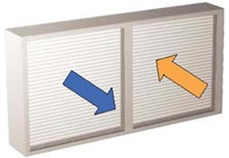
Heat Recovery
Heat Recovery Wheel: 70% heat recovery efficiency, self-cleaning and double surface cleaning, isolated pollution
Plate Heat Exchanger: Excellent performance of conductor, moisture permeability, corrosion resistance, aging resistance, compact structure, easy maintain
Ethylene Glycol Heat Recovery: Flexible layout and insallation, independent FA and RA system, safe and reliable
Heat Pipe Heat Recovery: compact structure, small footprint, low maintenance costs, flexible installation for multiple application
Equiped with various heat recovery options can reduce the AC system power consumption.
Heat recovery efficiency can up to 70% in winter.

Slide 18
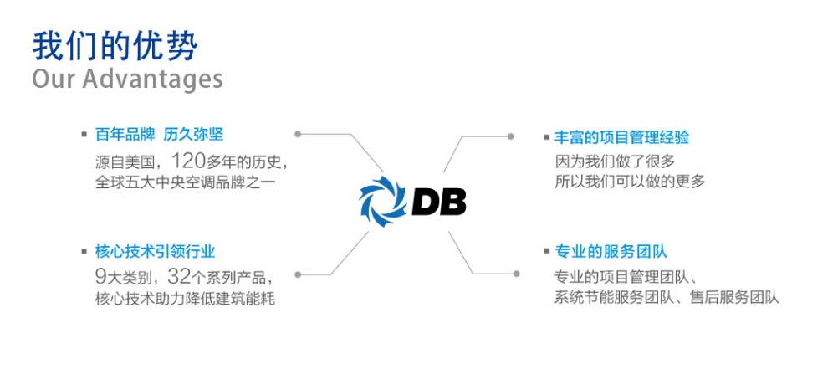
DB Cloud
Assist customer to improve AC system operation and maintenance management
Reducing the shut-down and trouble-shooting time.
Providing one-stop service
Assist customer to improve energy regulation performances
Assist cust
Assist cust
realized intelligent and precision control, low power consumption and high efficiency.
More than
120 yrs of history
Technology from USA
Experienced
and professional
7*24 hours online service
Alarm warning by email and message
9 categories
32 products series
Strong technical and service team
Applicable for IOS, Android and Windows
Remote monitoring, data and efficiency analysis and failure alarm reduce the building power consumption

Slide 19
Low Operating Expense
Item | Unit | Dunham-Bush | Other Brands
Rated Airflow Rate | CMH | 10000 | 10000
Rated Cooling Capacity | kW | 60 | 60
Leakage Rate | % | 0.68% | 3%
Airflow Loss | CMH | 68 | 3000
Cooling Capacity Loss | kW | 0.4 | 1.8
COP | - | 3 | 3
Electric Power Loss | kW | 0.13 | 0.6
Daily Electric Power Loss | kW·h | 1.3 | 6
Electricity Price | CNY | 0.8 | 0.8
Daily Electricity Expense Loss | CNY | 1.04 | 4.8
Annual Expense Loss | CNY | 380 | 1752
Saving Cost
Best Choice

Slide 20
CAHU Application and Solution

Slide 21
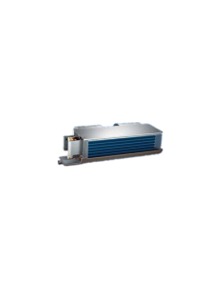
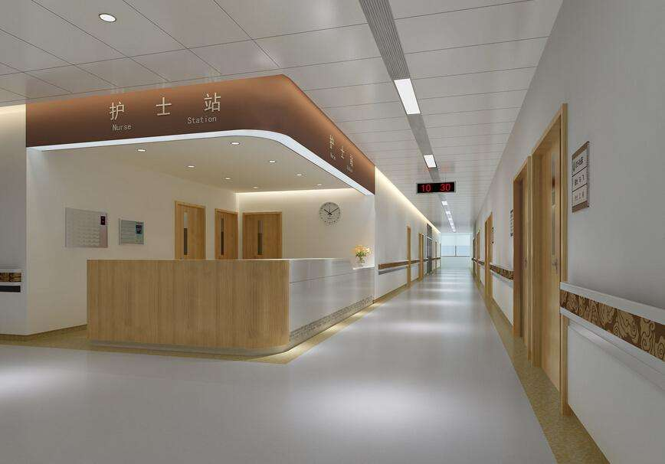
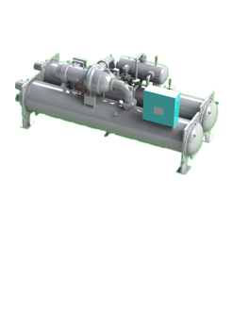
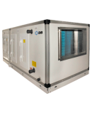
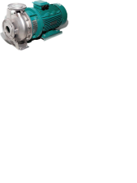
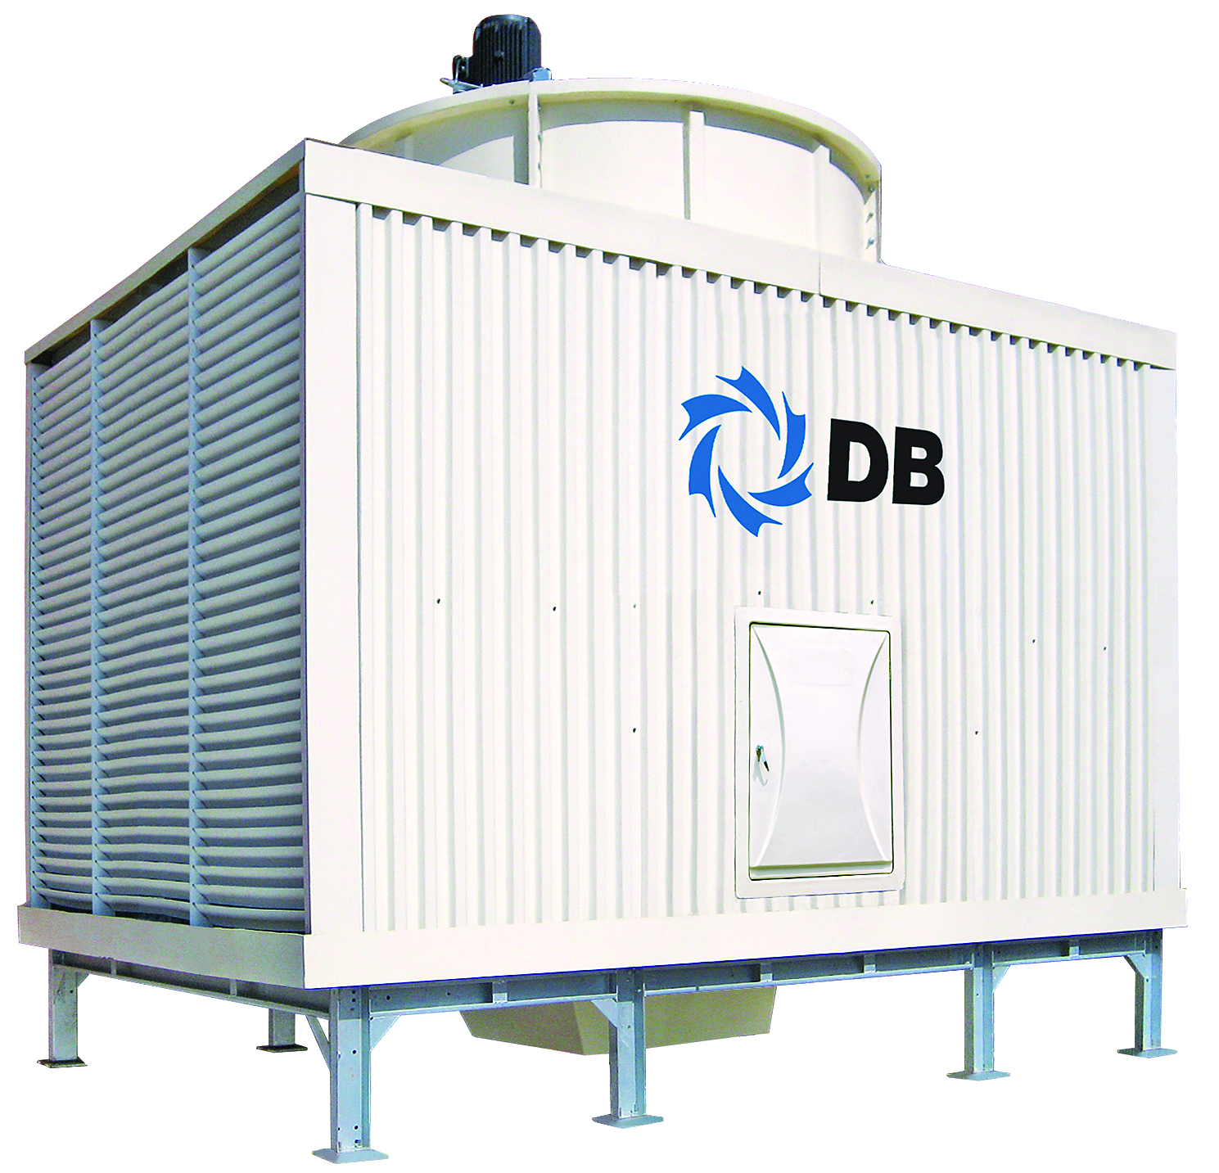
Classical AC System Solution
CRCF Ultra Quiet Fan Coil Unit
DCLC-M
Magnetic Centrifugal Chiller
Cooling Tower
CAHU
Water Pump
Energy Saving, Environmental-Friendly
Easy System
High Efficiency System
Comfortable AC Preferred Solution
VRF Flexible Application
Excellent Temp. and Humidity Control Performance

Slide 22
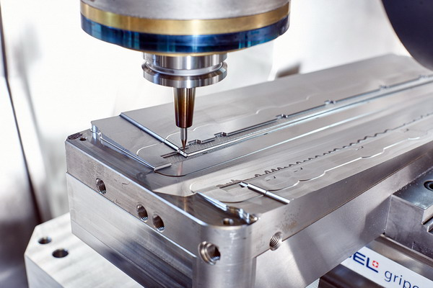
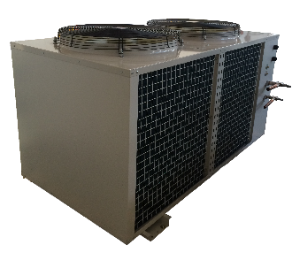
Fresh Air Direct-Expansion System
MSACC Air-Cooled CCU
CAHU Clean Air Handling Unit
Modular Design
High Efficiency
High Static Pressure and Air Flow Rate
Easy Installation and Maintenance
Energy-Saving on Water System
Simple Piping System
Applicable for electronic plant, exhibition center, food processing and etc.

Slide 23
Project Reference

Slide 24
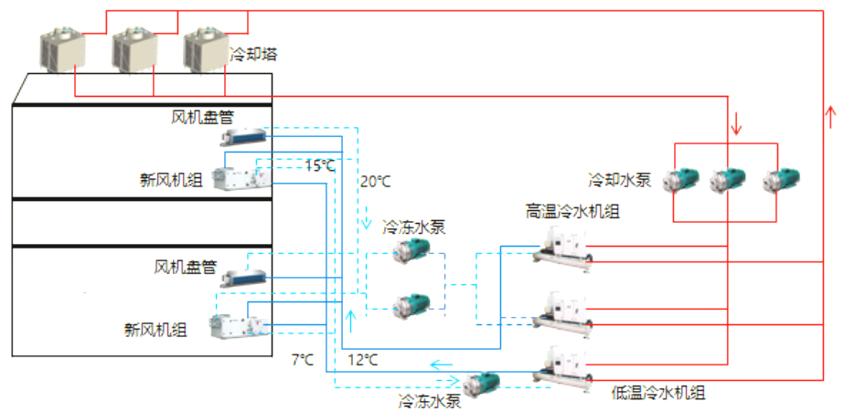
Dual Cold-Source Temp. and Humidity Control Purification Solution
Low temp. cold source supplies for the wet load of operating room; high temp. cold source supplies for cooling RA and parts of FA.
System Characteristic
Mature Technology, High Reliability
Flexible and Convenient Independent Fresh Air Supply System
Cooling Tower
FCU
Independent Temp. Control for Different Demands
Operating room 2
FAHU
CW Pump
CDW Pump
HT Chiller
High Efficiency, Low Operating Cost
FCU
Operating room 1
FAHU
Applicable for Clean Operating Room, ICU, Transplant Ward, Supplying Room, Distribution Center, etc.
CDW Pump
LT Chiller
Equiped with dehumidification wheel, Dunham-Bush CAHU can control air RH from 5% to 40% stably.

Slide 25
Commercial Complex
Dunham-Bush teamed up with Longhu Real Estate to create energy-efficient commercial buildings
Zhengzhou CBD Deputy Center - Longhu Financial Center is located in the middle of Longhu, Zhengdong New District, which covers an area about 15,000 km², connected with Zhengzhou CBD through a 3.7 km canal. It likes a Ruyi when views from sky.
This center, the landmark of Zhengzhou, is mainly used for financial office, business and tourism. All of the 22 bulidings in inner cycle which floor area are more than 1 million m² are applied Dunham-Bush airside products that total amount is around 30 million CNY.

Slide 26
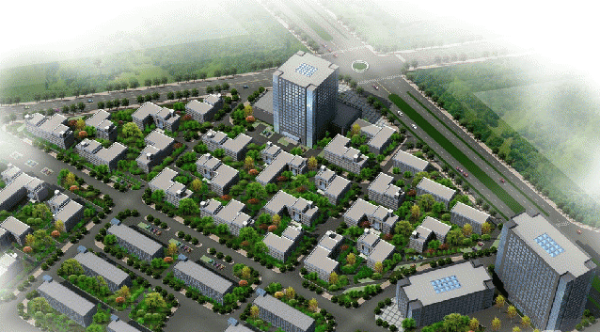
Electronic Clean Workshop
Dunham-Bush Landmark Project in Electronic Clean Workshop
Xi'an 5GW single crystal photovoltaic battery industrial park EPC project, covers an area about 184,880m², the total floor area is about 96,989 m². Including two production workshops, air separation station, an ammonia station, a special gas station and a chemicals warehouse and a wastewater treatment station.
Dunham-Bush supplies 112 clean air handing units (CAHU), with cooling, heating, humidification, silence, heat recovery and other more than thirty functions. The electronic purification and active filter carbon can fully meet the workshop cleanliness requirement.

Slide 27
Some Chinese Landmark Projects

Slide 28
THANK YOU
顿汉布什 唯进步，不止步！
Innovation…Never Ends!
敬请关注
顿汉布什 享誉世界的空调专家
DUNHAM-BUSH, YOUR COMFORT SPECIALIST！

